Slide 2
1 Peter 1:3
Blessed be the God and Father of our Lord Jesus Christ! According to his great mercy,
he has caused us to be born again to a living hope
through the resurrection of Jesus Christ from the dead.
Not of, But Sent Into.

Slide 3
John 17:14-19
I have given them your word, and the world has hated them because they are not of the world, just as I am not of the world. ¹⁵ I do not ask that you take them out of the world, but that you keep them from the evil one. ¹⁶They are not of the world, just as I am not of the world. ¹⁷ Sanctify them in the truth; your word is truth. ¹⁸ As you sent me into the world, so I have sent them into the world. ¹⁹ And for their sake I consecrate myself, that they also may be sanctified in truth.

Slide 4
John 17:18
“As you sent me into the world, so I have sent them into the world.”

Slide 5
John 17:15
“I do not ask that you take them out of the world, but that you keep them from the evil one.”
Jesus spoke to them, saying:

Slide 6
Matthew 28:18-20
And Jesus came and said to them, “All authority in heaven and on earth has been given to me. ¹⁹ Go therefore and make disciples of all nations, baptizing them in the name of the Father and of the Son and of the Holy Spirit, ²⁰ teaching them to observe all that I have commanded you. And behold, I am with you always, to the end of the age.”

Slide 7
1 John 2:15-17
Do not love the world or the things in the world. If anyone loves the world, the love of the Father is not in him. ¹⁶ For all that is in the world—the desires of the flesh and the desires of the eyes and pride of life—is not from the Father but is from the world. ¹⁷ And the world is passing away along with its desires, but whoever does the will of God abides forever.
Psalm 16:11
You make known to me the path of life; in your presence there is fullness of joy; at your right hand are pleasures forevermore.

Slide 8
Romans 12:2
Do not be conformed to this world, but be transformed by the renewal of your mind, that by testing you may discern what is the will of God, what is good and acceptable and perfect.

Slide 9
James 1:27
Religion that is pure and undefiled before God the Father is this: to visit orphans and widows in their affliction, and to keep oneself unstained from the world.

Slide 10
1 John 4:2-6
By this you know the Spirit of God: every spirit that confesses that Jesus Christ has come in the flesh is from God, ³ and every spirit that does not confess Jesus is not from God. This is the spirit of the antichrist, which you heard was coming and now is in the world already. ⁴ Little children, you are from God and have overcome them, for he who is in you is greater than he who is in the world. ⁵ They are from the world; therefore they speak from the world, and the world listens to them. ⁶ We are from God. Whoever knows God listens to us; whoever is not from God does not listen to us. By this we know the Spirit of truth and the spirit of error.

Slide 11
1 Peter 2:12
Keep your conduct among the Gentiles honorable, so that when they speak against you as evildoers, they may see your good deeds and glorify God on the day of visitation.

Slide 12
John 8:12
When Jesus spoke again to the people, he said, “I am the light of the world. Whoever follows me will never walk in darkness, but will have the light of life.”

Slide 13
Matthew 5:14-16
“You are the light of the world. A city set on a hill cannot be hidden. ¹⁵ Nor do people light a lamp and put it under a basket, but on a stand, and it gives light to all in the house.¹⁶ In the same way, let your light shine before others, so that they may see your good works and give glory to your Father who is in heaven.

Slide 14
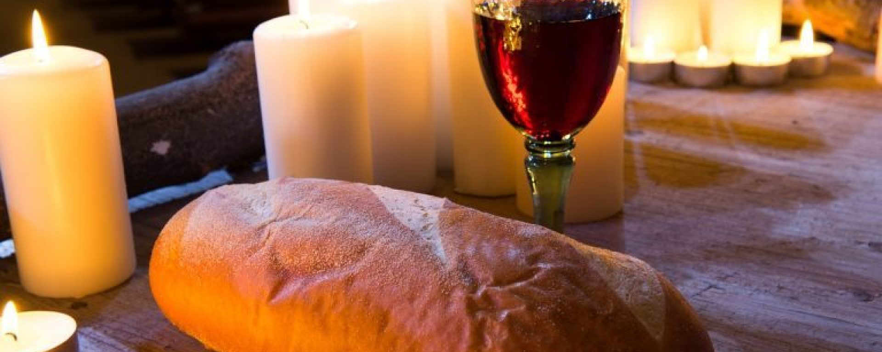

Slide 15
Matthew 27:45-46
From noon until three in the afternoon darkness came over all the land. ⁴⁶ About three in the afternoon Jesus cried out in a loud voice, “Eli, Eli, lema sabachthani?” (which means “My God, my God, why have you forsaken me?”).

Slide 16
Matthew 27:65-28:4 “Take a guard,” Pilate answered. “Go, make the tomb as secure as you know how.” ⁶⁶ So they went and made the tomb secure by putting a seal on the stone and posting the guard.
28 After the Sabbath, at dawn on the first day of the week, Mary Magdalene and the other Mary went to look at the tomb.² There was a violent earthquake, for an angel of the Lord came down from heaven and, going to the tomb, rolled back the stone and sat on it. ³ His appearance was like lightning, and his clothes were white as snow. ⁴ The guards were so afraid of him that they shook and became like dead men.

