Slide 2
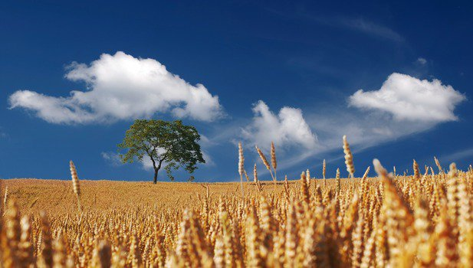
“FALSE WHEAT”
1 Peter 1:3
Blessed be the God and Father of our Lord Jesus Christ! According to his great mercy,
he has caused us to be born again to a living hope
through the resurrection of Jesus Christ from the dead.

Slide 3
Matthew 13: 24-30
He put another parable before them, saying, “The kingdom of heaven may be compared to a man who sowed good seed in his field, ²⁵ but while his men were sleeping, his enemy came and sowed weeds among the wheat and went away.²⁶ So when the plants came up and bore grain, then the weeds appeared also. ²⁷ And the servants of the master of the house came and said to him, ‘Master, did you not sow good seed in your field? How then does it have weeds?’……..

Slide 4
^{……..28} He said to them, ‘An enemy has done this.’ So the servants said to him, ‘Then do you want us to go and gather them?’ ²⁹ But he said, ‘No, lest in gathering the weeds you root up the wheat along with them. ³⁰ Let both grow together until the harvest, and at harvest time I will tell the reapers, “Gather the weeds first and bind them in bundles to be burned, but gather the wheat into my barn.”’

Slide 5
Matthew 13:31-32
He put another parable before them, saying, “The kingdom of heaven is like a grain of mustard seed that a man took and sowed in his field. ³² It is the smallest of all seeds, but when it has grown it is larger than all the garden plants and becomes a tree, so that the birds of the air come and make nests in its branches.”
Jesus spoke to them, saying:

Slide 6
Matthew 13:35
He told them another parable. “The kingdom of heaven is like leaven that a woman took and hid in three measures of flour, till it was all leavened.”

Slide 7
Matthew 13:36-43
Then he left the crowds and went into the house. And his disciples came to him, saying, “Explain to us the parable of the weeds of the field.” ³⁷ He answered, “The one who sows the good seed is the Son of Man. ³⁸ The field is the world, and the good seed is the sons of the kingdom. The weeds are the sons of the evil one, ³⁹ and the enemy who sowed them is the devil……..
Psalm 16:11
You make known to me the path of life; in your presence there is fullness of joy; at your right hand are pleasures forevermore.

Slide 8
…….The harvest is the end of the age, and the reapers are angels. ⁴⁰ Just as the weeds are gathered and burned with fire, so will it be at the end of the age. ⁴¹ The Son of Man will send his angels, and they will gather out of his kingdom all causes of sin and all law-breakers, ⁴² and throw them into the fiery furnace. In that place there will be weeping and gnashing of teeth. ⁴³ Then the righteous will shine like the sun in the kingdom of their Father. He who has ears, let him hear.

Slide 9
Ephesians 5:18
And do not get drunk with wine, for that is debauchery,
but be filled with the Spirit

Slide 10
John 16:13
When the Spirit of truth comes, he will guide you into all the truth, for he will not speak on his own authority, but whatever he hears he will speak, and he will declare to you the things that are to come.

Slide 11
Matthew 7:15-20 “Beware of false prophets, who come to you in sheep's clothing but inwardly are ravenous wolves. ¹⁶ You will recognize them by their fruits. Are grapes gathered from thornbushes, or figs from thistles? ¹⁷ So, every healthy tree bears good fruit, but the diseased tree bears bad fruit. ¹⁸ A healthy tree cannot bear bad fruit, nor can a diseased tree bear good fruit. ¹⁹ Every tree that does not bear good fruit is cut down and thrown into the fire. ²⁰ Thus you will recognize them by their fruits.

Slide 12
2 Peter 1:5-11
For this very reason, make every effort to supplement your faith with virtue, and virtue with knowledge, ⁶ and knowledge with self-control, and self-control with steadfastness, and steadfastness with godliness, ⁷ and godliness with brotherly affection, and brotherly affection with love. ⁸ For if these qualities are yours and are increasing, they keep you from being ineffective or unfruitful in the knowledge of our Lord Jesus Christ….

Slide 13
^{……..9} For whoever lacks these qualities is so nearsighted that he is blind, having forgotten that he was cleansed from his former sins. ¹⁰ Therefore, brothers, be all the more diligent to confirm your calling and election, for if you practice these qualities you will never fall.¹¹ For in this way there will be richly provided for you an entrance into the eternal kingdom of our Lord and Savior Jesus Christ.

