Slide 2
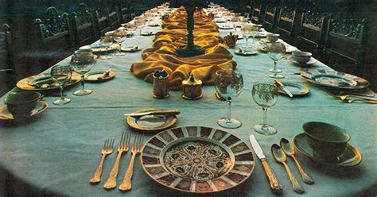
“A Hallelujah Wedding”
1 Peter 1:3
Blessed be the God and Father of our Lord Jesus Christ! According to his great mercy,
he has caused us to be born again to a living hope
through the resurrection of Jesus Christ from the dead.

Slide 3
Revelation 19:6-10
Then I heard what seemed to be the voice of a great multitude, like the roar of many waters and like the sound of mighty peals of thunder, crying out, “Hallelujah! For the Lord our God the Almighty reigns. ⁷ Let us rejoice and exult and give him the glory, for the marriage of the Lamb has come, and his Bride has made herself ready; ⁸ it was granted her to clothe herself with fine linen, bright and pure”—for the fine linen is the righteous deeds of the saints.⁹ And the angel said to me, “Write this: Blessed are those who are invited to the marriage supper of the Lamb.” And he said to me, “These are the true words of God.” ¹⁰ Then I fell down at his feet to worship him, but he said to me, “You must not do that! I am a fellow servant with you and your brothers who hold to the testimony of Jesus. Worship God.” For the testimony of Jesus is the spirit of prophecy.

Slide 4
Communion
Come To The Table

Slide 5
Revelation 19:1
“After this I heard what seemed to be the loud voice of a great multitude in heaven, crying out, Hallelujah! Salvation and glory and power belong to our God.”
Jesus spoke to them, saying:

Slide 6
Revelation 19:2-3
For his judgments are true and just; for he has judged the great prostitute who corrupted the earth with her immorality, and has avenged on her the blood of his servants.” ³ Once more they cried out, “Hallelujah! The smoke from her goes up forever and ever.”

Slide 7
Revelation 19:4-5
And the twenty-four elders and the four living creatures fell down and worshiped God who was seated on the throne, saying, “Amen. Hallelujah!” ⁵ And from the throne came a voice saying, “Praise our God, all you his servants, you who fear him, small and great.”
Psalm 16:11
You make known to me the path of life; in your presence there is fullness of joy; at your right hand are pleasures forevermore.

Slide 8
Revelation 19:6
Then I heard what seemed to be the voice of a great multitude, like the roar of many waters and like the sound of mighty peals of thunder, crying out, “Hallelujah! For the Lord our God the Almighty reigns.

Slide 9
Romans 8:38-39
For I am sure that neither death nor life, nor angels nor rulers, nor things present nor things to come, nor powers, ³⁹ nor height nor depth, nor anything else in all creation, will be able to separate us from the love of God in Christ Jesus our Lord.

Slide 10
Matthew 19:4-6
He answered, “Have you not read that he who created them from the beginning made them male and female, ⁵ and said, ‘Therefore a man shall leave his father and his mother and hold fast to his wife, and the two shall become one flesh’? ⁶ So they are no longer two but one flesh. What therefore God has joined together, let not man separate.”

Slide 11
Hallelujah
Hallelujah Hallelujah
Hallelujah

