Slide 3
Genesis 12:1-3
Now the Lord said to Abram, “Go from your country and your kindred and your father's house to the land that I will show you. ² And I will make of you a great nation, and I will bless you and make your name great, so that you will be a blessing. ³ I will bless those who bless you, and him who dishonors you I will curse, and in you all the families of the earth shall be blessed.

Slide 4
Romans 4:11
And he received the sign of circumcision, a seal of the righteousness of the faith which he had while still uncircumcised, that he might be the father of all those who believe, though they are uncircumcised, that righteousness might be imputed to them also,

Slide 5
Hebrews 6:13-20 For when God made a promise to Abraham, since he had no one greater by whom to swear, he swore by himself, ¹⁴ saying, “Surely I will bless you and multiply you.” ¹⁵ And thus Abraham, having patiently waited, obtained the promise. ¹⁶ For people swear by something greater than themselves, and in all their disputes an oath is final for confirmation. ¹⁷ So when God desired to show more convincingly to the heirs of the promise the unchangeable character of his purpose, he guaranteed it with an oath, ………….
Jesus spoke to them, saying:

Slide 6
^{…………..18} so that by two unchangeable things, in which it is impossible for God to lie, we who have fled for refuge might have strong encouragement to hold fast to the hope set before us. ¹⁹ We have this as a sure and steadfast anchor of the soul, a hope that enters into the inner place behind the curtain, ²⁰ where Jesus has gone as a forerunner on our behalf, having become a high priest forever after the order of Melchizedek.

Slide 7
1 Peter 1:3-5
Blessed be the God and Father of our Lord Jesus Christ! According to his great mercy, he has caused us to be born again to a living hope through the resurrection of Jesus Christ from the dead, ⁴ to an inheritance that is imperishable, undefiled, and unfading, kept in heaven for you, ⁵ who by God's power are being guarded through faith for a salvation ready to be revealed in the last time.
Psalm 16:11
You make known to me the path of life; in your presence there is fullness of joy; at your right hand are pleasures forevermore.

Slide 8
Proverbs 3:5-6
Trust in the Lord with all your heart, and do not lean on your own understanding.⁶ In all your ways acknowledge him, and he will make straight your paths.

Slide 9
Psalm 37:3-4
Trust in the Lord, and do good; dwell in the land and feed on His faithfulness. ⁴ Delight yourself in the Lord, and he will give you the desires of your heart.

Slide 10
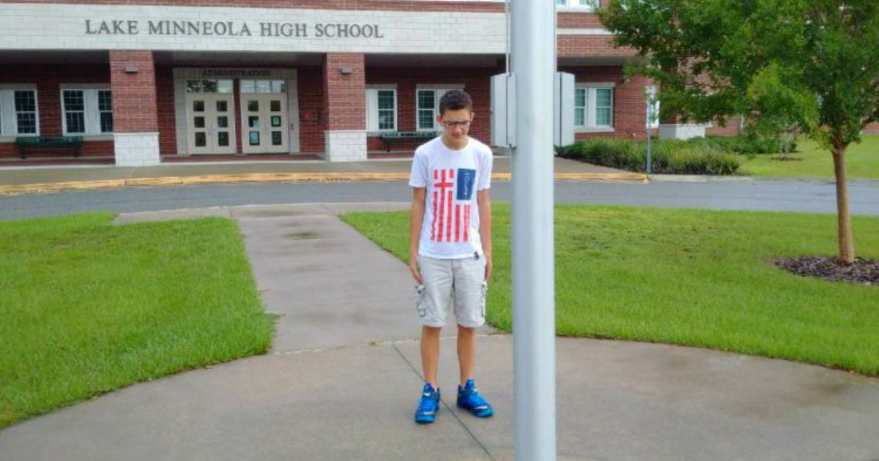
“Though None Go With Me Still I Will Follow”

Slide 11
2 Corinthians 1:9
Indeed, we felt that we had received the sentence of death. But that was to make us rely not on ourselves but on God who raises the dead.

Slide 12
Isaiah 26:3
You keep him in perfect peace whose mind is stayed on you, because he trusts in you.

Slide 13
Psalm 112:7
He is not afraid of bad news; his heart is firm, trusting in the Lord.

Slide 14
Psalm 33:18-22
Behold, the eye of the Lord is on those who fear him, on those who hope in his steadfast love,¹⁹ that he may deliver their soul from death and keep them alive in famine. ²⁰ Our soul waits for the Lord; he is our help and our shield. ²¹ For our heart is glad in him, because we trust in his holy name. ²² Let your steadfast love, O Lord, be upon us, even as we hope in you.

Slide 15
Sacrificial Love Remembered

