Slide 2
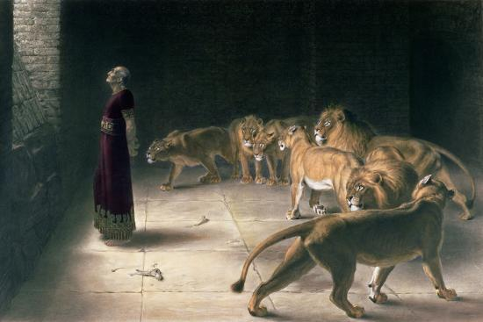
“
Exercise Defiant Faith

Slide 3
Hebrews 10:35-36
Therefore do not throw away your confidence, which has a great reward. ³⁶ For you have need of endurance, so that when you have done the will of God you may receive what is promised.

Slide 4
Daniel 6:1-10 It pleased Darius to set over the kingdom 120 satraps, to be throughout the whole kingdom; ² and over them three high officials, of whom Daniel was one, to whom these satraps should give account, so that the king might suffer no loss. ³ Then this Daniel became distinguished above all the other high officials and satraps, because an excellent spirit was in him. And the king planned to set him over the whole kingdom. ⁴ Then the high officials and the satraps sought to find a ground for complaint against Daniel with regard to the kingdom, but they could find no ground for complaint or any fault, because he was faithful, and no error or fault was found in him. ⁵ Then these men said, “We shall not find any ground for complaint against this Daniel unless we find it in connection with the law of his God.”………..

Slide 5
^{………6} Then these high officials and satraps came by agreement to the king and said to him, “O King Darius, live forever! ⁷ All the high officials of the kingdom, the prefects and the satraps, the counselors and the governors are agreed that the king should establish an ordinance and enforce an injunction, that whoever makes petition to any god or man for thirty days, except to you, O king, shall be cast into the den of lions. ⁸ Now, O king, establish the injunction and sign the document, so that it cannot be changed, according to the law of the Medes and the Persians, which cannot be revoked.” ⁹ Therefore King Darius signed the document and injunction.¹⁰ When Daniel knew that the document had been signed, he went to his house where he had windows in his upper chamber open toward Jerusalem. He got down on his knees three times a day and prayed and gave thanks before his God, as he had done previously.

Slide 6
Hebrews 1:14
Are they not all ministering spirits sent out to serve for the sake of those who are to inherit salvation.

Slide 7
Daniel 6:25-27
Then King Darius wrote to all the peoples, nations, and languages that dwell in all the earth: “Peace be multiplied to you. ²⁶ I make a decree, that in all my royal dominion people are to tremble and fear before the God of Daniel, for he is the living God, enduring forever; his kingdom shall never be destroyed, and his dominion shall be to the end. ²⁷ He delivers and rescues; he works signs and wonders in heaven and on earth, he who has saved Daniel from the power of the lions.”
Psalm 16:11
You make known to me the path of life; in your presence there is fullness of joy; at your right hand are pleasures forevermore.

Slide 8
Hebrews 11:24-30
By faith Moses, when he was grown up, refused to be called the son of Pharaoh's daughter, ²⁵ choosing rather to be mistreated with the people of God than to enjoy the fleeting pleasures of sin. ²⁶ He considered the reproach of Christ greater wealth than the treasures of Egypt, for he was looking to the reward. ²⁷ By faith he left Egypt, not being afraid of the anger of the king, for he endured as seeing him who is invisible. ²⁸ By faith he kept the Passover and sprinkled the blood, so that the Destroyer of the firstborn might not touch them.²⁹ By faith the people crossed the Red Sea as on dry land, but the Egyptians, when they attempted to do the same, were drowned. ³⁰ By faith the walls of Jericho fell down after they had been encircled for seven days.

Slide 9
2 Kings 6:15-18
When the servant of the man of God rose early in the morning and went out, behold, an army with horses and chariots was all around the city. And the servant said, “Alas, my master! What shall we do?” ¹⁶ He said, “Do not be afraid, for those who are with us are more than those who are with them.”¹⁷ Then Elisha prayed and said, “O Lord, please open his eyes that he may see. ”So the Lord opened the eyes of the young man, and he saw, and behold, the mountain was full of horses and chariots of fire all around Elisha.¹⁸ And when the Syrians came down against him, Elisha prayed to the Lord and said, “Please strike this people with blindness.” So he struck them with blindness in accordance with the prayer of Elisha.

Slide 10
Habakkuk 3:17-19
Though the fig tree should not blossom, nor fruit be on the vines, the produce of the olive fail and the fields yield no food, the flock be cut off from the fold and there be no herd in the stalls,¹⁸ yet I will rejoice in the Lord; I will take joy in the God of my salvation. ¹⁹ God, the Lord, is my strength; he makes my feet like the deer's; he makes me tread on my high places.

Slide 11
Acts 7:54-60 Now when they heard these things they were enraged, and they ground their teeth at him. ⁵⁵ But he, full of the Holy Spirit, gazed into heaven and saw the glory of God, and Jesus standing at the right hand of God. ⁵⁶ And he said, “Behold, I see the heavens opened, and the Son of Man standing at the right hand of God.” ⁵⁷ But they cried out with a loud voice and stopped their ears and rushed together at him. ⁵⁸ Then they cast him out of the city and stoned him. And the witnesses laid down their garments at the feet of a young man named Saul. ⁵⁹ And as they were stoning Stephen, he called out, “Lord Jesus, receive my spirit.” ⁶⁰ And falling to his knees he cried out with a loud voice, “Lord, do not hold this sin against them.” And when he had said this, he fell asleep.
.

Slide 12
Sacrificial Love Remembered

Slide 13
Psalm 23:4-6
Even though I walk through the valley of the shadow of death, I will fear no evil, for you are with me; your rod and your staff, they comfort me. ⁵ You prepare a table before me in the presence of my enemies; you anoint my head
with oil; my cup overflows. ⁶ Surely goodness and mercy shall follow me all the days of my life, and
I shall dwell in the house of the Lord forever.

Slide 14
Psalm 27:1-3
The Lord is my light and my salvation; whom shall I fear? The Lord is the stronghold of my life; of whom shall I be afraid? ² When evildoers assail me to eat up my flesh, my adversaries and foes, it is they who stumble and fall. ³ Though an army encamp against me, my heart shall not fear; though war arise against me, yet
I will be confident.

Slide 16
“
Exercise Defiant Faith

