Slide 2
Sacrificial Love Remembered

Slide 3
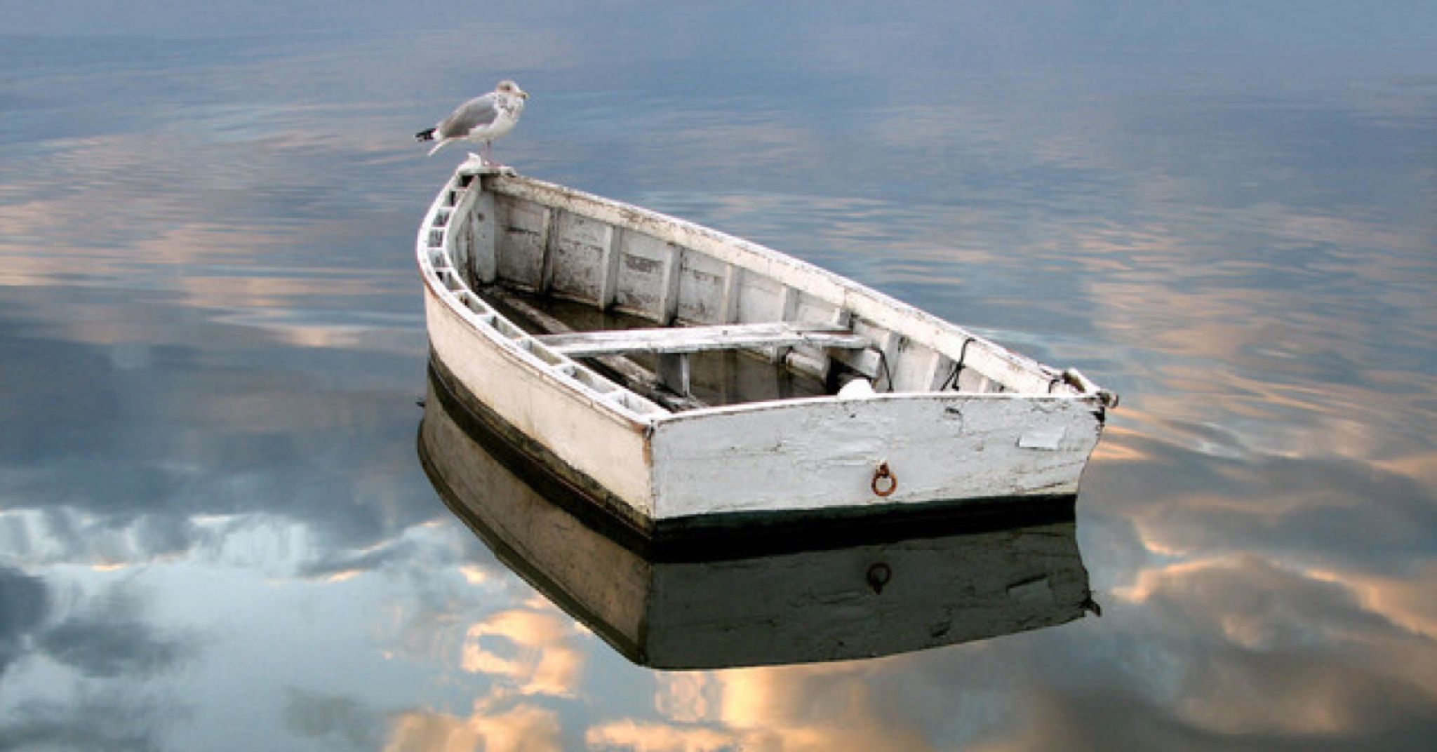
DRIFT PROTECTION

Slide 4
Matthew 26:36-46
Then Jesus went with them to a place called Gethsemane, and he said to his disciples, “Sit here, while I go over there and pray.” ³⁷ And taking with him Peter and the two sons of Zebedee, he began to be sorrowful and troubled. ³⁸ Then he said to them, “My soul is very sorrowful, even to death; remain here, and watch with me.” ³⁹ And going a little farther he fell on his face and prayed, saying, “My Father, if it be possible, let this cup pass from me; nevertheless, not as I will, but as you will.”

Slide 5
⁴⁰ And he came to the disciples and found them sleeping. And he said to Peter, “So, could you not watch with me one hour? ⁴¹ Watch and pray that you may not enter into temptation. The spirit indeed is willing, but the flesh is weak.” ⁴² Again, for the second time, he went away and prayed, “My Father, if this cannot pass unless I drink it, your will be done.” ⁴³ And again he came and found them sleeping, for their eyes were heavy. ⁴⁴ So, leaving them again, he went away and prayed for the third time, saying the same words again. ⁴⁵ Then he came to the disciples and said to them, “Sleep and take your rest later on. See, the hour is at hand, and the Son of Man is betrayed into the hands of sinners. ⁴⁶ Rise, let us be going; see, my betrayer is at hand.”

Slide 6
Matthew 25:1-10
“At that time the kingdom of heaven will be like ten virgins who took their lamps and went out to meet the bridegroom. ² Five of them were foolish and five were wise. ³ The foolish ones took their lamps but did not take any oil with them. ⁴ The wise ones, however, took oil in jars along with their lamps. ⁵ The bridegroom was a long time in coming, and they all became drowsy and fell asleep.⁶ “At midnight the cry rang out: ‘Here’s the bridegroom! Come out to meet him!’⁷ “Then all the virgins woke up and trimmed their lamps. ⁸ The foolish ones said to the wise, ‘Give us some of your oil; our lamps are going out.’⁹ “‘No,’ they replied, ‘there may not be enough for both us and you. Instead, go to those who sell oil and buy some for yourselves.’¹⁰ “But while they were on their way to buy the oil, the bridegroom arrived. The virgins who were ready went in with him to the wedding banquet. And the door was shut.
Jesus spoke to them, saying:

Slide 7
Hebrews 2:1
Therefore we must pay much closer attention to what we have heard, lest we drift away from it.

Slide 8
Mark 13:28-33
“From the fig tree learn its lesson: as soon as its branch becomes tender and puts out its leaves, you know that summer is near. ²⁹ So also, when you see these things taking place, you know that he is near, at the very gates. ³⁰ Truly, I say to you, this generation will not pass away until all these things take place. ³¹ Heaven and earth will pass away, but my words will not pass away.³² “But concerning that day or that hour, no one knows, not even the angels in heaven, nor the Son, but only the Father. ³³ Be on guard, keep awake. For you do not know when the time will come.
Psalm 16:11
You make known to me the path of life; in your presence there is fullness of joy; at your right hand are pleasures forevermore.

Slide 9
2 Peter 1:19
And we have the prophetic word more fully confirmed, to which you will do well to pay attention as to a lamp shining in a dark place, until the day dawns and the morning star rises in your hearts,

Slide 10
Matthew 24:9-12 “Then you will be handed over to be persecuted and put to death, and you will be hated by all nations because of me. ¹⁰ At that time many will turn away from the faith and will betray and hate each other, ¹¹ and many false prophets will appear and deceive many people. ¹² Because of the increase of wickedness, the love of most will grow cold,

Slide 11
1Timothy 4:1
The Spirit clearly says
that in later times some
will abandon the faith and follow deceiving spirits and things taught by demons.

Slide 12
Matthew 24:4
Jesus answered:
“Watch out that no one deceives you.”

Slide 13
Ezekiel 18:24
“But if a righteous person turns from their righteousness and commits sin and does the same detestable things the wicked person does, will they live? None of the righteous things that person has done will be remembered. Because of the unfaithfulness they are guilty of and because of the sins they have committed, they will die.

Slide 14
Hebrews 6:4-8
It is impossible for those who have once been enlightened, who have tasted the heavenly gift, who have shared in the Holy Spirit, ⁵ who have tasted the goodness of the word of God and the powers of the coming age ⁶ and who have fallen away, to be brought back to repentance. To their loss they are crucifying the Son of God all over again and subjecting him to public disgrace.
⁷ Land that drinks in the rain often falling on it and that produces a crop useful to those for whom it is farmed receives the blessing of God. ⁸ But land that produces thorns and thistles is worthless and is in danger of being cursed. In the end it will be burned.

Slide 15
2 Peter 2:20-21
If they have escaped the corruption of the world by knowing our Lord and Savior Jesus Christ and are again entangled in it and are overcome, they are worse off at the end than they were at the beginning. ²¹ It would have been better for them not to have known the way of righteousness, than to have known it and then to turn their backs on the sacred command that was passed on to them.

Slide 16
Revelation 3:5
The one who is victorious will, like them, be dressed in white. I will never blot out the name of that person from the book of life, but will acknowledge that name before my Father and his angels.

Slide 17
Luke 21:8
He replied: “Watch out that you are not deceived. For many will come in my name, claiming,
‘I am he,’ and, ‘The time is near.’
Do not follow them.

Slide 18
1 Corinthians 16:13
Be watchful, stand firm in the faith, act like men, be strong.

Slide 19
Mark 13:37
What I say to you,
I say to everyone: ‘Watch!’”

Slide 20
Luke 12:35-36
“Stay dressed for action and keep your lamps burning, ³⁶ and be like men who are waiting for their master to come home from the wedding feast, so that they may open the door to him at once when he comes and knocks.

