Slide 2
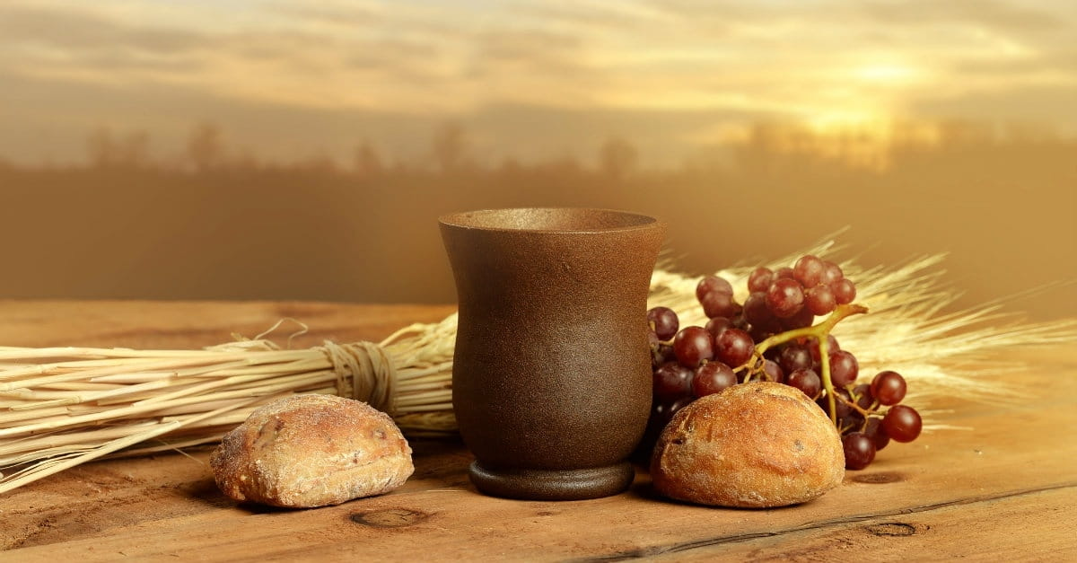
Sacrificial Love Remembered

Slide 3
“Jesus Teaches Kingdom Living”

Slide 4
Matthew 5: 6
“Blessed are those who hunger and thirst for righteousness, for they shall be satisfied.”

Slide 5
Matthew 5:7-12
⁷ “Blessed are the merciful, for they shall receive mercy. ⁸ “Blessed are the pure in heart, for they shall see God. ⁹ “Blessed are the peacemakers, for they shall be called sons of God. ¹⁰ “Blessed are those who are persecuted for righteousness' sake, for theirs is the kingdom of heaven. ¹¹ “Blessed are you when others revile you and persecute you and utter all kinds of evil against you falsely on my account.¹² Rejoice and be glad, for your reward is great in heaven, for so they persecuted the prophets who were before you.

Slide 6
Matthew 5:7
“Blessed are the merciful, for they shall receive mercy.”
Jesus spoke to them, saying:

Slide 7
Matthew 5:8
“Blessed are the pure in heart, for they shall see God.”

Slide 8
Psalm 24:3-4 Who shall ascend the hill of the Lord? And who shall stand in his holy place? ⁴ He who has clean hands and a pure heart, who does not lift up his soul to what is false and does not swear deceitfully. ⁵ He will receive blessing from the Lord and righteousness from the God of his salvation. ⁶ Such is the generation of those who seek him, who seek the face of the God of Jacob.
Psalm 16:11
You make known to me the path of life; in your presence there is fullness of joy; at your right hand are pleasures forevermore.

Slide 9
Matthew 22:37
And he said to him, “You shall love the Lord your God with all your heart and with all your soul and with all your mind.

Slide 10
Matthew 5:9
“Blessed are the peacemakers, for they shall be called sons of God.”

Slide 11
Matthew 5:43-45
“You have heard that it was said, ‘You shall love your neighbor and hate your enemy.’ ⁴⁴ But I say to you, Love your enemies and pray for those who persecute you, ⁴⁵ so that you may be sons of your Father who is in heaven. For he makes his sun rise on the evil and on the good, and sends rain on the just and on the unjust.”

Slide 12
Galatians 4:6
And because you are sons, God has sent the Spirit of his Son into our hearts, crying, “Abba! Father!”

Slide 13
Romans 8:14
For all who are led by the Spirit of God are sons of God.

Slide 14
Matthew 5:10-12
“Blessed are those who are persecuted for righteousness' sake, for theirs is the kingdom of heaven.¹¹ “Blessed are you when others revile you and persecute you and utter all kinds of evil against you falsely on my account.¹² Rejoice and be glad, for your reward is great in heaven, for so they persecuted the prophets who were before you.”

Slide 15
2 Timothy 3:12
Indeed, all who desire to live a godly life in Christ Jesus will be persecuted.

Slide 16
Matthew 10:25
It is enough for the disciple to be like his teacher, and the servant like his master. If they have called the master of the house Beelzebul, how much more will they malign those of his household.

Slide 17
Matthew 5:20
For I tell you, unless your righteousness exceeds that of the scribes and Pharisees, you will never enter the kingdom of heaven.

Slide 18
Matthew 5:10-12
“Blessed are those who are persecuted for righteousness' sake, for theirs is the kingdom of heaven.¹¹ “Blessed are you when others revile you and persecute you and utter all kinds of evil against you falsely on my account.¹² Rejoice and be glad, for your reward is great in heaven, for so they persecuted the prophets who were before you.

Slide 19
John 15:5
I am the vine; you are the branches. Whoever abides in me and I in him, he it is that bears much fruit, for apart from me you can do nothing.

Slide 20
Matthew 7:21-23
“Not everyone who says to me, ‘Lord, Lord,’ will enter the kingdom of heaven, but the one who does the will of my Father who is in heaven. ²² On that day many will say to me, ‘Lord, Lord, did we not prophesy in your name, and cast out demons in your name, and do many mighty works in your name?’ ²³ And then will I declare to them, ‘I never knew you; depart from me, you workers of lawlessness.’

Slide 21
Matthew 7:24-27
“Everyone then who hears these words of mine and does them will be like a wise man who built his house on the rock.²⁵ And the rain fell, and the floods came, and the winds blew and beat on that house, but it did not fall, because it had been founded on the rock. ²⁶ And everyone who hears these words of mine and does not do them will be like a foolish man who built his house on the sand. ²⁷ And the rain fell, and the floods came, and the winds blew and beat against that house, and it fell, and great was the fall of it.”

