Slide 2
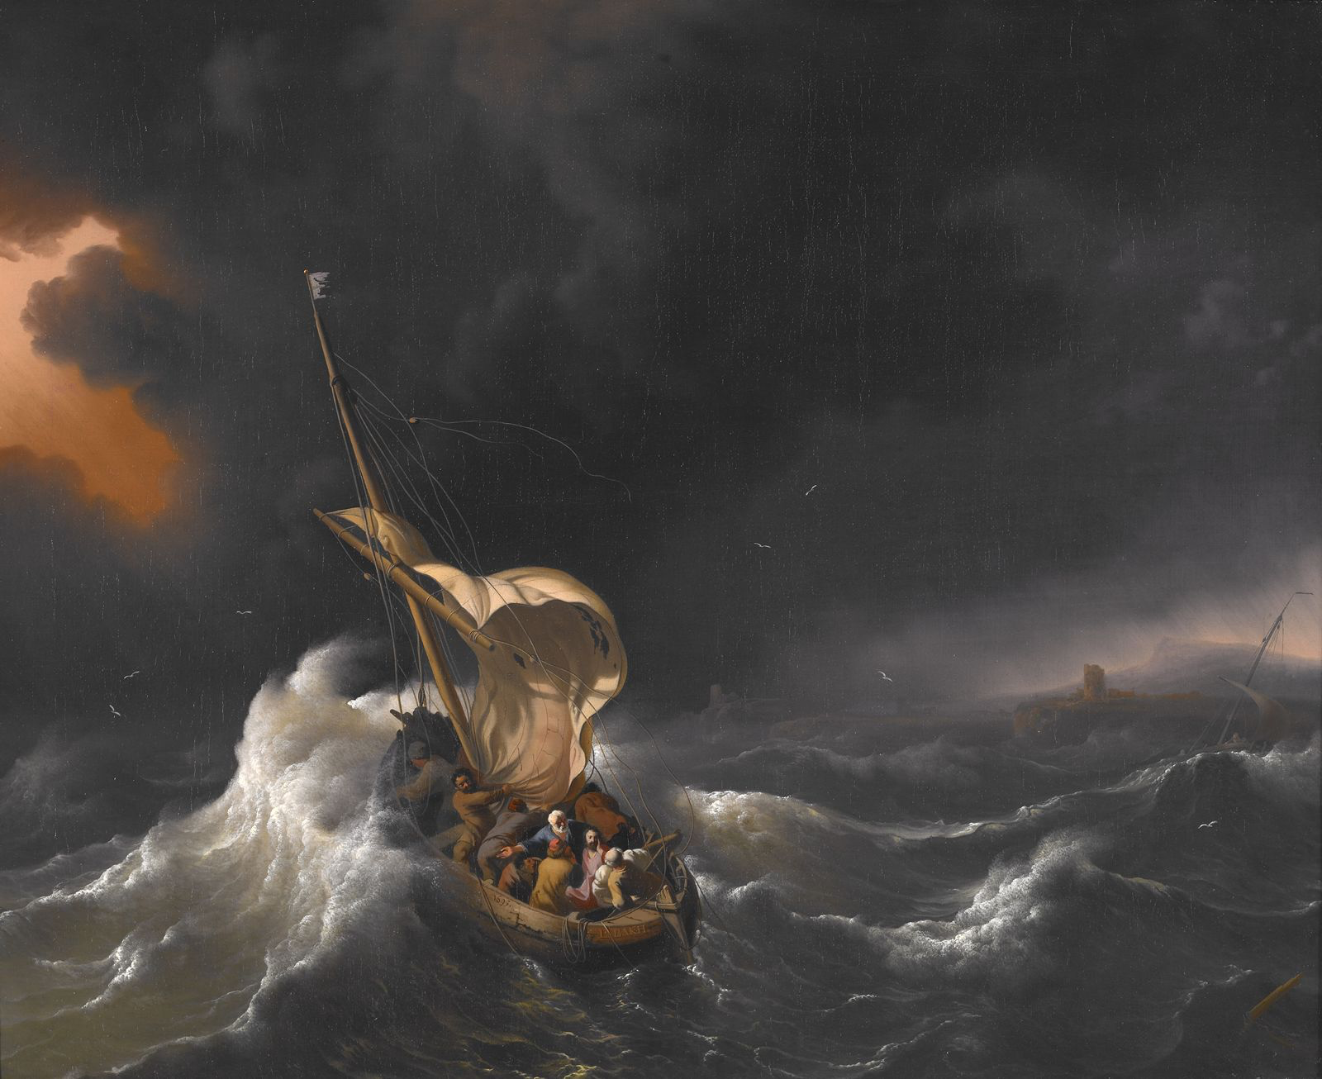
Kingdom Living
“Trust, In The Midst Of Chaos”

Slide 3
Psalm 34:8
Oh, taste and see that the Lord is good! Blessed is the man who takes refuge in him!

Slide 4
Psalm 40:4
Blessed is the man who makes the Lord his trust, who does not turn to the proud, to those who go astray after a lie!

Slide 5
Proverbs 16:20
Whoever gives thought to the word will discover good, and blessed is he who trusts in the Lord.
Jesus spoke to them, saying:

Slide 6
Matthew 13:15
For this people's heart has grown dull, and with their ears they can barely hear, and their eyes they have closed, lest they should see with their eyes and hear with their ears and understand with their heart and turn, and I would heal them.’

Slide 7
Mark 7:21-23 For from within, out of the heart of man, come evil thoughts, sexual immorality, theft, murder, adultery,
²²coveting, wickedness, deceit, sensuality, envy, slander, pride, foolishness. ³ All these evil things come from within, and they defile a person.”
Psalm 16:11
You make known to me the path of life; in your presence there is fullness of joy; at your right hand are pleasures forevermore.

Slide 8
Romans 2:6-8
He will render to each one according to his works: ⁷ to those who by patience in well-doing seek for glory and honor and immortality, he will give eternal life; ⁸ but for those who are self-seeking and do not obey the truth, but obey unrighteousness, there will be wrath and fury.

Slide 9
Revelation 2:22-23 Behold, I will throw her onto a sickbed, and those who commit adultery with her I will throw into great tribulation, unless they repent of her works, ²³ and I will strike her children dead. And all the churches will know that I am he who searches mind and heart, and I will give to each of you according to your works.

Slide 10
Psalm 139:23-24
Search me, O God, and know my heart! Try me and know my thoughts! ²⁴ And see if there be any grievous way in me, and lead me in the way everlasting

Slide 11
Jeremiah 17:7-10 “Blessed is the man who trusts in the Lord, whose trust is the Lord.⁸ He is like a tree planted by water, that sends out its roots by the stream, and does not fear when heat comes, for its leaves remain green, and is not anxious in the year of drought, for it does not cease to bear fruit.” ⁹ The heart is deceitful above all things and desperately sick; who can understand it? ¹⁰ “I the Lord search the heart and test the mind to give every man according to his ways, according to the fruit of his deeds.”

Slide 12
Psalm 20:6-8
Now I know that the Lord saves his anointed; he will answer him from his holy heaven with the saving might of his right hand.⁷ Some trust in chariots and some in horses, but we trust in the name of the Lord our God.⁸ They collapse and fall, but we rise and stand upright.

Slide 13
Isaiah 31:1
Woe to those who go down to Egypt for help and rely on horses, who trust in chariots because they are many and in horsemen because they are very strong, but do not look to the Holy One of Israel or consult the Lord

Slide 14
Mark 5:21-28 And when Jesus had crossed again in the boat to the other side, a great crowd gathered about him, and he was beside the sea. ²² Then came one of the rulers of the synagogue, Jairus by name, and seeing him, he fell at his feet ²³ and implored him earnestly, saying, “My little daughter is at the point of death. Come and lay your hands on her, so that she may be made well and live.” ²⁴ And he went with him. And a great crowd followed him and thronged about him. ²⁵ And there was a woman who had had a discharge of blood for twelve years, ²⁶ and who had suffered much under many physicians, and had spent all that she had, and was no better but rather grew worse.²⁷ She had heard the reports about Jesus and came up behind him in the crowd and touched his garment. ²⁸ For she said, “If I touch even his garments, I will be made well.” Daughter, your faith has made you well; go in peace, and be healed of your disease…………….

Slide 15
Mark 5:35-43 While he was still speaking, there came from the ruler's house some who said, “Your daughter is dead. Why trouble the Teacher any further?” ³⁶ But overhearing what they said, Jesus said to the ruler of the synagogue, “Do not fear, only believe.” ³⁷ And he allowed no one to follow him except Peter and James and John the brother of James. ³⁸ They came to the house of the ruler of the synagogue, and Jesus saw a commotion, people weeping and wailing loudly.³⁹ And when he had entered, he said to them, “Why are you making a commotion and weeping? The child is not dead but sleeping.”⁴⁰ And they laughed at him. But he put them all outside and took the child's father and mother and those who were with him and went in where the child was. ⁴¹ Taking her by the hand he said to her, “Talitha cumi,” which means, “Little girl, I say to you, arise.” ⁴² And immediately the girl got up and began walking (for she was twelve years of age), and they were immediately overcome with amazement. ⁴³ And he strictly charged them that no one should know this, and told them to give her something to eat.

Slide 16
Matthew 14:22-33 Immediately he made the disciples get into the boat and go before him to the other side, while he dismissed the crowds. ²³ And after he had dismissed the crowds, he went up on the mountain by himself to pray. When evening came, he was there alone, ²⁴but the boat by this time was a long way from the land, beaten by the waves, for the wind was against them. ²⁵And in the fourth watch of the night he came to them, walking on the sea. ²⁶But when the disciples saw him walking on the sea, they were terrified, and said, “It is a ghost!” and they cried out in fear. ²⁷But immediately Jesus spoke to them, saying, “Take heart; it is I. Do not be afraid.”²⁸And Peter answered him, “Lord, if it is you, command me to come to you on the water.” ²⁹He said, “Come.” So Peter got out of the boat and walked on the water and came to Jesus.³⁰But when he saw the wind, he was afraid, and beginning to sink he cried out, “Lord, save me.” ³¹ Jesus immediately reached out his hand and took hold of him, saying to him, “O you of little faith, why did you doubt?” ³² And when they got into the boat, the wind ceased. ³³ And those in the boat worshiped him, saying,
“Truly you are the Son of God.”

Slide 17
James 1:2-4
Count it all joy, my brothers, when you meet trials of various kinds, ³ for you know that the testing of your faith produces steadfastness. ⁴ And let steadfastness have its full effect, that you may be perfect and complete, lacking in nothing.

Slide 18
Psalm 46:1
God is our refuge and strength, a very present help in trouble.

Slide 19
James 1:12 Blessed is the man who remains steadfast under trial, for when he has stood the test he will receive the crown of life, which God has promised to those who love him.

Slide 20
Romans 5:2-5
Through him we have also obtained access by faith into this grace in which we stand, and we rejoice in hope of the glory of God. ³ Not only that, but we rejoice in our sufferings, knowing that suffering produces endurance, ⁴ and endurance produces character, and character produces hope, ⁵ and hope does not put us to shame, because God's love has been poured into our hearts through the Holy Spirit who has been given to us.

