Slide 2
OTHERS

Slide 3
Acts 1:3
He presented himself alive to them after his suffering by many proofs, appearing to them during forty days and speaking about the kingdom of God

Slide 4
Matthew 28:16-20 Now the eleven disciples went to Galilee, to the mountain to which Jesus had directed them. ¹⁷ And when they saw him they worshiped him, but some doubted. ¹⁸ And Jesus came and said to them, “All authority in heaven and on earth has been given to me. ¹⁹ Go therefore and make disciples of all nations, baptizing them in the name of the Father and of the Son and of the Holy Spirit, ²⁰ teaching them to observe all that I have commanded you. And behold, I am with you always, to the end of the age.”

Slide 5
Acts 1:3-5
He presented himself alive to them after his suffering by many proofs, appearing to them during forty days and speaking about the kingdom of God. ⁴ And while staying with them he ordered them not to depart from Jerusalem, but to wait for the promise of the Father, which, he said, “you heard from me;⁵ for John baptized with water, but you will be baptized with the Holy Spirit not many days from now.”
Jesus spoke to them, saying:

Slide 6
Matthew 6:33
But seek first the kingdom of God and his righteousness,
and all these things will be added to you.

Slide 7
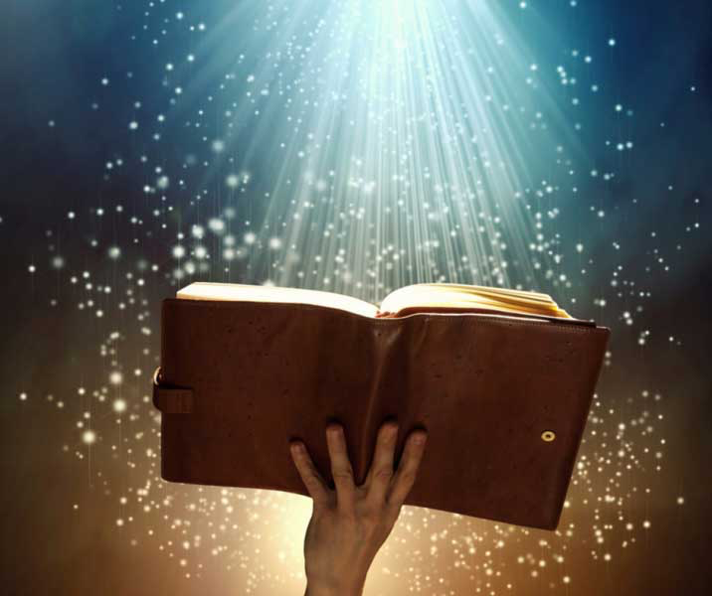
Romans 8:32
He who did not spare his own Son but gave him up for us all, how will he not also with him graciously give us all things?
Psalm 16:11
You make known to me the path of life; in your presence there is fullness of joy; at your right hand are pleasures forevermore.
Philippians 4:19 And my God will supply every need of yours according to his riches in glory in Christ Jesus.

Slide 8
1 Peter 5:6-7
Humble yourselves, therefore, under the mighty hand of God so that at the proper time he may exalt you, ⁷ casting all your anxieties on him, because he cares for you.

Slide 9
Mark 1:14 Now after John was arrested, Jesus came into Galilee, proclaiming the gospel of God,

Slide 10
Matthew 9:35 And Jesus went throughout all the cities and villages, teaching in their synagogues and proclaiming the gospel of the kingdom and healing every disease and every affliction.

Slide 11
Matthew 24:14 And this gospel of the kingdom will be proclaimed throughout the whole world as a testimony to all nations, and then the end will come.
Acts 8:12 But when they believed Philip as he preached good news about the kingdom of God and the name of Jesus Christ, they were baptized, both men and women.
Acts 14:22 strengthening the souls of the disciples, encouraging them to continue in the faith, and saying that through many tribulations we must enter the kingdom of God.

Slide 12
Galatians 1:6-7 I am astonished that you are so quickly deserting him who called you in the grace of Christ and are turning to a different gospel—⁷ not that there is another one, but there are some who trouble you and want to distort the gospel of Christ.

Slide 13
Daniel 2:44
And in the days of those kings the God of heaven will set up a kingdom that shall never be destroyed, nor shall the kingdom be left to another people. It shall break in pieces all these kingdoms and bring them to an end, and it shall stand forever,

Slide 14
Daniel 7:18 But the saints of the Most High shall receive the kingdom and possess the kingdom forever, forever and ever.’
Daniel 7:22 until the Ancient of Days came, and judgment was given for the saints of the Most High, and the time came when the saints possessed the kingdom.
Daniel 7:27 And the kingdom and the dominion and the greatness of the kingdoms under the whole heaven shall be given to the people of the saints of the Most High; His kingdom shall be an everlasting kingdom, and all dominions shall serve and obey Him.’

Slide 15
Matthew 6:9-10
Pray then like this: “Our Father in heaven, hallowed be your name. ¹⁰ Your kingdom come, your will be done, on earth as it is in heaven.

Slide 16
Matthew 3:7-8
But when he saw many of the Pharisees and Sadducees coming to his baptism, he said to them, “You brood of vipers! Who warned you to flee from the wrath to come? ⁸ Bear fruit in keeping with repentance.

Slide 17
Acts 28:30-31
He lived there two whole years at his own expense, and welcomed all who came to him, ³¹ proclaiming the kingdom of God and teaching about the Lord Jesus Christ with all boldness and without hindrance.

Slide 18
Matthew 24:3-14
As he sat on the Mount of Olives, the disciples came to him privately, saying, “Tell us, when will these things be, and what will be the sign of your coming and of the end of the age?” ⁴ And Jesus answered them, “See that no one leads you astray. ⁵ For many will come in my name, saying, ‘I am the Christ,’ and they will lead many astray. ⁶ And you will hear of wars and rumors of wars. See that you are not alarmed, for this must take place, but the end is not yet.⁷ For nation will rise against nation, and kingdom against kingdom, and there will be famines and earthquakes in various places. ⁸ All these are but the beginning of the birth pains…..

Slide 19
…….. ⁹ “Then they will deliver you up to tribulation and put you to death, and you will be hated by all nations for my name's sake. ¹⁰ And then many will fall away and betray one another and hate one another.¹¹ And many false prophets will arise and lead many astray. ¹² And because lawlessness will be increased, the love of many will grow cold. ¹³ But the one who endures to the end will be saved. ¹⁴ And this gospel of the kingdom will be proclaimed throughout the whole world as a testimony to all nations, and then the end will come.

Slide 21
Luke 9:23
And he said to all, “If anyone would come after me, let him deny himself and take up his cross daily and follow me.
Galatians 2:20
I have been crucified with Christ. It is no longer I who live, but Christ who lives in me. And the life I now live in the flesh I live by faith in the Son of God, who loved me and gave himself for me.
1 Corinthians 11:24-25
and when he had given thanks, he broke it, and said, “This is my body, which is for you. Do this in remembrance of me.” ²⁵ In the same way also he took the cup, after supper, saying, “This cup is the new covenant in my blood. Do this, as often as you drink it, in remembrance of me.”

