Slide 2
“The Character Of Kingdom Living”

Slide 3
Matthew 5:1-2
Seeing the crowds, he went up on the mountain, and when he sat down, his disciples came to him. ² And he opened his mouth and taught them, saying:

Slide 4
Matthew 5:3
“Blessed are the poor in spirit, for theirs is the kingdom of heaven.”

Slide 5
Luke 18:9-13 He also told this parable to some who trusted in themselves that they were righteous, and treated others with contempt: ¹⁰ “Two men went up into the temple to pray, one a Pharisee and the other a tax collector. ¹¹ The Pharisee, standing by himself, prayed thus: ‘God, I thank you that I am not like other men, extortioners, unjust, adulterers, or even like this tax collector. ¹² I fast twice a week; I give tithes of all that I get.’ ¹³ But the tax collector, standing far off, would not even lift up his eyes to heaven, but beat his breast, saying, ‘God, be merciful to me, a sinner!’
Jesus spoke to them, saying:

Slide 6
Revelation 3:17-18
For you say, I am rich, I have prospered, and I need nothing, not realizing that you are wretched, pitiable, poor, blind, and naked.¹⁸ I counsel you to buy from me gold refined by fire, so that you may be rich, and white garments so that you may clothe yourself and the shame of your nakedness may not be seen, and salve to anoint your eyes, so that you may see

Slide 7
Matthew 5:4
“Blessed are those who mourn, for they shall be comforted.”
Psalm 16:11
You make known to me the path of life; in your presence there is fullness of joy; at your right hand are pleasures forevermore.

Slide 8
Matthew 5:5
“Blessed are the meek, for they shall inherit the earth.”

Slide 9
Psalm 37:11
But the meek shall inherit the land and delight themselves in abundant peace.

Slide 10
Isaiah 61:1-3
The Spirit of the Lord God is upon me, because the Lord has anointed me to bring good news to the poor; he has sent me to bind up the brokenhearted, to proclaim liberty to the captives, and the opening of the prison to those who are bound; to proclaim the year of the Lord's favor, and the day of vengeance of our God; to comfort all who mourn; ³ to grant to those who mourn in Zion—to give them a beautiful headdress instead of ashes, the oil of gladness instead of mourning, the garment of praise instead of a faint spirit; that they may be called oaks of righteousness, the planting of the Lord, that he may be glorified.

Slide 11
Matthew 11:27-29 All things have been handed over to me by my Father, and no one knows the Son except the Father, and no one knows the Father except the Son and anyone to whom the Son chooses to reveal him. ²⁸ Come to me, all who labor and are heavy laden, and I will give you rest. ²⁹ Take my yoke upon you, and learn from me, for I am gentle and lowly in heart, and you will find rest for your souls.

Slide 12
Matthew 5:6
“Blessed are those who hunger and thirst for righteousness, for they shall be satisfied

Slide 13
Psalm 11:7 For the Lord is righteous; he loves righteous deeds; the upright shall behold his face.
Psalm 106:3 Blessed are they who observe justice, who do righteousness at all times!
Proverbs 12:28 In the path of righteousness is life, and in its pathway there is no death.

Slide 14
Matthew 5:20
For I tell you that unless your righteousness surpasses that of the Pharisees and the teachers of the law, you will certainly not enter the Kingdom of heaven.

Slide 15
Matthew 5:21–26
You have heard that it was said to the people long ago, ‘You shall not murder, and anyone who murders will be subject to judgment.’ ²² But I tell you that anyone who is angry with a brother or sister[ will be subject to judgment. Again, anyone who says to a brother or sister, ‘Raca,’ is answerable to the court. And anyone who says, ‘You fool!’ will be in danger of the fire of hell.²³ “Therefore, if you are offering your gift at the altar and there remember that your brother or sister has something against you,²⁴ leave your gift there in front of the altar. First go and be reconciled to them; then come and offer your gift. ²⁵ “Settle matters quickly with your adversary who is taking you to court. Do it while you are still together on the way, or your adversary may hand you over to the judge, and the judge may hand you over to the officer, and you may be thrown into prison.²⁶ Truly I tell you, you will not get out until you have paid the last penny.

Slide 16
Matthew 5: 27–30 You have heard that it was said, ‘You shall not commit adultery. ²⁸ But I tell you that anyone who looks at a woman lustfully has already committed adultery with her in his heart. ²⁹ If your right eye causes you to stumble, gouge it out and throw it away. It is better for you to lose one part of your body than for your whole body to be thrown into hell. ³⁰ And if your right hand causes you to stumble, cut it off and throw it away. It is better for you to lose one part of your body than for your whole body to go into hell.

Slide 17
Matthew 5:31–32 “It has been said, ‘Anyone who divorces his wife must give her a certificate of divorce.’ ³² But I tell you that anyone who divorces his wife, except for sexual immorality, makes her the victim of adultery, and anyone who marries a divorced woman commits adultery.

Slide 18
Matthew 5:33–37
“Again, you have heard that it was said to the people long ago, ‘Do not break your oath, but fulfill to the Lord the vows you have made.’ ³⁴ But I tell you, do not swear an oath at all: either by heaven, for it is God’s throne; ³⁵ or by the earth, for it is his footstool; or by Jerusalem, for it is the city of the Great King.³⁶ And do not swear by your head, for you cannot make even one hair white or black. ³⁷ All you need to say is simply ‘Yes’ or ‘No’; anything beyond this comes from the evil one.”

Slide 19
Matthew 5:38–42 “You have heard that it was said, ‘Eye for eye, and tooth for tooth.’ ³⁹But I tell you, do not resist an evil person. If anyone slaps you on the right cheek, turn to them the other cheek also.⁴⁰ And if anyone wants to sue you and take your shirt, hand over your coat as well.⁴¹If anyone forces you to go one mile, go with them two miles.
⁴²Give to the one who asks you, and do not turn away from the one who wants to borrow from you.

Slide 20
Matthew 5:43–48
“You have heard that it was said, ‘Love your neighbor and hate your enemy.’ ⁴⁴But I tell you, love your enemies and pray for those who persecute you, ⁴⁵that you may be children of your Father in heaven. He causes his sun to rise on the evil and the good, and sends rain on the righteous and the unrighteous. ⁴⁶If you love those who love you, what reward will you get? Are not even the tax collectors doing that? ⁴⁷And if you greet only your own people, what are you doing more than others? Do not even pagans do that? ⁴⁸Be perfect, therefore, as your heavenly Father is perfect.

Slide 21
Matthew 6:33
But seek first the kingdom of God and his righteousness, and all these things will be added to you.

Slide 22
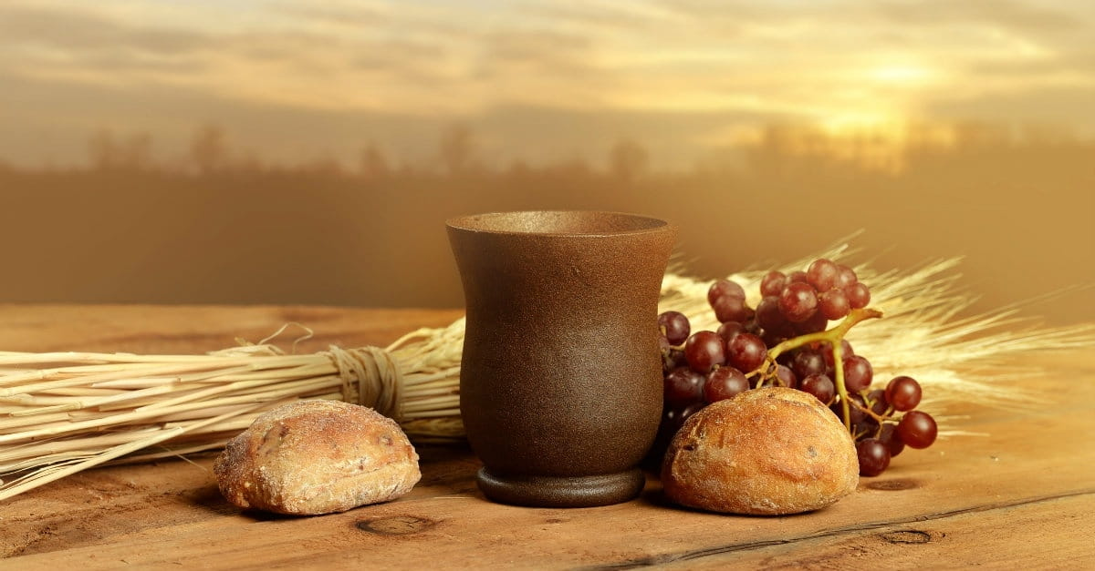
Sacrificial Love Remembered

