Slide 1
3/24/19

Slide 2
1 Peter 4:11 Whoever speaks must speak God’s words. Whoever serves must serve with the strength that God supplies so that in every way God receives Glory through Christ Jesus. Glory and power belong to Christ Jesus forever and ever! Amen.

Slide 3
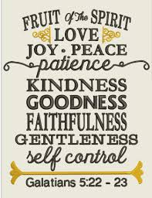

Slide 6
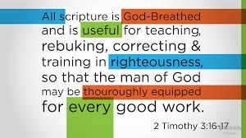
The Bible. HIS Word.

Slide 7
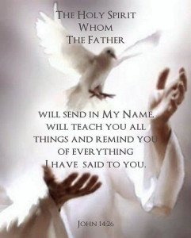
The Holy Spirit.

Slide 8
Each other/Community.

Slide 9
Steps to becoming a Rabbi/Discipleship:
Age 4-5 years old. One is considered fit to learn scripture.
Being associated with a local synagogue each community would hire a teacher that they would respectively call “Rabbi” but the “rabbi” generally had no authority in the synagogue even though he was responsible for the town or villages education. At the age of 4 or 5 children would begin their studies. Studies would focus on the reading, writing and memorization of the Torah.

Slide 10
At about 10 years old, after “Elementary school” two things would happen at the same time.
The girls would go home and learn how to keep a home while the boys would begin learning a trade.
The best students would begin the next phase of school… “middle school”.
The education here focused on studying the books of the prophets in addition to the torah as well as learn the interpretations of the oral torah. They would also learn to make their own applications and interpretations. Memorization was still considered important because not many had a copy of scripture of their own.

Slide 11
After finishing this level of education only a chosen few were considered good enough students to study with a “Famous” Rabbi from the synagogue itself.
This was considered a high honor not just for the student, but also for the family as very few people get chosen.

Slide 13
Romans 12:3-21
Because of the kindness that God has shown me, I ask you not to think of yourselves more highly than you should. Instead, your thoughts should lead you to use good judgment based on what God has given each of you as believers. Our bodies have many parts, but these parts don’t all do the same thing. In the same way, even though we are many individuals, Christ makes us one body and individuals who are connected to each other. God in his kindness gave each of us different gifts. If your gift is speaking what God has revealed, make sure what you say agrees with the Christian faith. If your gift is serving, then devote yourself to serving. If it is teaching, devote yourself to teaching. If it is encouraging others, devote yourself to giving encouragement. If it is sharing, be generous. If it is leadership, lead enthusiastically. If it is helping people in need, help them cheerfully.
Love sincerely. Hate evil. Hold on to what is good. Be devoted to each other like a loving family. Excel in showing respect for each other. Don’t be lazy in showing your devotion. Use your energy to serve the Lord. Be happy in your confidence, be patient in trouble, and pray continually. Share what you have with God’s people who are in need. Be hospitable.
Bless those who persecute you. Bless them, and don’t curse them. Be happy with those who are happy. Be sad with those who are sad. Live in harmony with each other. Don’t be arrogant, but be friendly to humble people. Don’t think that you are smarter than you really are.
Don’t pay people back with evil for the evil they do to you. Focus your thoughts on those things that are considered noble. As much as it is possible, live in peace with everyone. Don’t take revenge, dear friends. Instead, let God’s anger take care of it. After all, Scripture says, “I alone have the right to take revenge. I will pay back, says the Lord.” But,
“If your enemy is hungry, feed him.
If he is thirsty, give him a drink.
If you do this, you will make him feel guilty and ashamed.”
Don’t let evil conquer you, but conquer evil with good.

