Slide 2
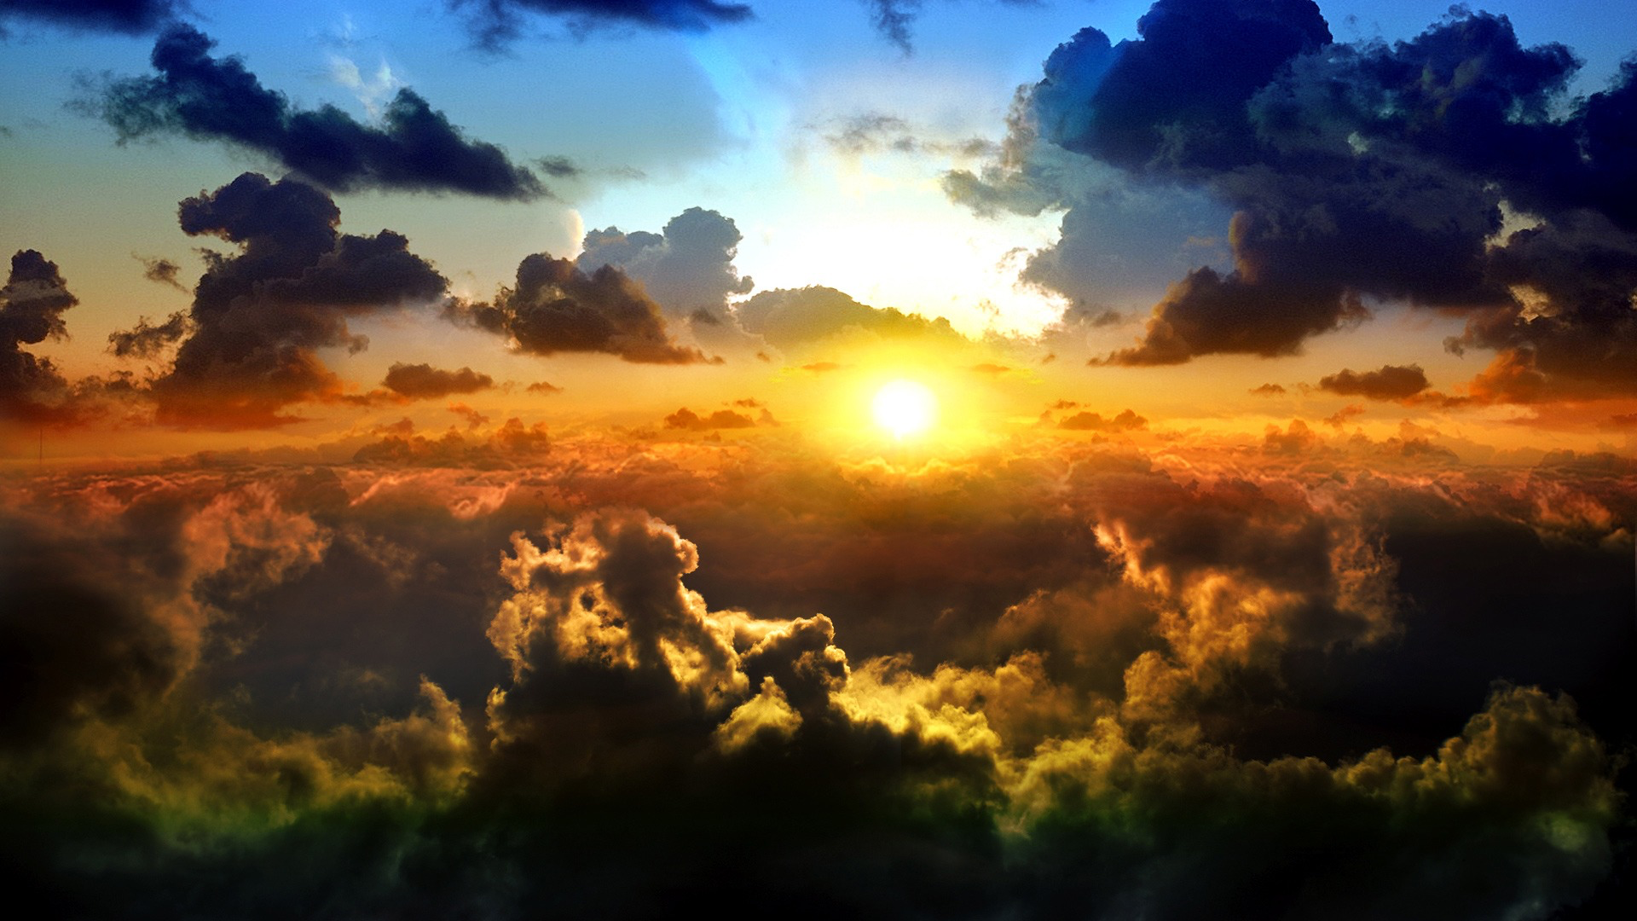
“For HIS Glory”

Slide 3
Isaiah 43:7
everyone who is called by my name, whom I created for my glory, whom I formed and made.”

Slide 4
Isaiah 48:11
For my own sake, for my own sake, I do it, for how should my name be profaned? My glory I will not give to another.

Slide 5
Psalm 106:7-8
Our fathers, when they were in Egypt, did not consider your wondrous works; they did not remember the abundance of your steadfast love, but rebelled by the sea, at the Red Sea.⁸ Yet he saved them for his name's sake, that he might make known his mighty power.
Jesus spoke to them, saying:

Slide 6
John 7:18 The one who speaks on his own authority seeks his own glory; but the one who seeks the glory of him who sent him is true, and in him there is no falsehood.

Slide 7
Matthew 5:16
In the same way, let your light shine before others, so that they may see your good works and give glory to your Father who is in heaven.
Psalm 16:11
You make known to me the path of life; in your presence there is fullness of joy; at your right hand are pleasures forevermore.

Slide 8
1 Peter 2:12 Keep your conduct among the Gentiles honorable, so that when they speak against you as evildoers, they may see your good deeds and glorify God on the day of visitation.

Slide 9
Matthew 25:34-46
Then the King will say to those on his right, ‘Come, you who are blessed by my Father, inherit the kingdom prepared for you from the foundation of the world. ³⁵ For I was hungry and you gave me food, I was thirsty and you gave me drink, I was a stranger and you welcomed me, ³⁶ I was naked and you clothed me, I was sick and you visited me, I was in prison and you came to me.’ ³⁷ Then the righteous will answer him, saying, ‘Lord, when did we see you hungry and feed you, or thirsty and give you drink? ³⁸ And when did we see you a stranger and welcome you, or naked and clothe you? ³⁹ And when did we see you sick or in prison and visit you?’ ⁴⁰ And the King will answer them, ‘Truly, I say to you, as you did it to one of the least of these my brothers, you did it to me.’

Slide 10
⁴¹ “Then he will say to those on his left, ‘Depart from me, you cursed, into the eternal fire prepared for the devil and his angels. ⁴² For I was hungry and you gave me no food, I was thirsty and you gave me no drink,⁴³ I was a stranger and you did not welcome me, naked and you did not clothe me, sick and in prison and you did not visit me.’ ⁴⁴ Then they also will answer, saying, ‘Lord, when did we see you hungry or thirsty or a stranger or naked or sick or in prison, and did not minister to you?’ ⁴⁵ Then he will answer them, saying, ‘Truly, I say to you, as you did not do it to one of the least of these, you did not do it to me.’ ⁴⁶ And these will go away into eternal punishment, but the righteous into eternal life.”

Slide 11
Matthew 7:21-23 “Not everyone who says to me, ‘Lord, Lord,’ will enter the kingdom of heaven, but the one who does the will of my Father who is in heaven. ²² On that day many will say to me, ‘Lord, Lord, did we not prophesy in your name, and cast out demons in your name, and do many mighty works in your name?’ ²³ And then will I declare to them, ‘I never knew you; depart from me, you workers of lawlessness.’

Slide 12
Colossians 3:17
And whatever you do, in word or deed, do everything in the name of the Lord Jesus, giving thanks to God the Father through him.

Slide 13
1 Peter 4:10-11 As each has received a gift, use it to serve one another, as good stewards of God's varied grace:¹¹ whoever speaks, as one who speaks oracles of God; whoever serves, as one who serves by the strength that God supplies—in order that in everything God may be glorified through Jesus Christ. To him belong glory and dominion forever and ever. Amen.

Slide 14
1 Corinthians 10:31
So, whether you eat or drink, or whatever you do, do all to the glory of God.

Slide 15
Isaiah 40:5
And the glory of the Lord shall be revealed, and all flesh shall see it together, for the mouth of the Lord has spoken.”

Slide 16
John 16:14
He will glorify me, for he will take what is mine and declare it to you.

Slide 17
John 11:4 But when Jesus heard it he said, “This illness does not lead to death. It is for the glory of God, so that the Son of God may be glorified through it.”

Slide 18
John 17:4
I glorified you on earth, having accomplished the work that you gave me to do.

Slide 19
Hebrews 1:3 He is the radiance of the glory of God and the exact imprint of his nature, and he upholds the universe by the word of his power. After making purification for sins, he sat down at the right hand of the Majesty on high,

Slide 20
Isaiah 6:1-3
In the year that King Uzziah died I saw the Lord sitting upon a throne, high and lifted up; and the train of his robe filled the temple. ² Above him stood the seraphim. Each had six wings: with two he covered his face, and with two he covered his feet, and with two he flew. ³ And one called to another and said: “Holy, holy, holy is the Lord of hosts; the whole earth is full of his glory!”

Slide 21
Revelation 21:23
And the city has no need of sun or moon to shine on it, for the glory of God gives it light, and its lamp is the Lamb.

Slide 23
1 Corinthians 11:23-26
For I received from the Lord what I also delivered to you, that the Lord Jesus on the night when he was betrayed took bread, ²⁴ and when he had given thanks, he broke it, and said, “This is my body, which is for you. Do this in remembrance of me.” ²⁵ In the same way also he took the cup, after supper, saying, “This cup is the new covenant in my blood. Do this, as often as you drink it, in remembrance of me.” ²⁶ For as often as you eat this bread and drink the cup, you proclaim the Lord's death until he comes.

