Slide 2
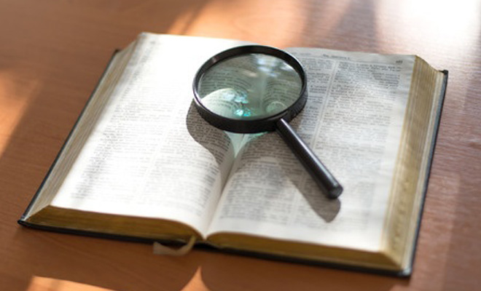
“Clear Focus”

Slide 3
Revelation 2:1-3
“To the angel of the church in Ephesus write: ‘The words of him who holds the seven stars in his right hand, who walks among the seven golden lampstands.² “‘I know your works, your toil and your patient endurance, and how you cannot bear with those who are evil, but have tested those who call themselves apostles and are not, and found them to be false. ³ I know you are enduring patiently and bearing up for my name's sake, and you have not grown weary.

Slide 4
Revelation 2:4-7
But I have this against you, that you have abandoned the love you had at first. ⁵ Remember therefore from where you have fallen; repent, and do the works you did at first. If not, I will come to you and remove your lampstand from its place, unless you repent. ⁶ Yet this you have: you hate the works of the Nicolaitans, which I also hate. ⁷ He who has an ear, let him hear what the Spirit says to the churches. To the one who conquers I will grant to eat of the tree of life, which is in the paradise of God.’

Slide 5
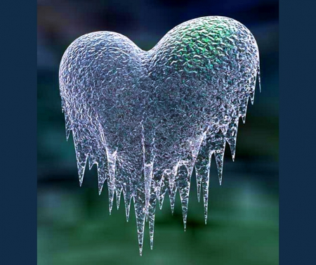
Matthew 24:12
And because lawlessness
will be increased, the love of many will grow cold.
Jesus spoke to them, saying:

Slide 6
2 Thessalonians 1:3 We ought always to give thanks to God for you, brothers, as is right, because your faith is growing abundantly, and the love of every one of you for one another is increasing.

Slide 7
Hebrews 6:10
For God is not unjust so as to overlook your work and the love that you have shown for his name in serving the saints, as you still do.
Psalm 16:11
You make known to me the path of life; in your presence there is fullness of joy; at your right hand are pleasures forevermore.

Slide 8
Genesis 1:27-28
So God created man in his own image, in the image of God he created him; male and female he created them. ²⁸ And God blessed them. And God said to them, “Be fruitful and multiply and fill the earth and subdue it, and have dominion over the fish of the sea and over the birds of the heavens and over every living thing that moves on the earth.”

Slide 9
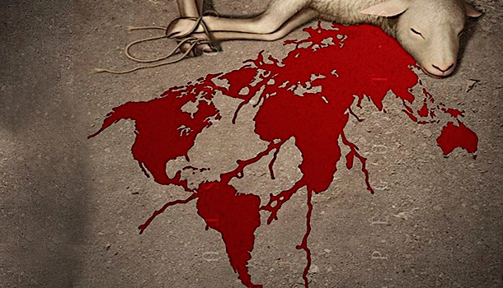
1 Peter 1:19-20 It was the precious blood of Christ, the sinless, spotless Lamb of God. ²⁰ God chose him as your ransom long before the world began, but now in these last days he has been revealed for your sake.

Slide 10
Proverbs 11:25
A generous person will prosper; whoever refreshes others will be refreshed.

Slide 11
Proverbs 22:9
The generous will themselves be blessed, for they share their food with the poor.

Slide 12
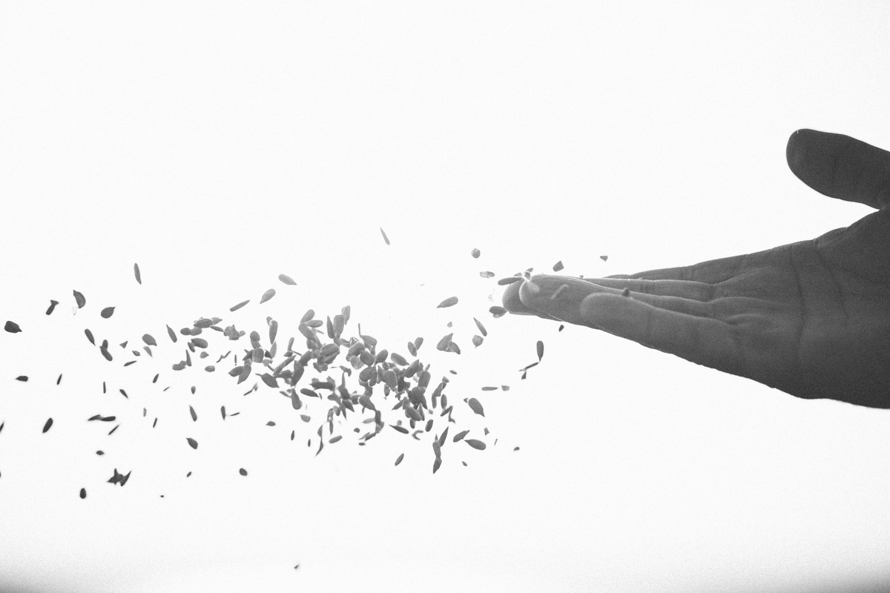
2 Corinthians 9:6 Remember this: Whoever sows sparingly will also reap sparingly, and whoever sows generously will also reap generously.

Slide 13
Luke 6:38
Give, and it will be given to you. A good measure, pressed down, shaken together and running over, will be poured into your lap. For with the measure you use, it will be measured to you.”

Slide 14
Acts 3:19-21
Repent, then, and turn to God, so that your sins may be wiped out, that times of refreshing may come from the Lord, ²⁰ and that he may send the Messiah, who has been appointed for you—even Jesus.²¹ Heaven must receive him until the time comes for God to restore everything, as he promised long ago through his holy prophets.

Slide 15
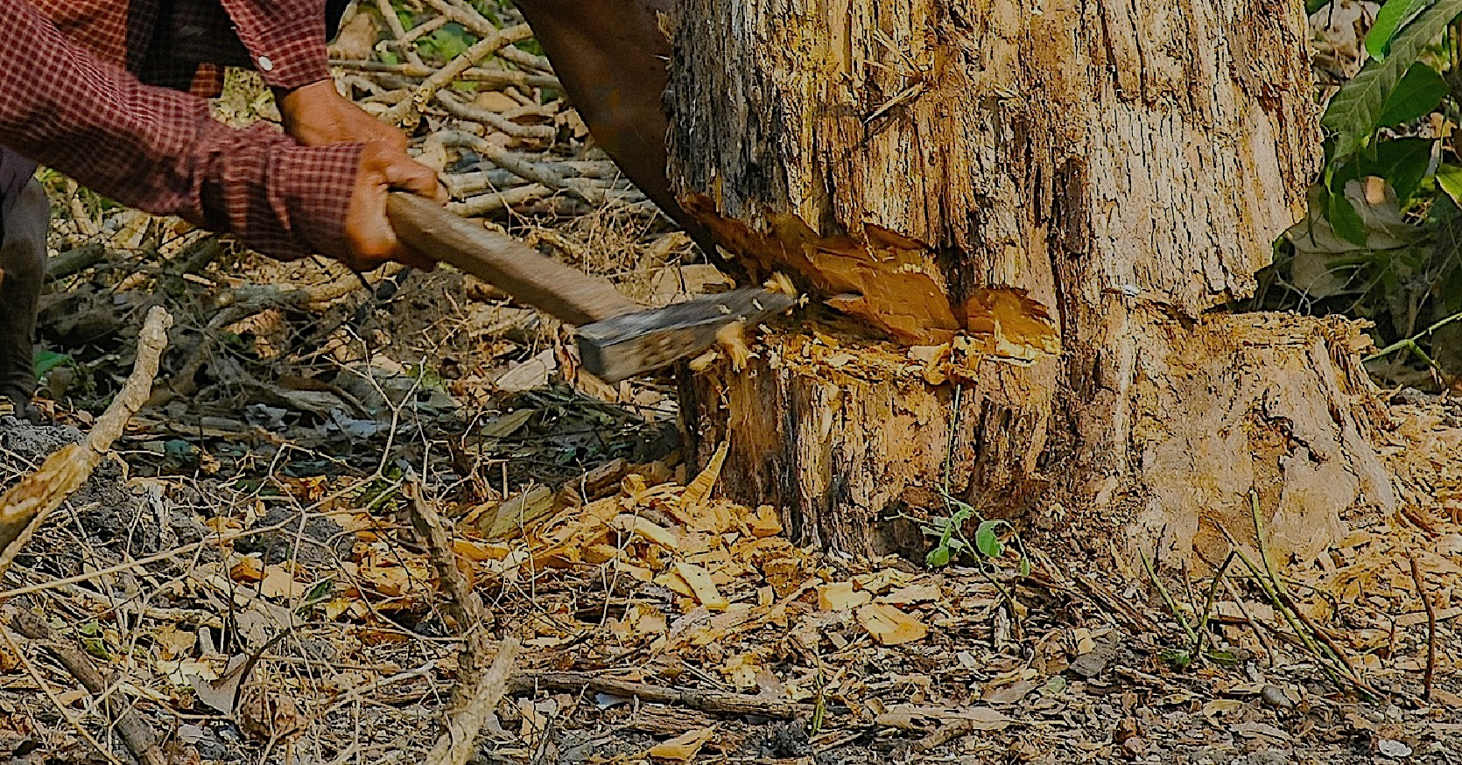
Matthew 3:8-10 Bear fruit in keeping with repentance. ⁹ And do not presume to say to yourselves, ‘We have Abraham as our father,’ for I tell you, God is able from these stones to raise up children for Abraham. ¹⁰ Even now the axe is laid to the root of the trees. Every tree therefore that does not bear good fruit is cut down and thrown into the fire.

Slide 16
Revelation 2:5
Remember therefore from where you have fallen; repent, and do the works you did at first. If not, I will come to you and remove your lampstand from its place, unless you repent.

Slide 18
1 Corinthians 11:23-26
For I received from the Lord what I also delivered to you, that the Lord Jesus on the night when he was betrayed took bread, ²⁴ and when he had given thanks, he broke it, and said, “This is my body, which is for you. Do this in remembrance of me.” ²⁵ In the same way also he took the cup, after supper, saying, “This cup is the new covenant in my blood. Do this, as often as you drink it, in remembrance of me.” ²⁶ For as often as you eat this bread and drink the cup, you proclaim the Lord's death until he comes.

