Slide 2
to the Teaching of Christ

Slide 3
2 Corinthians 6:16-7:1
What agreement has the temple of God with idols? For we are the temple of the living God; as God said, “I will make my dwelling among them and walk among them, and I will be their God, and they shall be my people.¹⁷ Therefore go out from their midst and be separate from them, says the Lord, and touch no unclean thing; then I will welcome you,¹⁸ and I will be a father to you, and you shall be sons and daughters to me, says the Lord Almighty.”

Slide 4
7:1 Since we have these promises, beloved, let us cleanse ourselves from every defilement of body
and spirit, bringing holiness to completion in the fear of God.
Psalm 16:11
You make known to me the path of life; in your presence there is fullness of joy; at your right hand are pleasures forevermore.

Slide 5
Acts 2:42-47 And they devoted themselves to the apostles' teaching and the fellowship, to the breaking of bread and the prayers. ⁴³ And awe came upon every soul, and many wonders and signs were being done through the apostles. ⁴⁴ And all who believed were together and had all things in common. ⁴⁵ And they were selling their possessions and belongings and distributing the proceeds to all, as any had need. ⁴⁶ And day by day, attending the temple together and breaking bread in their homes, they received their food with glad and generous hearts, ⁴⁷ praising God and having favor with all the people. And the Lord added to their number day by day those who were being saved.

Slide 6
Matthew 28:19-20
Go therefore and make disciples of all nations, baptizing them in the name of the Father and of the Son and of the Holy Spirit,²⁰ teaching them to observe all that I have commanded you. And behold, I am with you always, to the end of the age.”

Slide 7
1 Corinthians 15:1-4 Now I would remind you, brothers, of the gospel I preached to you, which you received, in which you stand, ² and by which you are being saved, if you hold fast to the word I preached to you—unless you believed in vain.³ For I delivered to you as of first importance what I also received: that Christ died for our sins in accordance with the Scriptures, ⁴ that he was buried, that he was raised on the third day in accordance with the Scriptures,

Slide 8
2 Thessalonians 2:13-15 But we ought always to give thanks to God for you, brothers beloved by the Lord, because God chose you as the first fruits to be saved, through sanctification by the Spirit and belief in the truth. ¹⁴ To this he called you through our gospel, so that you may obtain the glory of our Lord Jesus Christ. ¹⁵ So then, brothers, stand firm and hold to the traditions that you were taught by us, either by our spoken word or by our letter.

Slide 9
John 8:31-32
So Jesus said to the Jews who had believed him, “If you abide in my word, you are truly my disciples, ³² and you will know the truth,

Slide 10
Galatians 6:14 But far be it from me to boast except in the cross of our Lord Jesus Christ, by which the world has been crucified to me, and I to the world.

Slide 11
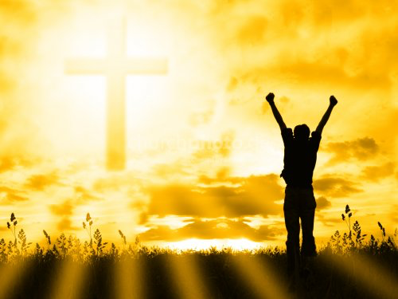
1 Corinthians 1:18 The message of the cross is foolish to those who are headed for destruction! But we who are being saved know it is the very power of God.

Slide 12
Through the cross God has made available this glorious inheritance to us:
A New Nature.
A New Home
A New Ruler and Lord
A New Mind
Victory over Satan.
Victory over Death.
Continual Washing from Sin.

Slide 14
1 Corinthians 11:23-26 For I received from the Lord what I also delivered to you, that the Lord Jesus on the night when he was betrayed took bread, ²⁴ and when he had given thanks, he broke it, and said, “This is my body, which is for you. Do this in remembrance of me.” ²⁵ In the same way also he took the cup, after supper, saying, “This cup is the new covenant in my blood. Do this, as often as you drink it, in remembrance of me.” ²⁶ For as often as you eat this bread and drink the cup, you proclaim the Lord's death until he comes.

