Slide 2
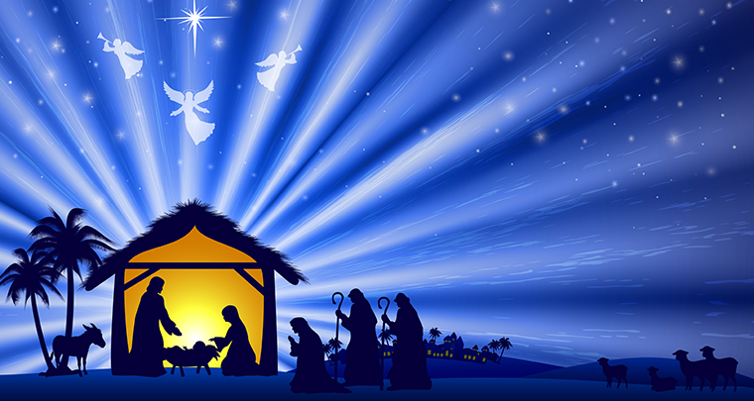
Emmanuel
God With Us

Slide 3
Luke 2:8-14 And there were in the same country shepherds abiding in the field, keeping watch over their flock by night.⁹ And, lo, the angel of the Lord came upon them, and the glory of the Lord shone round about them: and they were sore afraid.¹⁰ And the angel said unto them, Fear not: for, behold, I bring you good tidings of great joy, which shall be to all people.¹¹ For unto you is born this day in the city of David a Saviour, which is Christ the Lord.¹² And this shall be a sign unto you; Ye shall find the babe wrapped in swaddling clothes, lying in a manger.¹³ And suddenly there was with the angel a multitude of the heavenly host praising God, and saying,¹⁴ Glory to God in the highest, and on earth peace, good will toward men.

Slide 4
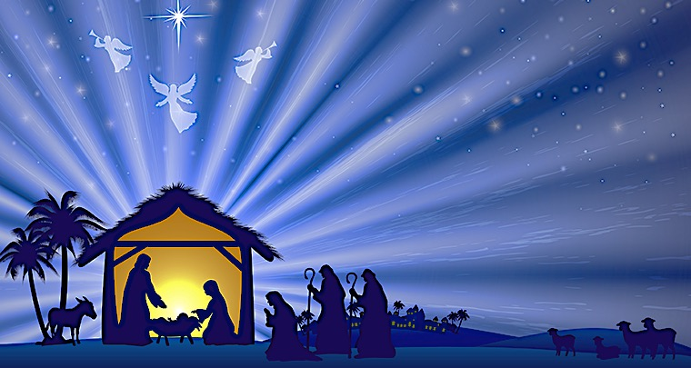
Luke 2:9 And an angel of the Lord appeared to them, and the glory of the Lord shone around them, and they were filled with great fear.

Slide 5
Luke 2:12 And this will be a sign for you: you will find a baby wrapped in swaddling cloths and lying in a manger.”

Slide 6
Colossians 1:17
And he is before all things, and in him all things hold together. It’s a source of unending wonder that the God who brought the universe into being clothed himself in our skin, or more precisely, added human nature to his deity. God is great not merely because he is sovereign and exalted above his creation, but because in unspeakable humility, he became a part of it.
2 Corinthians 4:18 So we fix our eyes not on what is seen, but on what is unseen, since what is seen is temporary, but what is unseen is eternal.

Slide 7
Genesis 3:15
I will put enmity between you and the woman, and between your offspring and her offspring; he shall bruise your head, and you shall bruise his heel.”

Slide 8
2 Samuel 7:16
And your house and your kingdom shall be made sure forever before me. Your throne shall be established forever.’”

Slide 9
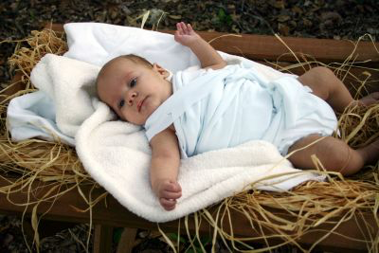
Isaiah 53:5
But he was pierced for our transgressions; he was crushed for our iniquities; upon him was the chastisement that brought us peace, and with his wounds we are healed.

Slide 10
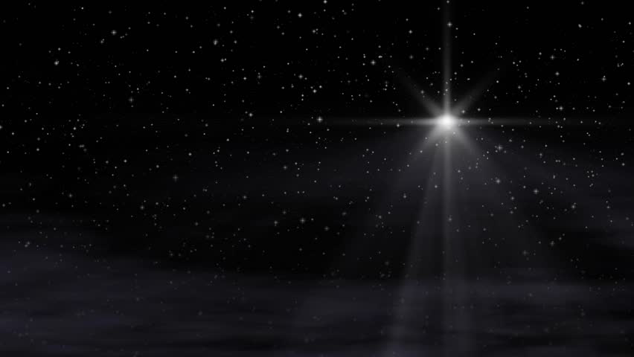
1 John 3:2
Beloved, we are God's children now, and what we will be has not yet appeared; but we know that when he appears we shall be like him, because we shall see him as he is.

Slide 11
Romans 8:28 And we know that for those who love God all things work together for good, for those who are called according to his purpose.

Slide 12
Revelation 21:4
He will wipe away every tear from their eyes, and death shall be no more, neither shall there be mourning, nor crying, nor pain anymore, for the former things have passed away.”

Slide 13
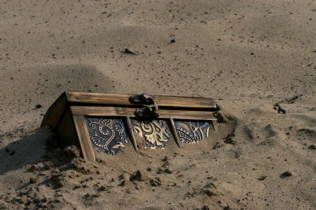
Matthew 13:44 “The kingdom of heaven is like treasure hidden in a field, which a man found and covered up. Then in his joy he goes and sells all that he has and buys that field

Slide 14
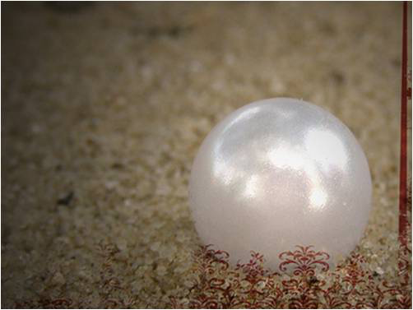
Matthew 13:45-46
“Again, the kingdom of heaven is like a merchant in search of fine pearls, ⁴⁶ who, on finding one pearl of great value, went and sold all that he had and bought it.

