Slide 2
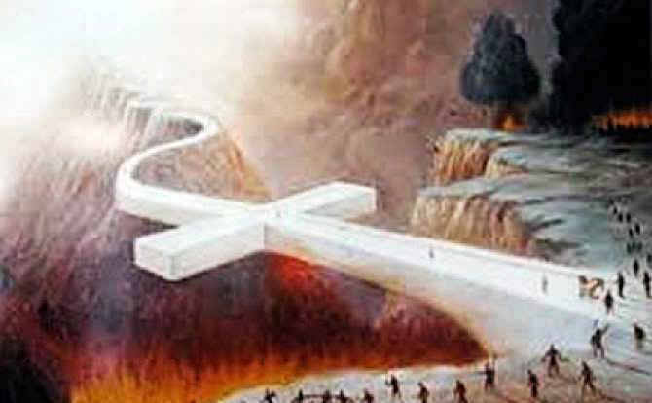
JESUS is the WAY

Slide 3
John 14:6 Jesus said to him, “I am the way, and the truth, and the life. No one comes to the Father except through me.

Slide 4
Matthew 7:14
For the gate is narrow and the way is hard that leads to life, and those who find it are few.

Slide 5
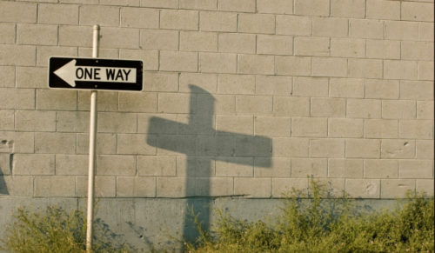
Isaiah 35:8 And a highway shall be there, and it shall be called the Way of Holiness; the unclean shall not pass over it. It shall belong to those who walk on the way; even if they are fools, they shall not go astray.

Slide 6
John 14:12 “Truly, truly, I say to you, whoever believes in me will also do the works that I do; and greater works than these will he do, because I am going to the Father.
2 Corinthians 4:18 So we fix our eyes not on what is seen, but on what is unseen, since what is seen is temporary, but what is unseen is eternal.

Slide 7
1 John 2:4-6
Whoever says “I know him” but does not keep his commandments is a liar, and the truth is not in him,⁵ but whoever keeps his word, in him truly the love of God is perfected. By this we may know that we are in him: ⁶ whoever says he abides in him ought to walk in the same way in which he walked.

Slide 8
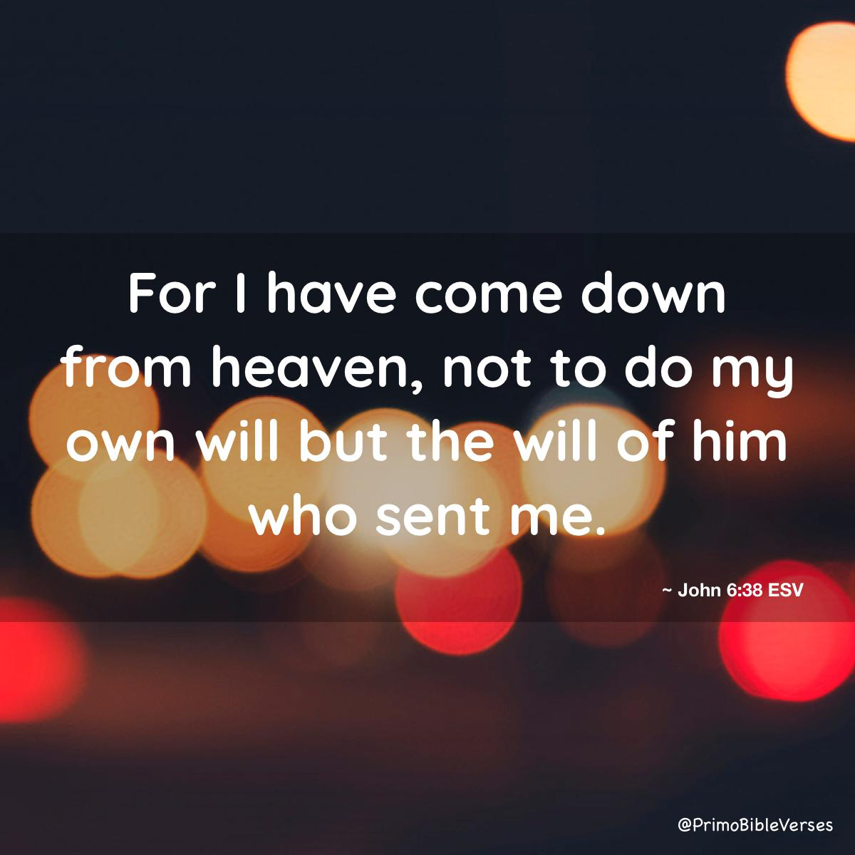

Slide 9
John 13:12-15 When he had washed their feet and put on his outer garments and resumed his place, he said to them, “Do you understand what I have done to you? ¹³ You call me Teacher and Lord, and you are right, for so I am. ¹⁴ If I then, your Lord and Teacher, have washed your feet, you also ought to wash one another's feet.¹⁵ For I have given you an example, that you also should do just as I have done to you.

Slide 10
1 John 4:15-17
Whoever confesses that Jesus is the Son of God, God abides in him, and he in God. ¹⁶ So we have come to know and to believe the love that God has for us. God is love, and whoever abides in love abides in God, and God abides in him.
¹⁷ By this is love perfected with us, so that we may have confidence for the day of judgment, because as he is so also are we in this world.

Slide 11
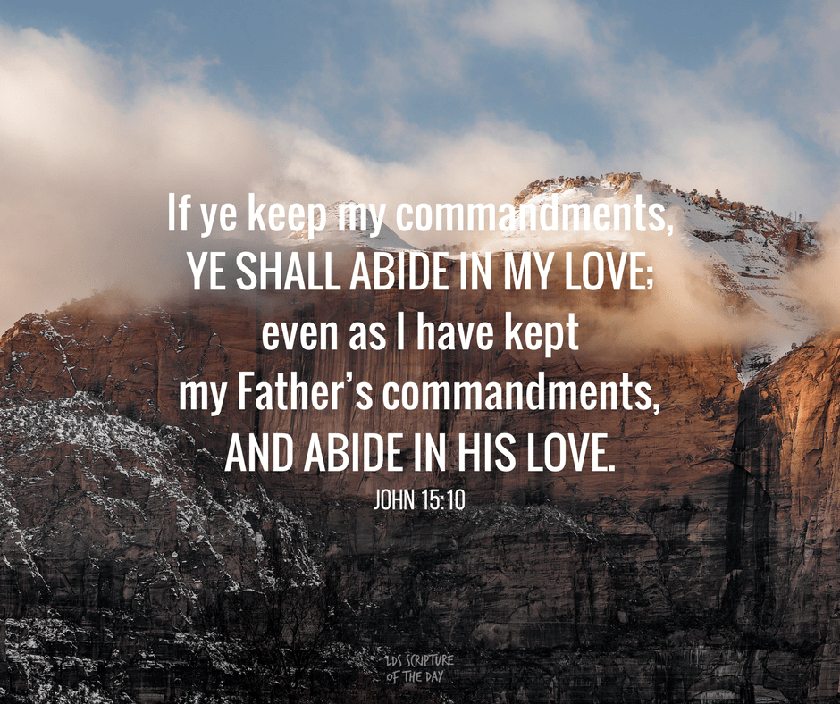

Slide 12
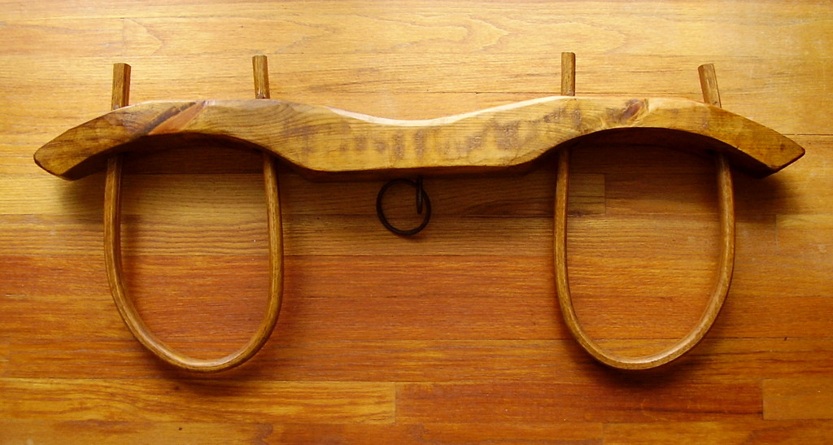
Matthew 11:29
Take my yoke upon you, and learn from me, for I am gentle and lowly in heart, and you will find rest for your souls

Slide 13
1 Peter 2:20-22 For what credit is it if, when you sin and are beaten for it, you endure? But if when you do good and suffer for it you endure, this is a gracious thing in the sight of God. ²¹ For to this you have been called, because Christ also suffered for you, leaving you an example, so that you might follow in his steps. ²² He committed no sin, neither was deceit found in his mouth.

Slide 14
1 John 3:24 Whoever keeps his commandments abides in God, and God in him. And by this we know that he abides in us, by the Spirit whom he has given us.

Slide 15
John 14:20-21 In that day you will know that I am in my Father, and you in me, and I in you. ²¹ Whoever has my commandments and keeps them, he it is who loves me. And he who loves me will be loved by my Father, and I will love him and manifest myself to him.”

Slide 16
1 Peter 1:8-9
2 Peter 1:5-12
For this very reason, make every effort to supplement your faith with virtue, and virtue with knowledge,⁶ and knowledge with self-control, and self-control with steadfastness, and steadfastness with godliness,⁷ and godliness with brotherly affection, and brotherly affection with love. ⁸ For if these qualities are yours and are increasing, they keep you from being ineffective or unfruitful in the knowledge of our Lord Jesus Christ. ⁹ For whoever lacks these qualities is so nearsighted that he is blind, having forgotten that he was cleansed from his former sins. ¹⁰ Therefore, brothers, be all the more diligent to confirm your calling and election, for if you practice these qualities you will never fall.
¹¹ For in this way there will be richly provided for you an entrance into the eternal kingdom of our Lord and Savior Jesus Christ.
Though you have not seen him, you love him; and even though you do not see him now, you believe in him and are filled with an inexpressible and glorious joy, ⁹ for you are receiving the end result of your faith, the salvation of your souls.

Slide 17
Galatians 2:20 I have been crucified with Christ. It is no longer I who live, but Christ who lives in me. And the life I now live in the flesh I live by faith in the Son of God, who loved me and gave himself for me.
2 Corinthians 5:7
For we live by faith, not by sight.

