Slide 2
Walk Worthy
of the
Gospel

Slide 3
Philippians 1:27-29
Only let your manner of life be worthy of the gospel of Christ, so that whether I come and see you or am absent, I may hear of you that you are standing firm in one spirit, with one mind striving side by side for the faith of the gospel, ²⁸ and not frightened in anything by your opponents. This is a clear sign to them of their destruction, but of your salvation, and that from God. ²⁹ For it has been granted to you that for the sake of Christ you should not only believe in him but also suffer for his sake,

Slide 5
Luke 22:24-26
A dispute also arose among them as to which of them was considered to be greatest. ²⁵ Jesus said to them, “The kings of the Gentiles lord it over them; and those who exercise authority over them call themselves Benefactors. ²⁶ But you are not to be like that. Instead, the greatest among you should be like the youngest, and the one who rules like the one who serves.

Slide 6
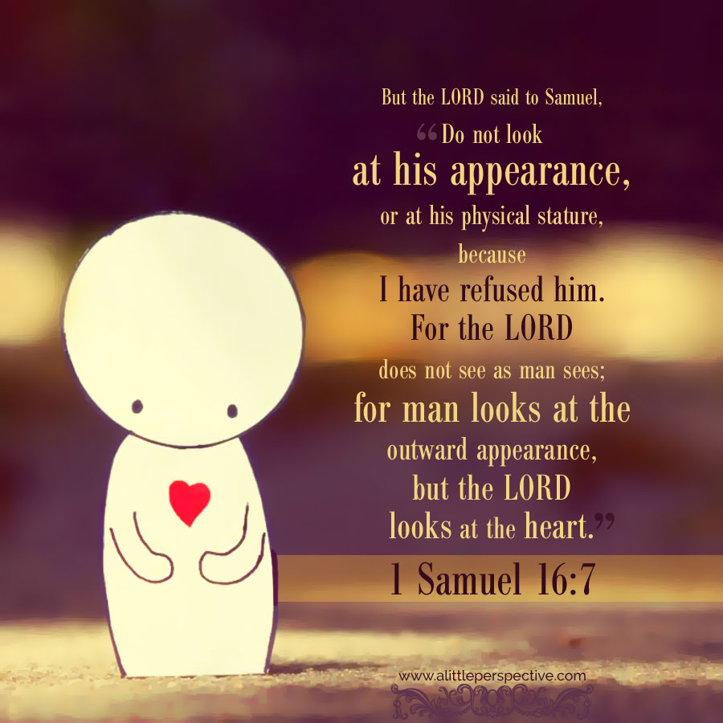

Slide 7
Colossians 3:5-10 Put to death, therefore, whatever belongs to your earthly nature: sexual immorality, impurity, lust, evil desires and greed, which is idolatry. ⁶ Because of these, the wrath of God is coming. ⁷ You used to walk in these ways, in the life you once lived. ⁸ But now you must also rid yourselves of all such things as these: anger, rage, malice, slander, and filthy language from your lips. ⁹ Do not lie to each other, since you have taken off your old self with its practices ¹⁰ and have put on the new self, which is being renewed in knowledge in the image of its Creator.

Slide 8
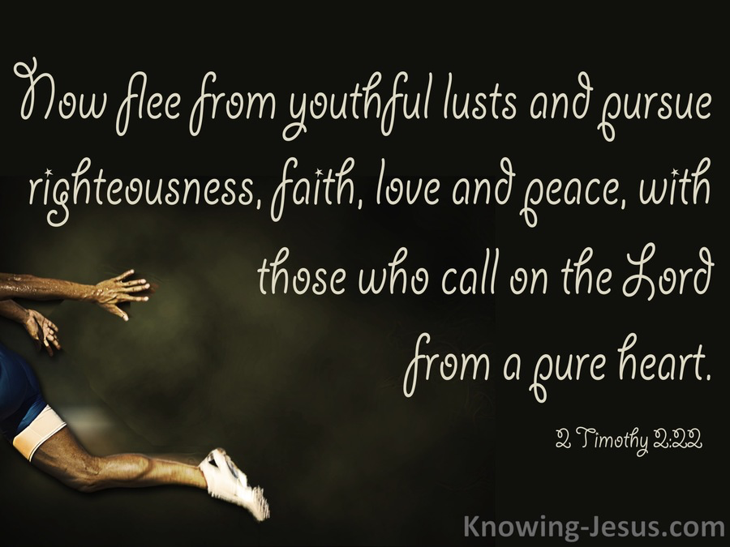

Slide 9
Philippians 1:27-28
Only let your manner of life be worthy of the gospel of Christ, so that whether I come and see you or am absent, I may hear of you that you are standing firm in one spirit, with one mind striving side by side for the faith of the gospel, ²⁸ and not frightened in anything by your opponents.

Slide 10
Philippians 1:29
For it has been granted to you that for the sake of Christ you should not only believe in him but also suffer for his sake

Slide 11
Matthew 5:11-12 “Blessed are you when people insult you, persecute you and falsely say all kinds of evil against you because of me. ¹² Rejoice and be glad, because great is your reward in heaven, for in the same way they persecuted the prophets who were before you.

Slide 12
Romans 5:3-4 Not only so, but we also glory in our sufferings, because we know that suffering produces perseverance;⁴ perseverance, character; and character, hope.

Slide 13
Colossians 1:9-10
For this reason, since the day we heard about you, we have not stopped praying for you. We continually ask God to fill you with the knowledge of his will through all the wisdom and understanding that the Spirit gives,¹⁰ so that you may live a life worthy of the Lord and please him in every way: bearing fruit in every good work, growing in the knowledge of God,

Slide 15
A Christians walk worthy of the Gospel, is by faith living as citizens of Heaven.
A Christians walk worthy of the Gospel, is by faith standing firm.
A Christians walk worthy of the Gospel is by faith, working as a team.
A Christians walk worthy of the Gospel is by faith, being confident in the face of opposition.

