Slide 2
Alert
and
Sober

Slide 3
Isaiah 55:6-9 Seek the Lord while he may be found; call on him while he is near.⁷ Let the wicked forsake their ways and the unrighteous their thoughts. Let them turn to the Lord, and he will have mercy on them, and to our God, for he will freely pardon. ⁸ “For my thoughts are not your thoughts, neither are your ways my ways,” declares the Lord.⁹ “As the heavens are higher than the earth, so are my ways higher than your ways and my thoughts than your thoughts.

Slide 4
Deuteronomy 4:29-30
But if from there you seek the Lord your God, you will find him if you seek him with all your heart and with all your soul. ³⁰ When you are in distress and all these things have happened to you, then in later days you will return to the Lord your God and obey him.

Slide 6
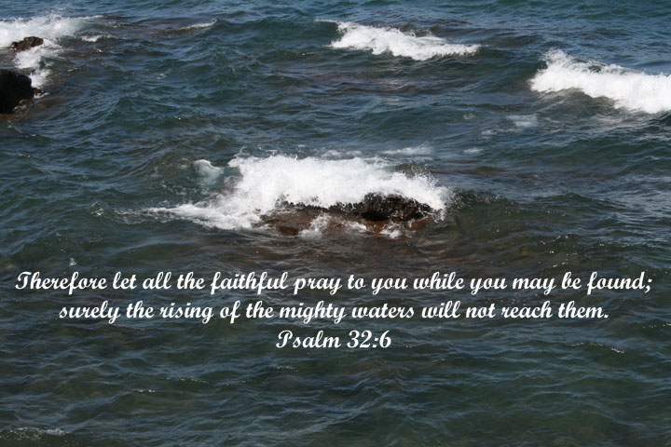

Slide 7
Mark 13:7-8 When you hear of wars and rumors of wars, do not be alarmed. Such things must happen, but the end is still to come. ⁸ Nation will rise against nation, and kingdom against kingdom. There will be earthquakes in various places, and famines. These are the beginning of birth pains.

Slide 8
Luke 21:10-12
Then he said to them, “Nation will rise against nation, and kingdom against kingdom. ¹¹ There will be great earthquakes, and in various places famines and pestilences. And there will be terrors and great signs from heaven. ¹² But before all this they will lay their hands on you and persecute you, delivering you up to the synagogues and prisons, and you will be brought before kings and governors for my name's sake.

Slide 9
Matthew 24:9-13“Then you will be handed over to be persecuted and put to death, and you will be hated by all nations because of me. ¹⁰ At that time many will turn away from the faith and will betray and hate each other, ¹¹ and many false prophets will appear and deceive many people. ¹² Because of the increase of wickedness, the love of most will grow cold, ¹³ but the one who stands firm to the end will be saved.

Slide 10
2 Timothy 3:1-5
But mark this: There will be terrible times in the last days. ² People will be lovers of themselves, lovers of money, boastful, proud, abusive, disobedient to their parents, ungrateful, unholy, ³ without love, unforgiving, slanderous, without self-control, brutal, not lovers of the good, ⁴ treacherous, rash, conceited, lovers of pleasure rather than lovers of God— ⁵ having a form of godliness but denying its power. Have nothing to do with such people.

Slide 11
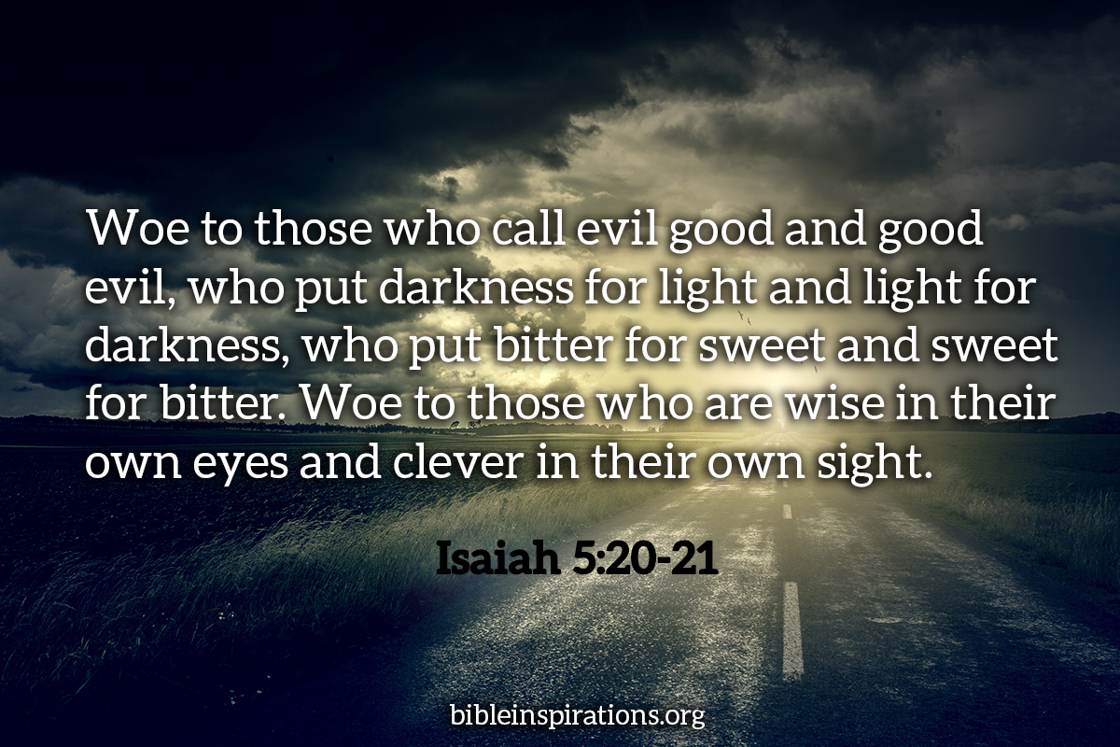

Slide 12
2 Timothy 4:3-4
For the time will come when people will not put up with sound doctrine. Instead, to suit their own desires, they will gather around them a great number of teachers to say what their itching ears want to hear. ⁴ They will turn their ears away from the truth and turn aside to myths.

Slide 13
1John 2:15-17
Do not love the world or anything in the world. If anyone loves the world, love for the Father is not in them. ¹⁶ For everything in the world—the lust of the flesh, the lust of the eyes, and the pride of life—comes not from the Father but from the world. ¹⁷ The world and its desires pass away, but whoever does the will of God lives forever.

Slide 14
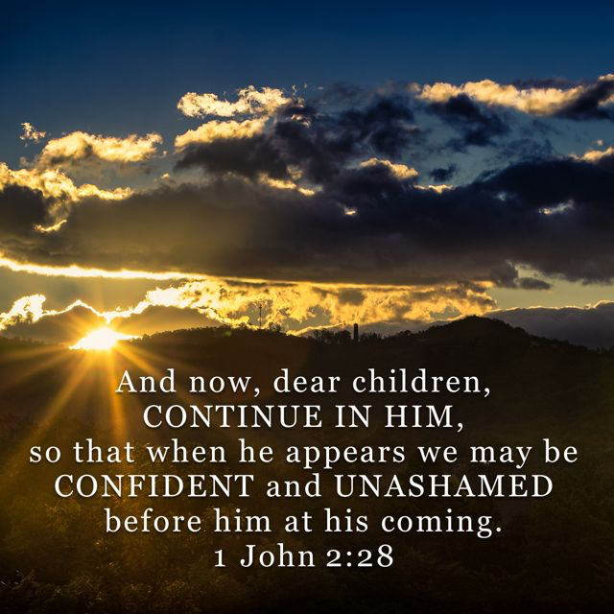

Slide 15
1Peter 5:8-9
Be alert and of sober mind. Your enemy the devil prowls around like a roaring lion looking for someone to devour. ⁹ Resist him, standing firm in the faith, because you know that the family of believers throughout the world is undergoing the same kind of sufferings.

Slide 16
2 Timothy 3:12-14 In fact, everyone who wants to live a godly life in Christ Jesus will be persecuted, ¹³ while evildoers and impostors will go from bad to worse, deceiving and being deceived. ¹⁴ But as for you, continue in what you have learned and have become convinced of, because you know those from whom you learned it,

Slide 17
Hebrews 10:24-25
And let us consider how to stir up one another to love and good works, ²⁵ not neglecting to meet together, as is the habit of some, but encouraging one another, and all the more as you see the Day drawing near.

Slide 18
Mark 13:33
Be on guard! Be alert! You do not know when that time will come.
Ephesians 6:18
And pray in the Spirit on all occasions with all kinds of prayers and requests. With this in mind, be alert and always keep on praying for all the Lord’s people.

Slide 19
Matthew 6:21 For where your treasure is, there your heart will be also.

