Slide 2
Responding
to the
Word of God

Slide 3
Matthew 13:3-9 And he told them many things in parables, saying: “A sower went out to sow.⁴ And as he sowed, some seeds fell along the path, and the birds came and devoured them. ⁵ Other seeds fell on rocky ground, where they did not have much soil, and immediately they sprang up, since they had no depth of soil, ⁶ but when the sun rose they were scorched. And since they had no root, they withered away.⁷ Other seeds fell among thorns, and the thorns grew up and choked them. ⁸ Other seeds fell on good soil and produced grain, some a hundredfold, some sixty, some thirty. ⁹ He who has ears, let him hear.”

Slide 5
The Hard Heart - Matthew 13:3-4, 18-19
And he told them many things in parables, saying: “A sower went out to sow.⁴ And as he sowed, some seeds fell along the path, and the birds came and devoured them……..
¹⁸“Hear then the parable of the sower: ¹⁹ When anyone hears the word of the kingdom and does not understand it, the evil one comes and snatches away what has been sown in his heart. This is what was sown along the path.

Slide 6
Deuteronomy 32:47
For it is no empty word for you, but your very life, and by this word you shall live long in the land that you are going over the Jordan to possess.”

Slide 7
The Shallow Heart - Matthew 13:5-6, 20-21
Other seeds fell on rocky ground, where they did not have much soil, and immediately they sprang up, since they had no depth of soil, ⁶ but when the sun rose they were scorched. And since they had no root, they withered away.
²⁰ As for what was sown on rocky ground, this is the one who hears the word and immediately receives it with joy, ²¹ yet he has no root in himself, but endures for a while, and when tribulation or persecution arises on account of the word, immediately he falls away.

Slide 8
Matthew 24:13 But the one who endures to the end will be saved.
Luke 9:62 Jesus said to him, “No one who puts his hand to the plow and looks back is fit for the kingdom of God.”

Slide 9
The Divided Heart - Matthew 13:7, 22 Other seeds fell among thorns, and the thorns grew up and choked them………..
²² As for what was sown among thorns, this is the one who hears the word, but the cares of the world and the deceitfulness of riches choke the word, and it proves unfruitful

Slide 10
Hosea 7:8-11 “The people of Israel mingle with godless foreigners, making themselves as worthless as a half-baked cake! ⁹ Worshiping foreign gods has sapped their strength, but they don’t even know it.Their hair is gray, but they don’t realize they’re old and weak.¹⁰ Their arrogance testifies against them, yet they don’t return to the Lord their God or even try to find him.
¹¹ “The people of Israel have become like silly, witless doves, first calling to Egypt, then flying to Assyria for help.

Slide 11
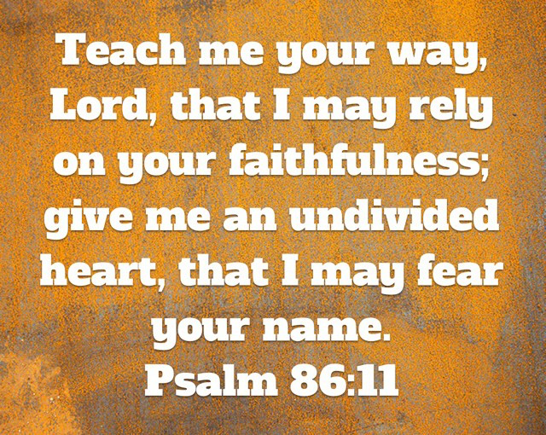

Slide 12
The Open Heart - Matthew 13:8, 23 Still other seed fell on good soil, where it produced a crop—a hundred, sixty or thirty times what was sown……
²³ But the seed falling on good soil refers to someone who hears the word and understands it. This is the one who produces a crop, yielding a hundred, sixty or thirty times what was sown.”

Slide 13
Isaiah 55:10-11
“For as the rain and the snow come down from heaven and do not return there but water the earth, making it bring forth and sprout, giving seed to the sower and bread to the eater,¹¹ so shall my word be that goes out from my mouth; it shall not return to me empty, but it shall accomplish that which I purpose, and shall succeed in the thing for which I sent it.

Slide 14
Proverbs 4:5
Get wisdom, get understanding; do not forget my words or turn away from them.

Slide 17
James 1:22 Do not merely listen to the word, and so deceive yourselves. Do what it says
Luke 11:28 He replied, “Blessed rather are those who hear the word of God and obey it.”

