Slide 2
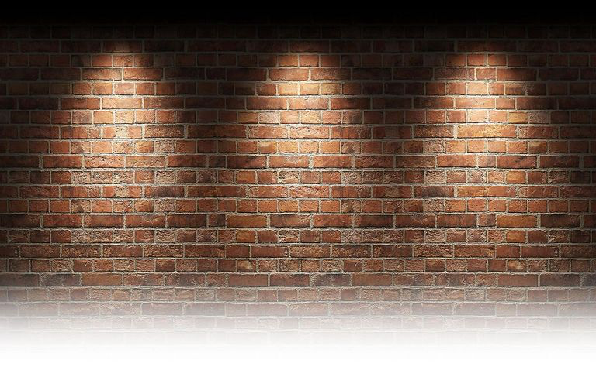
How to Persevere as a Follower of Christ

Slide 3
Hebrews 12:1-2 Therefore, since we are surrounded by such a great cloud of witnesses, let us throw off everything that hinders and the sin that so easily entangles, and let us run with perseverance the race marked out for us. 2 Let us fix our eyes on Jesus, the author and perfecter of our faith, who for the joy set before him endured the cross, scorning its shame, and sat down at the right hand of the throne of God.

Slide 4
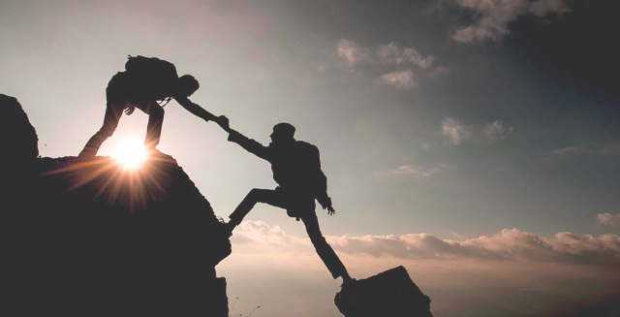
2 Chronicles 16:9
For the eyes of the Lord run to and fro throughout the whole earth, to give strong support to those whose heart is blameless toward him.

Slide 5
Hebrews 11:1-3
Now faith is the assurance of things hoped for, the conviction of things not seen. ² For by it the people of old received their commendation. ³ By faith we understand that the universe was created by the word of God, so that what is seen was not made out of things that are visible.

Slide 6
Hebrews 11:6
And without faith it is impossible to please him, for whoever would draw near to God must believe that he exists and that he rewards those who seek him.

Slide 7
7 By faith Noah, being warned by God concerning events as yet unseen, in reverent fear constructed an ark for the saving of his household.
11 By faith Sarah herself received power to conceive, even when she was past the age, since she considered him faithful who had promised.
17-18 By faith Abraham, when he was tested, offered up Isaac, and he who had received the promises was in the act of offering up his only son, ¹⁸ of whom it was said, “Through Isaac shall your offspring be named.”
23 By faith Moses, when he was born, was hidden for three months by his parents, because they saw that the child was beautiful, and they were not afraid of the king's edict.
24-25 By faith Moses, when he was grown up, refused to be called the son of Pharaoh's daughter, ²⁵ choosing rather to be mistreated with the people of God than to enjoy the fleeting pleasures of sin.
By faith the people crossed the Red Sea, By faith the walls of Jericho fell down after they had been encircled for seven days.

Slide 8
Hebrews 11:32-37 And what more shall I say? For time would fail me to tell of Gideon, Barak, Samson, Jephthah, of David and Samuel and the prophets— ³³ who through faith conquered kingdoms, enforced justice, obtained promises, stopped the mouths of lions, ³⁴ quenched the power of fire, escaped the edge of the sword, were made strong out of weakness, became mighty in war, put foreign armies to flight. ³⁵ Women received back their dead by resurrection. Some were tortured, refusing to accept release, so that they might rise again to a better life. ³⁶ Others suffered mocking and flogging, and even chains and imprisonment. ³⁷ They were stoned, they were sawn in two, they were killed with the sword.

Slide 9
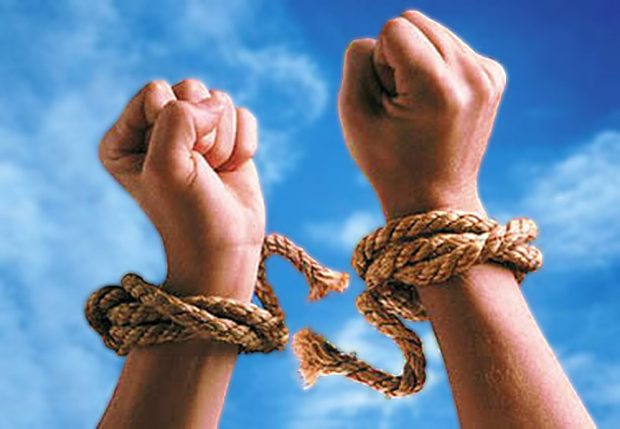
Hebrews 12:1 …let us throw off everything that hinders and the sin that so easily entangles…

Slide 10
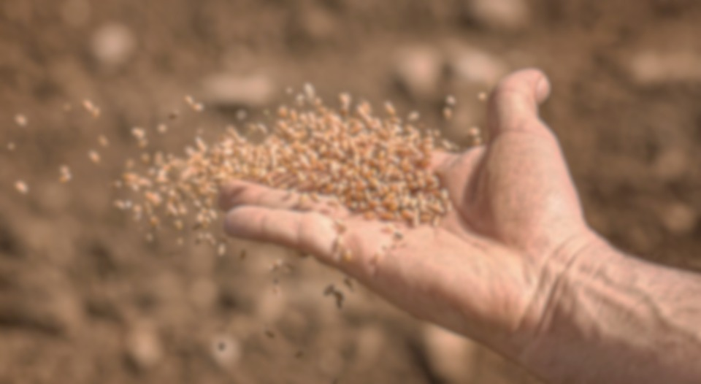
Luke 8:4-8 "A farmer went out to sow his seed. As he was scattering the seed, some fell along the path; it was trampled on, and the birds of the air ate it up. 6 Some fell on rock, and when it came up, the plants withered because they had no moisture. 7 Other seed fell among thorns, which grew up with it and choked the plants. 8 Still other seed fell on good soil. It came up and yielded a crop, a hundred times more than was sown."

Slide 11
Luke 8:11-15 "This is the meaning of the parable: The seed is the word of God. 12 Those along the path are the ones who hear, and then the devil comes and takes away the word from their hearts, so that they may not believe and be saved. 13 Those on the rock are the ones who receive the word with joy when they hear it, but they have no root. They believe for a while, but in the time of testing they fall away. 14 The seed that fell among thorns stands for those who hear, but as they go on their way they are choked by life’s worries, riches and pleasures, and they do not mature. 15 But the seed on good soil stands for those with a noble and good heart, who hear the word, retain it, and by persevering produce a crop.

Slide 12
Hebrews 12:16 See that no one is sexually immoral, or is godless like Esau, who for a single meal sold his inheritance rights as the oldest son.

Slide 13
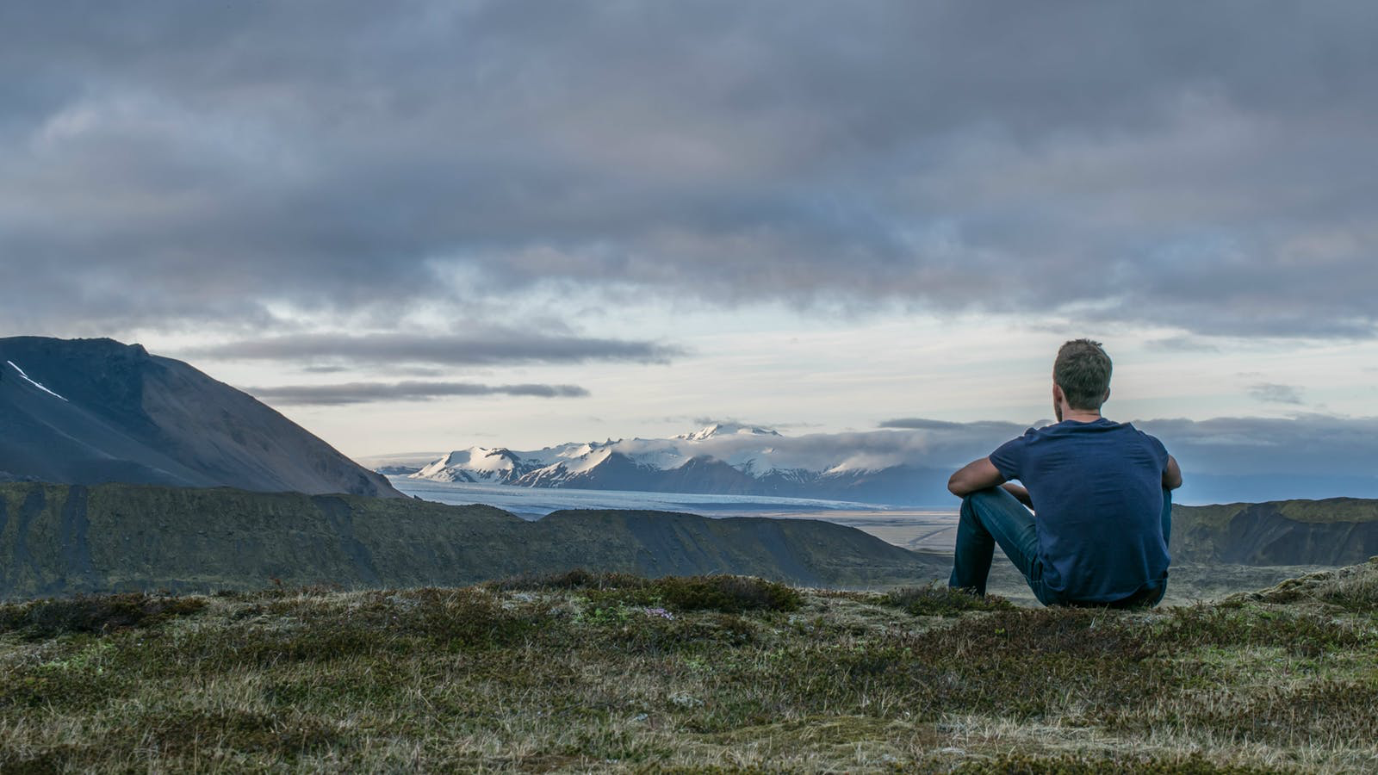
Hebrews 12:17
Afterward, as you know, when he wanted to inherit this blessing, he was rejected. He could bring about no change of mind, though he sought the blessing with tears.

Slide 14
Hebrews 12:2-3 Let us fix our eyes on Jesus, the author and perfecter of our faith, who for the joy set before him endured the cross, scorning its shame, and sat down at the right hand of the throne of God. ³Consider him who endured such opposition from sinful men, so that you will not grow weary and lose heart.

Slide 15
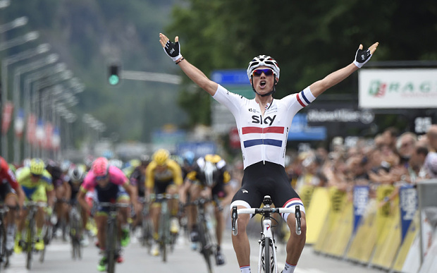
2 Timothy 4:6-8 For I am already being poured out like a drink offering, and the time has come for my departure. 7 I have fought the good fight, I have finished the race, I have kept the faith. 8 Now there is in store for me the crown of righteousness, which the Lord, the righteous Judge, will award to me on that day-and not only to me, but also to all who have longed for his appearing.

Slide 16
James 1:12
Blessed is the man who perseveres under trial, because when he has stood the test, he will receive the crown of life that God has promised to those who love him.

Slide 17
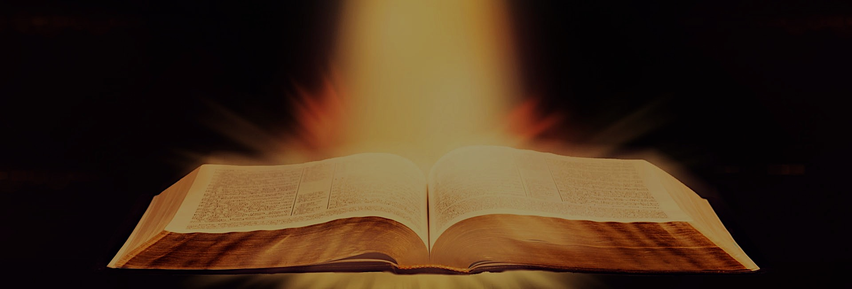
Hebrews 12:5 And you have forgotten that word of encouragement that addresses you as sons:

Slide 18
Romans 5:3-5 we also rejoice in our sufferings, because we know that suffering produces perseverance; ⁴perseverance, character; and character, hope.
⁵And hope does not disappoint us.

