Slide 2
“God Working On Our Behalf”

Slide 3
Psalm 121:1-3 I lift up my eyes to the hills. From where does my help come? ² My help comes from the Lord, who made heaven and earth ³ He will not let your foot be moved; he who keeps you will not slumber.

Slide 4
Isaiah 64:4 From of old no one has heard or perceived by the ear, no eye has seen a God besides you, who acts for those who wait for him.

Slide 5
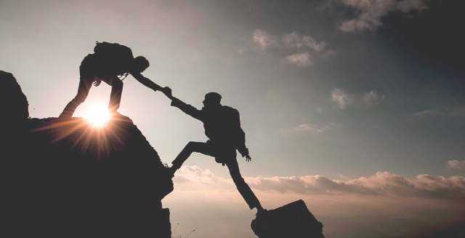
2 Chronicles 16:9 For the eyes of the Lord run to and fro throughout the whole earth, to give strong support to those whose heart is blameless toward him. You have done foolishly in this, for from now on you will have wars.”

Slide 6
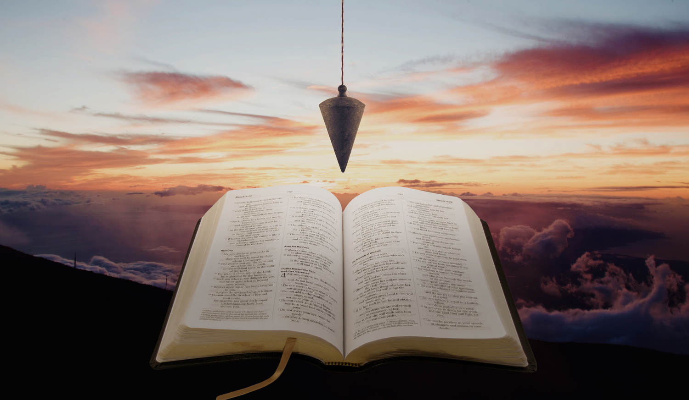
Zechariah 4:10 For whoever has despised the day of small things shall rejoice, and shall see the plumb line in the hand of Zerubbabel.“These seven are the eyes of the Lord, which range through the whole earth.”

Slide 7
Mark 10:45
For even the Son of Man came not to be served but to serve, and to give his life as a ransom for many.”

Slide 8
1 Thessalonians 5:16

Slide 9
Ephesians 5:20 giving thanks always and for everything to God the Father in the name of our Lord Jesus Christ,
Philippians 4:6-7 do not be anxious about anything, but in everything by prayer and supplication with thanksgiving let your requests be made known to God. And the peace of God, which surpasses all understanding, will guard your hearts and your minds in Christ Jesus.

Slide 10
John 12:25 Whoever loves his life loses it, and whoever hates his life in this world will keep it for eternal life.
Matthew 22:39 And a second is like it: You shall love your neighbor as yourself

Slide 12
John 14:27 Peace I leave with you; my peace I give to you. Not as the world gives do I give to you. Let not your hearts be troubled, neither let them be afraid.
Isaiah 40:29 He gives power to the faint, and to him who has no might he increases strength.

Slide 13
Isaiah 12:2 “Behold, God is my salvation;
I will trust, and will not be afraid; for the Lord God is my strength and my song, and he has become my salvation.”
Philippians 4:13 I can do all things through him who strengthens me.

Slide 14
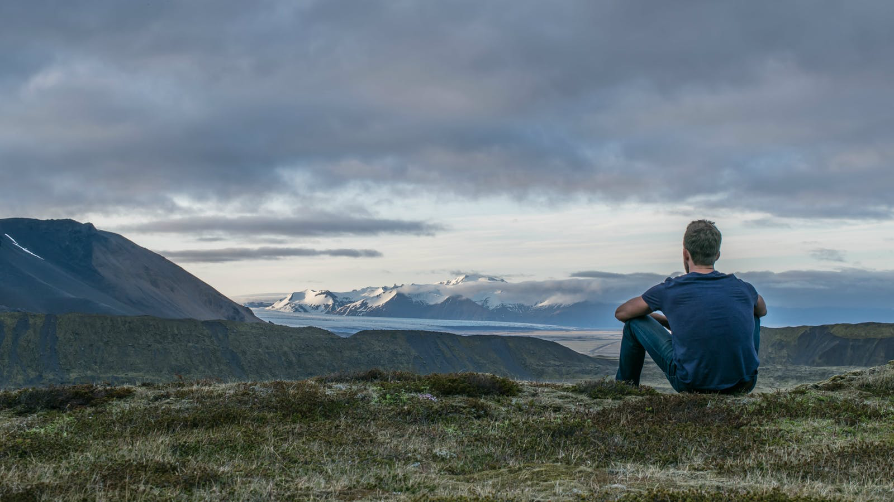
Colossians 1:11 being strengthened with all power, according to his glorious might, for all endurance and patience with joy;

Slide 15
Romans 8:28 And we know that for those who love God all things work together for good, for those who are called according to his purpose.

Slide 16
2 Chronicles 16:9
For the eyes of the Lord run to and fro throughout the whole earth, to give strong support to those whose heart is blameless toward him.

