Slide 2
PENTECOST

Slide 3
Exodus 34:22 “Celebrate the Festival of Weeks with the firstfruits of the wheat harvest, and the Festival of Ingathering at the turn of the year.

Slide 4
Leviticus 23:15-17, 21 “‘From the day after the Sabbath, the day you brought the sheaf of the wave offering, count off seven full weeks. ¹⁶ Count off fifty days up to the day after the seventh Sabbath, and then present an offering of new grain to the Lord.¹⁷ From wherever you live, bring two loaves made of two-tenths of an ephah of the finest flour, baked with yeast, as a wave offering of firstfruits to the Lord.
²¹On that same day you are to proclaim a sacred assembly and do no regular work. This is to be a lasting ordinance for the generations to come, wherever you live.

Slide 5
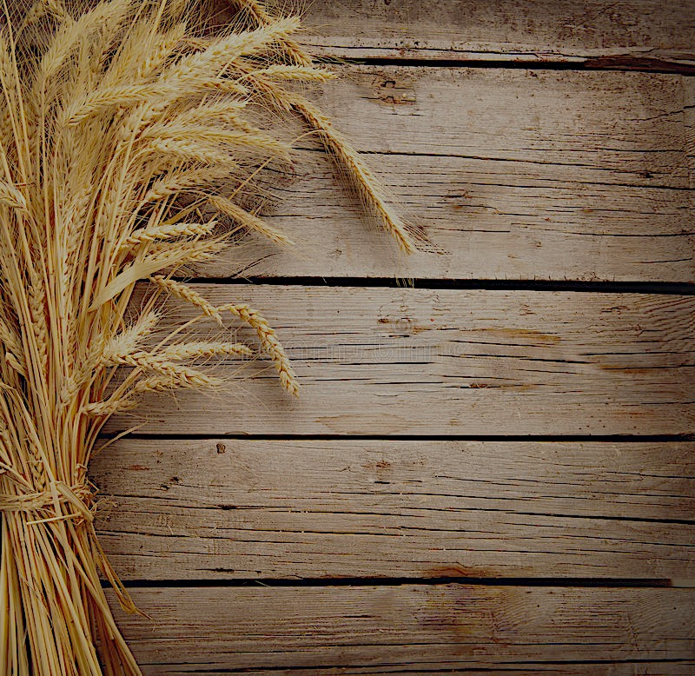
Psalm 67
May God be gracious to us and bless us and make his face shine on us—
² so that your ways may be known on earth, your salvation among all nations.
³ May the peoples praise you, God; may all the peoples praise you.
⁴ May the nations be glad and sing for joy, for you rule the peoples with equity and guide the nations of the earth. ⁵ May the peoples praise you, God; may all the peoples praise you.
⁶ The land yields its harvest; God, our God, blesses us. ⁷ May God bless us still, so that all the ends of the earth will fear him.

Slide 6
Exodus 19:1-8 On the third new moon after the people of Israel had gone out of the land of Egypt, on that day they came into the wilderness of Sinai. ² They set out from Rephidim and came into the wilderness of Sinai, and they encamped in the wilderness. There Israel encamped before the mountain, ³ while Moses went up to God. The Lord called to him out of the mountain, saying, “Thus you shall say to the house of Jacob, and tell the people of Israel: ⁴ ‘You yourselves have seen what I did to the Egyptians, and how I bore you on eagles' wings and brought you to myself. ⁵ Now therefore, if you will indeed obey my voice and keep my covenant, you shall be my treasured possession among all peoples, for all the earth is mine; ⁶ and you shall be to me a kingdom of priests and a holy nation.’ These are the words that you shall speak to the people of Israel.”⁷ So Moses came and called the elders of the people and set before them all these words that the Lord had commanded him. ⁸ All the people answered together and said, “All that the Lord has spoken we will do.” And Moses reported the words of the people to the Lord.

Slide 7
Exodus 24:12 The Lord said to Moses, “Come up to me on the mountain and wait there, that I may give you the tablets of stone, with the law and the commandment, which I have written for their instruction.”

Slide 8
Jeremiah 31:33
For this is the covenant that I will make with the house of Israel after those days, declares the Lord: I will put my law within them, and I will write it on their hearts. And I will be their God, and they shall be my people.

Slide 9
Ezekiel 11:19-20
And I will give them one heart, and a new spirit I will put within them. I will remove the heart of stone from their flesh and give them a heart of flesh, ²⁰ that they may walk in my statutes and keep my rules and obey them. And they shall be my people, and I will be their God.

Slide 10
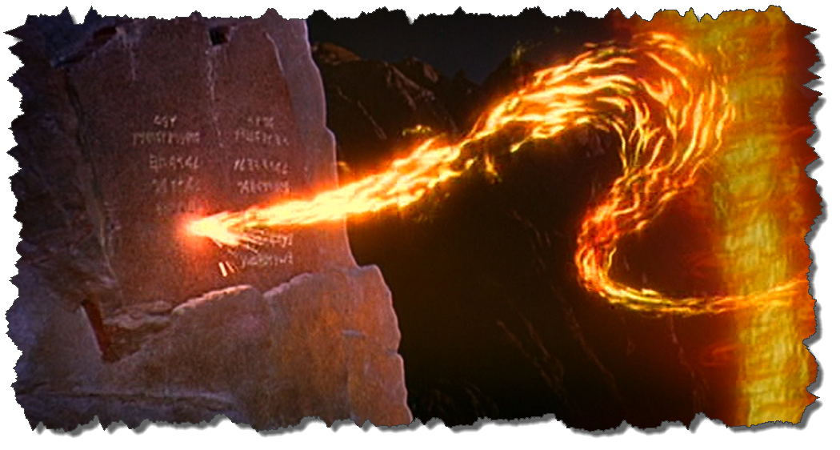
Exodus 31:18 And he gave to Moses, when he had finished speaking with him on Mount Sinai, the two tablets of the testimony, tablets of stone, written with the finger of God.

Slide 11
2 Corinthians 3:3 And you show that you are a letter from Christ delivered by us, written not with ink but with the Spirit of the living God, not on tablets of stone but on tablets of human hearts.
Hebrews 8:10 For this is the covenant that I will make with the house of Israel after those days, declares the Lord: I will put my laws into their minds, and write them on their hearts, and I will be their God, and they shall be my people.

Slide 12
Exodus 32:25-28 And when Moses saw that the people had broken loose for Aaron had let them break loose, to the derision of their enemies, ²⁶ then Moses stood in the gate of the camp and said, “Who is on the Lord's side? Come to me.” And all the sons of Levi gathered around him. ²⁷ And he said to them, “Thus says the Lord God of Israel, ‘Put your sword on your side each of you, and go to and fro from gate to gate throughout the camp, and each of you kill his brother and his companion and his neighbor.’” ²⁸ And the sons of Levi did according to the word of Moses. And that day about three thousand men of the people fell.

Slide 13
Acts 2:38-41
And Peter said to them, “Repent and be baptized every one of you in the name of Jesus Christ for the forgiveness of your sins, and you will receive the gift of the Holy Spirit. ³⁹ For the promise is for you and for your children and for all who are far off, everyone whom the Lord our God calls to himself.” ⁴⁰ And with many other words he bore witness and continued to exhort them, saying, “Save yourselves from this crooked generation.” ⁴¹ So those who received his word were baptized, and there were added that day about three thousand souls.

Slide 14
Romans 7:6 But now we are released from the law, having died to that which held us captive, so that we serve in the new way of the Spirit and not in the old way of the written code.
2 Corinthians 3:6 who has made us sufficient to be ministers of a new covenant, not of the letter but of the Spirit. For the letter kills, but the Spirit gives life.

Slide 15
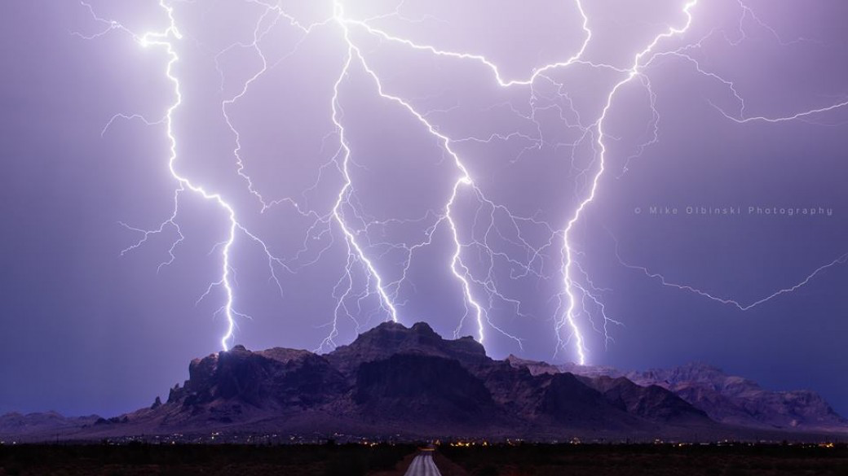
Exodus 20:18-20 Now when all the people saw the thunder and the flashes of lightning and the sound of the trumpet and the mountain smoking, the people were afraid and trembled, and they stood far off ¹⁹ and said to Moses, “You speak to us, and we will listen; but do not let God speak to us, lest we die.” ²⁰ Moses said to the people, “Do not fear, for God has come to test you, that the fear of him may be before you, that you may not sin.”

Slide 16
Acts 2:1-13
When the day of Pentecost arrived, they were all together in one place. ² And suddenly there came from heaven a sound like a mighty rushing wind, and it filled the entire house where they were sitting. ³ And divided tongues as of fire appeared to them and rested on each one of them. ⁴ And they were all filled with the Holy Spirit and began to speak in other tongues as the Spirit gave them utterance. ⁵ Now there were dwelling in Jerusalem Jews, devout men from every nation under heaven. ⁶ And at this sound the multitude came together, and they were bewildered, because each one was hearing them speak in his own language.⁷ And they were amazed and astonished, saying, “Are not all these who are speaking Galileans? ⁸ And how is it that we hear, each of us in his own native language? ⁹ Parthians and Medes and Elamites and residents of Mesopotamia, Judea and Cappadocia, Pontus and Asia, ¹⁰ Phrygia and Pamphylia, Egypt and the parts of Libya belonging to Cyrene, and visitors from Rome, ¹¹ both Jews and proselytes, Cretans and Arabians—we hear them telling in our own tongues the mighty works of God.” ¹² And all were amazed and perplexed, saying to one another, “What does this mean?” ¹³ But others mocking said, “They are filled with new wine.”

Slide 17
Exodus 19:7-8
So Moses came and called the elders of the people and set before them all these words that the Lord had commanded him. ⁸ All the people answered together and said, “All that the Lord has spoken we will do.” And Moses reported the words of the people to the Lord.

Slide 18
Matthew 7:21-23
“Not everyone who says to me, ‘Lord, Lord,’ will enter the kingdom of heaven, but the one who does the will of my Father who is in heaven. ²² On that day many will say to me, ‘Lord, Lord, did we not prophesy in your name, and cast out demons in your name, and do many mighty works in your name?’ ²³ And then will I declare to them, ‘I never knew you; depart from me, you workers of lawlessness.’

