Slide 2
Feast Of
First Fruits

Slide 3
Hebrews 4:12 For the word of God is alive and active. Sharper than any double-edged sword, it penetrates even to dividing soul and spirit, joints and marrow; it judges the thoughts and attitudes of the heart.

Slide 4
Leviticus 23:10-11
“Speak to the people of Israel and say to them, When you come into the land that I give you and reap its harvest, you shall bring the sheaf of the firstfruits of your harvest to the priest, ¹¹ and he shall wave the sheaf before the Lord, so that you may be accepted. On the day after the Sabbath the priest shall wave it.

Slide 5
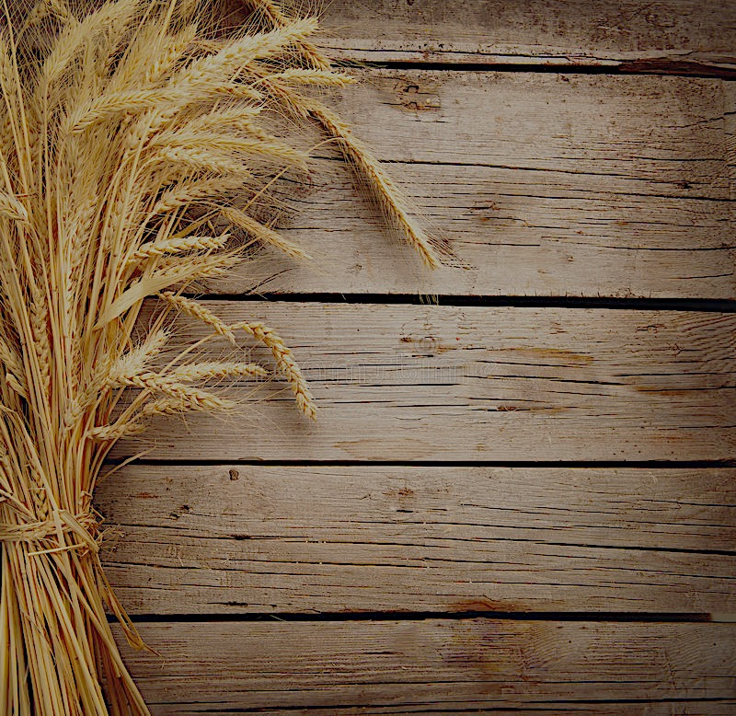
Genesis 37:5-8 Now Joseph had a dream, and when he told it to his brothers they hated him even more. ⁶ He said to them, “Hear this dream that I have dreamed: ⁷ Behold, we were binding sheaves in the field, and behold, my sheaf arose and stood upright. And behold, your sheaves gathered around it and bowed down to my sheaf.” ⁸ His brothers said to him, “Are you indeed to reign over us? Or are you indeed to rule over us?” So they hated him even more for his dreams and for his words.

Slide 6
2 Chronicles 31:5
As soon as the command was spread abroad, the people of Israel gave in abundance the firstfruits of grain, wine, oil, honey, and of all the produce of the field. And they brought in abundantly the tithe of everything

Slide 7
Nehemiah 10:35-39 We obligate ourselves to bring the firstfruits of our ground and the firstfruits of all fruit of every tree, year by year, to the house of the Lord; ³⁶ also to bring to the house of our God, to the priests who minister in the house of our God, the firstborn of our sons and of our cattle, as it is written in the Law, and the firstborn of our herds and of our flocks; ³⁷ and to bring the first of our dough, and our contributions, the fruit of every tree, the wine and the oil, to the priests, to the chambers of the house of our God; and to bring to the Levites the tithes from our ground, for it is the Levites who collect the tithes in all our towns where we labor. ³⁸ And the priest, the son of Aaron, shall be with the Levites when the Levites receive the tithes. And the Levites shall bring up the tithe of the tithes to the house of our God, to the chambers of the storehouse. ³⁹ For the people of Israel and the sons of Levi shall bring the contribution of grain, wine, and oil to the chambers, where the vessels of the sanctuary are, as well as the priests who minister, and the gatekeepers and the singers. We will not neglect the house of our God.”

Slide 9
Jeremiah 2:3
Israel was holy to the Lord, the firstfruits of his harvest. All who ate of it incurred guilt; disaster came upon them, declares the Lord.”

Slide 10
Exodus 13:2 “Consecrate to me all the firstborn. Whatever is the first to open the womb among the people of Israel, both of man and of beast, is mine.”

Slide 11
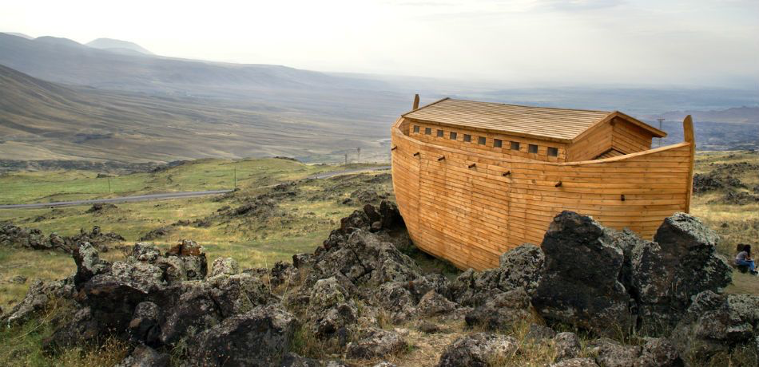
Genesis 8:4
and in the seventh month, on the seventeenth day of the month, the ark came to rest on the mountains of Ararat.

Slide 12
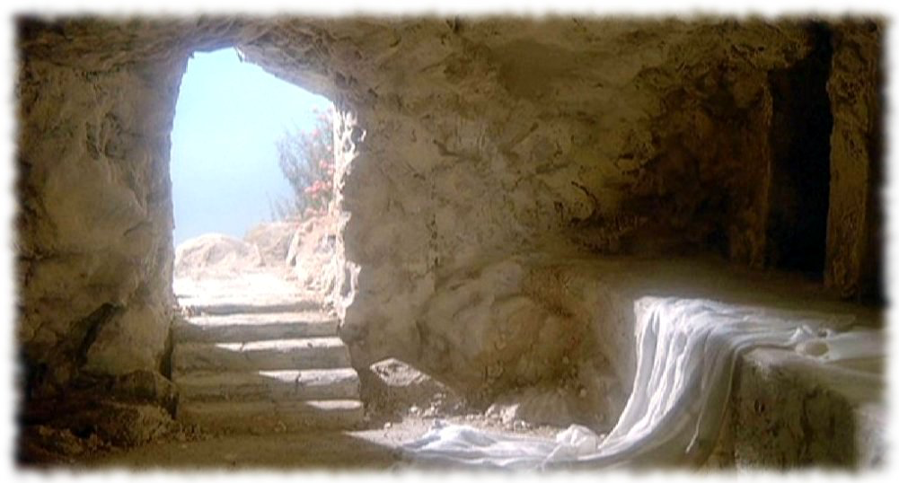
1 Corinthians 15:20-23
But in fact Christ has been raised from the dead, the firstfruits of those who have fallen asleep. ²¹ For as by a man came death, by a man has come also the resurrection of the dead. ²² For as in Adam all die, so also in Christ shall all be made alive. ²³ But each in his own order: Christ the firstfruits, then at his coming those who belong to Christ.

Slide 13
Colossians 2:16-17 Therefore let no one pass judgment on you in questions of food and drink, or with regard to a festival or a new moon or a Sabbath. ¹⁷ These are a shadow of the things to come, but the substance belongs to Christ.

Slide 14
1 Corinthians 15:20 But in fact Christ has been raised from the dead, the firstfruits of those who have fallen asleep.
1 Corinthians 15:22-23 For as in Adam all die, so also in Christ shall all be made alive. ²³ But each in his own order: Christ the firstfruits, then at his coming those who belong to Christ.
Colossians 1:18 And he is the head of the body, the church. He is the beginning, the firstborn from the dead, that in everything he might be preeminent.

Slide 15
John 14:19
Yet a little while and the world will see me no more, but you will see me. Because I live, you also will live.

Slide 16
Matthew 13:36-43
Then he left the crowds and went into the house. And his disciples came to him, saying, “Explain to us the parable of the weeds of the field.” ³⁷He answered, “The one who sows the good seed is the Son of Man. ³⁸The field is the world, and the good seed is the sons of the kingdom. The weeds are the sons of the evil one, ³⁹ and the enemy who sowed them is the devil. The harvest is the end of the age, and the reapers are angels. ⁴⁰Just as the weeds are gathered and burned with fire, so will it be at the end of the age. ⁴¹ The Son of Man will send his angels, and they will gather out of his kingdom all causes of sin and all law-breakers,⁴² and throw them into the fiery furnace. In that place there will be weeping and gnashing of teeth. ⁴³ Then the righteous will shine like the sun in the kingdom of their Father. He who has ears, let him hear.

Slide 17
John 11:25-26
Jesus said to her, “I am the resurrection and the life. Whoever believes in me, though he die, yet shall he live, ²⁶ and everyone who lives and believes in me shall never die. Do you believe this?”

