Slide 2
Jesus Christ
Fulfillment of Passover

Slide 3
Exodus 3:8 and I have come down to deliver them out of the hand of the Egyptians and to bring them up out of that land to a good and broad land, a land flowing with milk and honey, to the place of the Canaanites, the Hittites, the Amorites, the Perizzites, the Hivites, and the Jebusites.

Slide 4
Exodus 3:18 And they will listen to your voice, and you and the elders of Israel shall go to the king of Egypt and say to him, ‘The Lord, the God of the Hebrews, has met with us; and now, please let us go a three days' journey into the wilderness, that we may sacrifice to the Lord our God.’

Slide 5
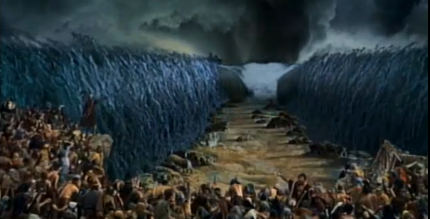
Exodus 14:13 And Moses said to the people, “Fear not, stand firm, and see the salvation of the Lord, which he will work for you today. For the Egyptians whom you see today, you shall never see again.

Slide 7
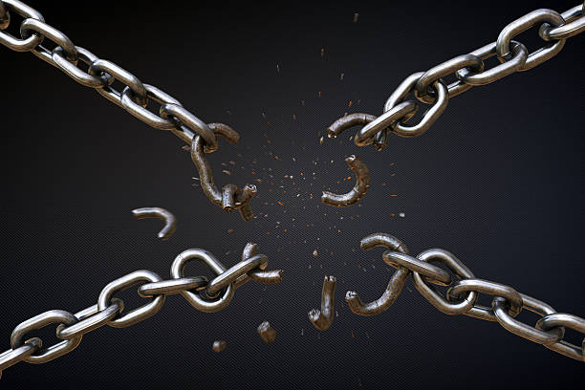
Hebrews 2:14-15 Since the children have flesh and blood, he too shared in their humanity so that by his death he might break the power of him who holds the power of death—that is, the devil—¹⁵ and free those who all their lives were held in slavery by their fear of death.

Slide 8
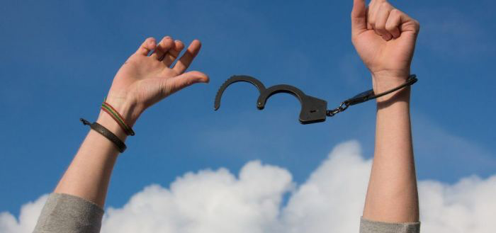
Romans 6:17-18 But thanks be to God that, though you used to be slaves to sin, you have come to obey from your heart the pattern of teaching that has now claimed your allegiance. ¹⁸ You have been set free from sin and have become slaves to righteousness.

Slide 9
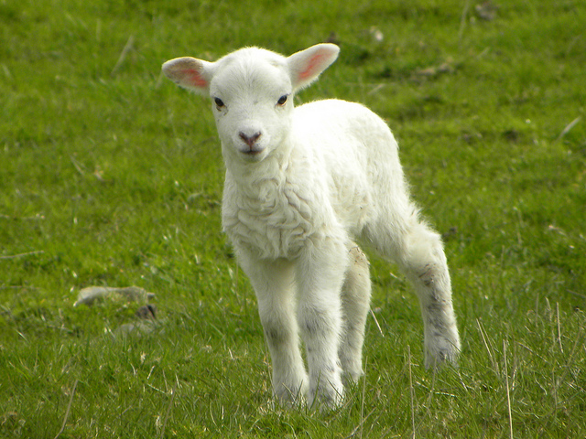
Exodus 12:3
Tell the whole community of Israel that on the tenth day of this month each man is to take a lamb for his family, one for each household.
John 1:29
The next day John saw Jesus coming toward him and said, “Look, the Lamb of God, who takes away the sin of the world!

Slide 10
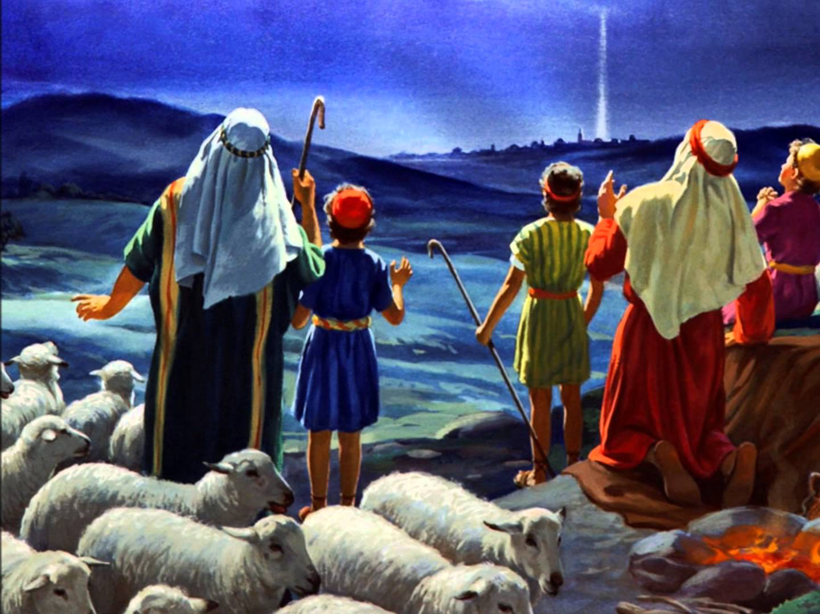
Luke 2:8
And there were shepherds living out in the fields nearby, keeping watch over their flocks at night

Slide 11
Exodus 12:5 -6
The animals you choose must be year-old males without defect, and you may take them from the sheep or the goats. ⁶ Take care of them until the fourteenth day of the month, when all the members of the community of Israel must slaughter them at twilight.

Slide 12
Matthew 27:19 While Pilate was sitting on the judge’s seat, his wife sent him this message: “Don’t have anything to do with that innocent man, for I have suffered a great deal today in a dream because of him.”
Matthew 27:24 When Pilate saw that he was getting nowhere, but that instead an uproar was starting, he took water and washed his hands in front of the crowd. “I am innocent of this man’s blood,” he said. “It is your responsibility!”

Slide 13
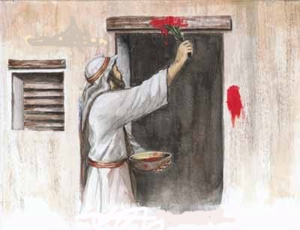
Exodus 12:7 “Then they shall take some of the blood and put it on the two doorposts and the lintel of the houses in which they eat it.

Slide 14
Ephesians 2:19
Consequently, you are no longer foreigners and strangers, but fellow citizens with God’s people and also members of his household,
Hebrews 3:6
But Christ is faithful as the Son over God’s house. And we are his house, if indeed we hold firmly to our confidence and the hope in which we glory.

Slide 15
John 10:7
So Jesus again said to them, “Truly, truly, I say to you, I am the door of the sheep.

Slide 16
Exodus 12:14 “This is a day you are to commemorate; for the generations to come you shall celebrate it as a festival to the Lord—a lasting ordinance.
Luke 22:13-15,19 They left and found things just as Jesus had told them. So they prepared the Passover. ¹⁴ When the hour came, Jesus and his apostles reclined at the table. ¹⁵ And he said to them, “I have eagerly desired to eat this Passover with you before I suffer……
…. ¹⁹ And he took bread, gave thanks and broke it, and gave it to them, saying, “This is my body given for you; do this in remembrance of me.”

Slide 17
Exodus 12:43-46 And the Lord said to Moses and Aaron, “This is the statute of the Passover: no foreigner shall eat of it, ⁴⁴ but every slave that is bought for money may eat of it after you have circumcised him. ⁴⁵ No foreigner or hired worker may eat of it. ⁴⁶ It shall be eaten in one house; you shall not take any of the flesh outside the house, and you shall not break any of its bones.
John 19:33 But when they came to Jesus and saw that he was already dead, they did not break his legs.

Slide 18
Malachi 3:16-18
Then those who feared the Lord talked with each other, and the Lord listened and heard. A scroll of remembrance was written in his presence concerning those who feared the Lord and honored his name.¹⁷ “On the day when I act,” says the Lord Almighty, “they will be my treasured possession. I will spare them, just as a father has compassion and spares his son who serves him. ¹⁸ And you will again see the distinction between the righteous and the wicked, between those who serve God and those who do not.

Slide 19
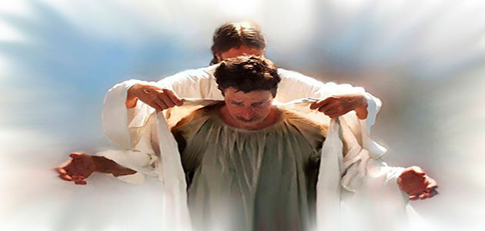
Revelation 3:5 The one who conquers will be clothed thus in white garments, and I will never blot his name out of the book of life. I will confess his name before my Father and before his angels.

Slide 20
Exodus 13:3 Then Moses said to the people, “Remember this day in which you came out from Egypt, out of the house of slavery, for by a strong hand the Lord brought you out from this place. No leavened bread shall be eaten.
Deuteronomy 7:17-19 “If you say in your heart, ‘These nations are greater than I. How can I dispossess them?’ ¹⁸ you shall not be afraid of them but you shall remember what the Lord your God did to Pharaoh and to all Egypt, ¹⁹ the great trials that your eyes saw, the signs, the wonders, the mighty hand, and the outstretched arm, by which the Lord your God brought you out. So will the Lord your God do to all the peoples of whom you are afraid.

Slide 21
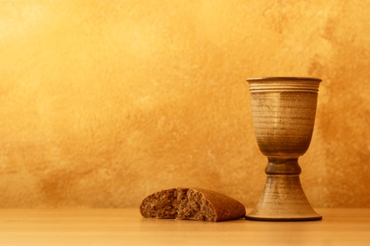
1 Corinthians 11:25-26 In the same manner He also took the cup after supper, saying, “This cup is the new covenant in My blood. This do, as often as you drink it, in remembrance of Me.”²⁶ For as often as you eat this bread and drink this cup, you proclaim the Lord’s death till He comes.

Slide 22
For I do not want you to be ignorant of the fact, brothers and sisters, that our ancestors were all under the cloud and that they all passed through the sea. ² They were all baptized into Moses in the cloud and in the sea. ³ They all ate the same spiritual food ⁴ and drank the same spiritual drink; for they drank from the spiritual rock that accompanied them, and that rock was Christ. ⁵ Nevertheless, God was not pleased with most of them; their bodies were scattered in the wilderness.⁶ Now these things occurred as examples to keep us from setting our hearts on evil things as they did. ⁷ Do not be idolaters, as some of them were; as it is written: “The people sat down to eat and drink and got up to indulge in revelry.” ⁸ We should not commit sexual immorality, as some of them did—and in one day twenty-three thousand of them died. ⁹ We should not test Christ, as some of them did—and were killed by snakes. ¹⁰ And do not grumble, as some of them did—and were killed by the destroying angel.¹¹ These things happened to them as examples and were written down as warnings for us, on whom the culmination of the ages has come. ¹² So, if you think you are standing firm, be careful that you don’t fall! 1 Corinthians 10:1-12

Slide 23
Hebrews 3:12-19
See to it, brothers and sisters, that none of you has a sinful, unbelieving heart that turns away from the living God. ¹³ But encourage one another daily, as long as it is called “Today,” so that none of you may be hardened by sin’s deceitfulness. ¹⁴ We have come to share in Christ, if indeed we hold our original conviction firmly to the very end. ¹⁵ As has just been said: “Today, if you hear his voice, do not harden your hearts as you did in the rebellion.”¹⁶ Who were they who heard and rebelled? Were they not all those Moses led out of Egypt? ¹⁷ And with whom was he angry for forty years? Was it not with those who sinned, whose bodies perished in the wilderness? ¹⁸ And to whom did God swear that they would never enter his rest if not to those who disobeyed? ¹⁹ So we see that they were not able to enter, because of their unbelief.

