Slide 2
The Triumphal Entry of the Heavenly Warrior

Slide 3
Mark 11:1-6 As they approached Jerusalem and came to Bethphage and Bethany at the Mount of Olives, Jesus sent two of his disciples, ² saying to them, “Go to the village ahead of you, and just as you enter it, you will find a colt tied there, which no one has ever ridden. Untie it and bring it here. ³ If anyone asks you, ‘Why are you doing this?’ say, ‘The Lord needs it and will send it back here shortly.’”⁴ They went and found a colt outside in the street, tied at a doorway. As they untied it, ⁵ some people standing there asked, “What are you doing, untying that colt?” ⁶ They answered as Jesus had told them to, and the people let them go.

Slide 4
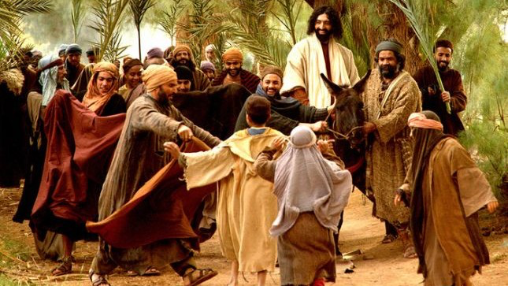
Zechariah 9:9
Rejoice greatly, Daughter Zion! Shout, Daughter Jerusalem! See, your king comes to you, righteous and victorious, lowly and riding on a donkey, on a colt, the foal of a donkey.

Slide 5
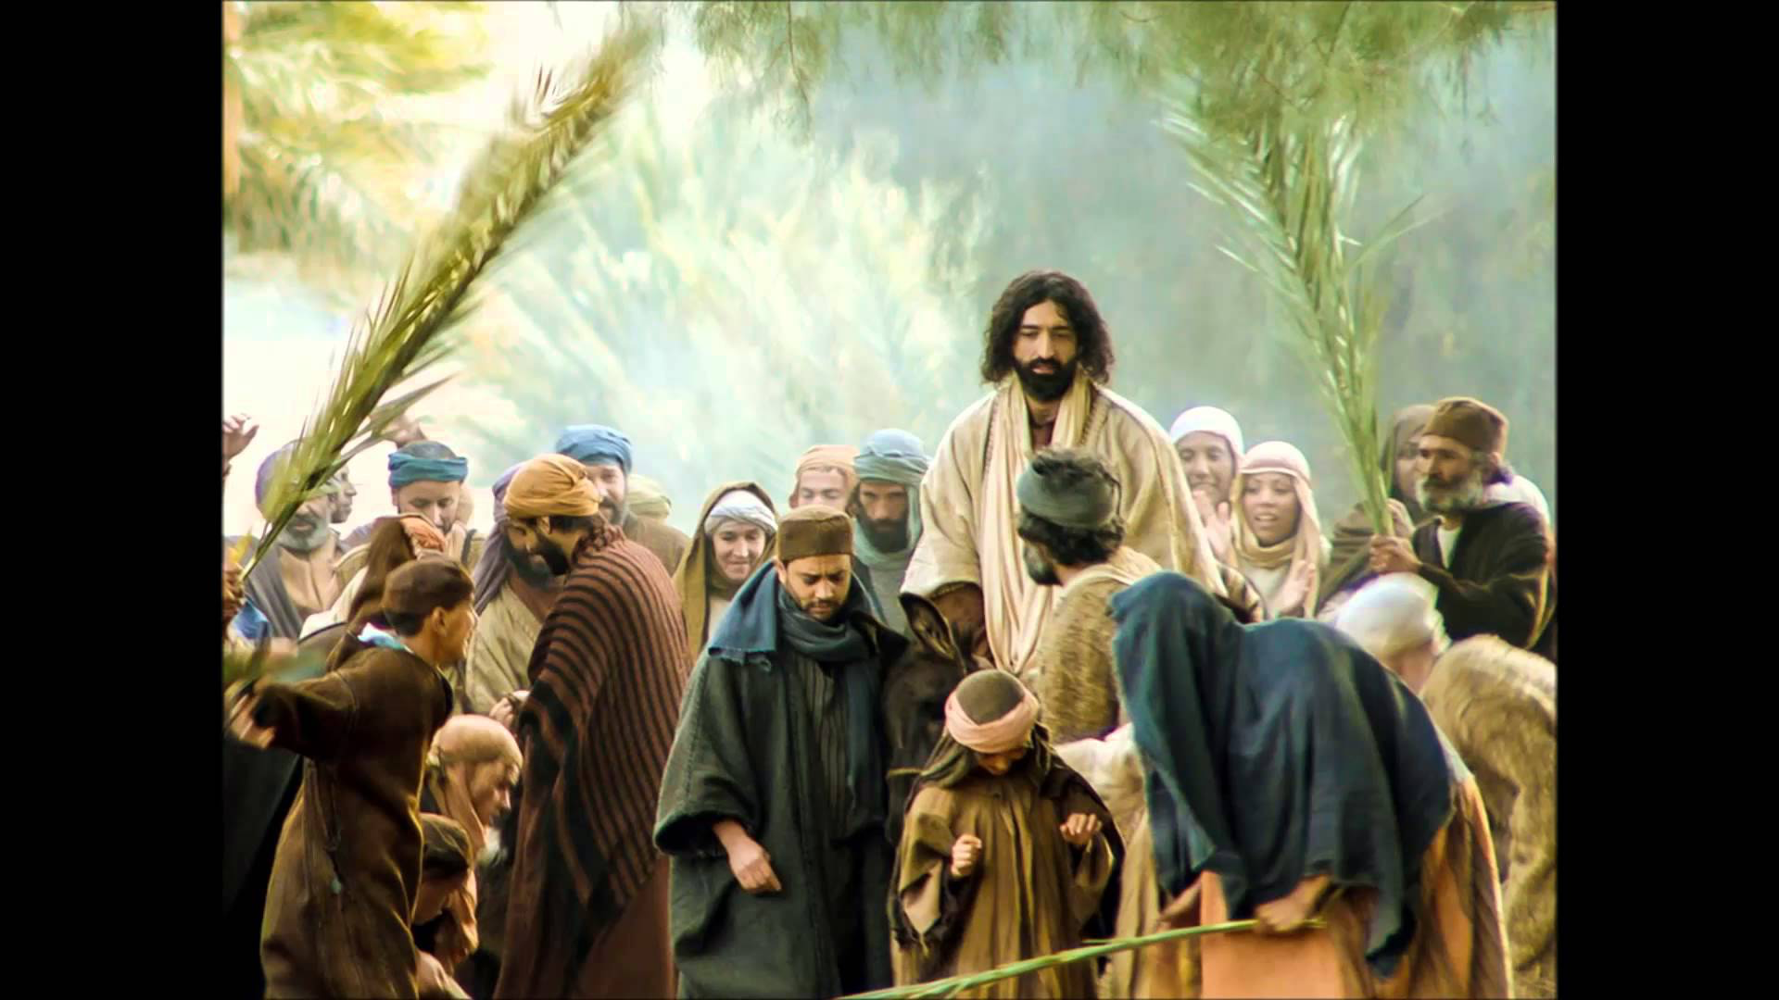
Mark 11:7-11 When they brought the colt to Jesus and threw their cloaks over it, he sat on it. ⁸ Many people spread their cloaks on the road, while others spread branches they had cut in the fields. ⁹ Those who went ahead and those who followed shouted, “Hosanna!” “Blessed is he who comes in the name of the Lord!” ¹⁰“Blessed is the coming kingdom of our father David!” “Hosanna in the highest heaven!” ¹¹Jesus entered Jerusalem and went into the temple courts. He looked around at everything, but since it was already late, he went out to Bethany with the Twelve.

Slide 6
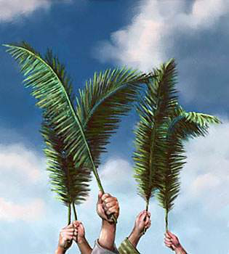
Leviticus 23:40
On the first day you are to take branches from luxuriant trees—from palms, willows and other leafy trees—and rejoice before the Lord your God for seven days.

Slide 7
After this I looked, and there before me was a great multitude that no one could count, from every nation, tribe, people and language, standing before the throne and before the Lamb. They were wearing white robes and were holding palm branches in their hands.

Slide 8
Psalm 118:26 Blessed is he who comes in the name of the Lord. From the house of the Lord we bless you.

Slide 9
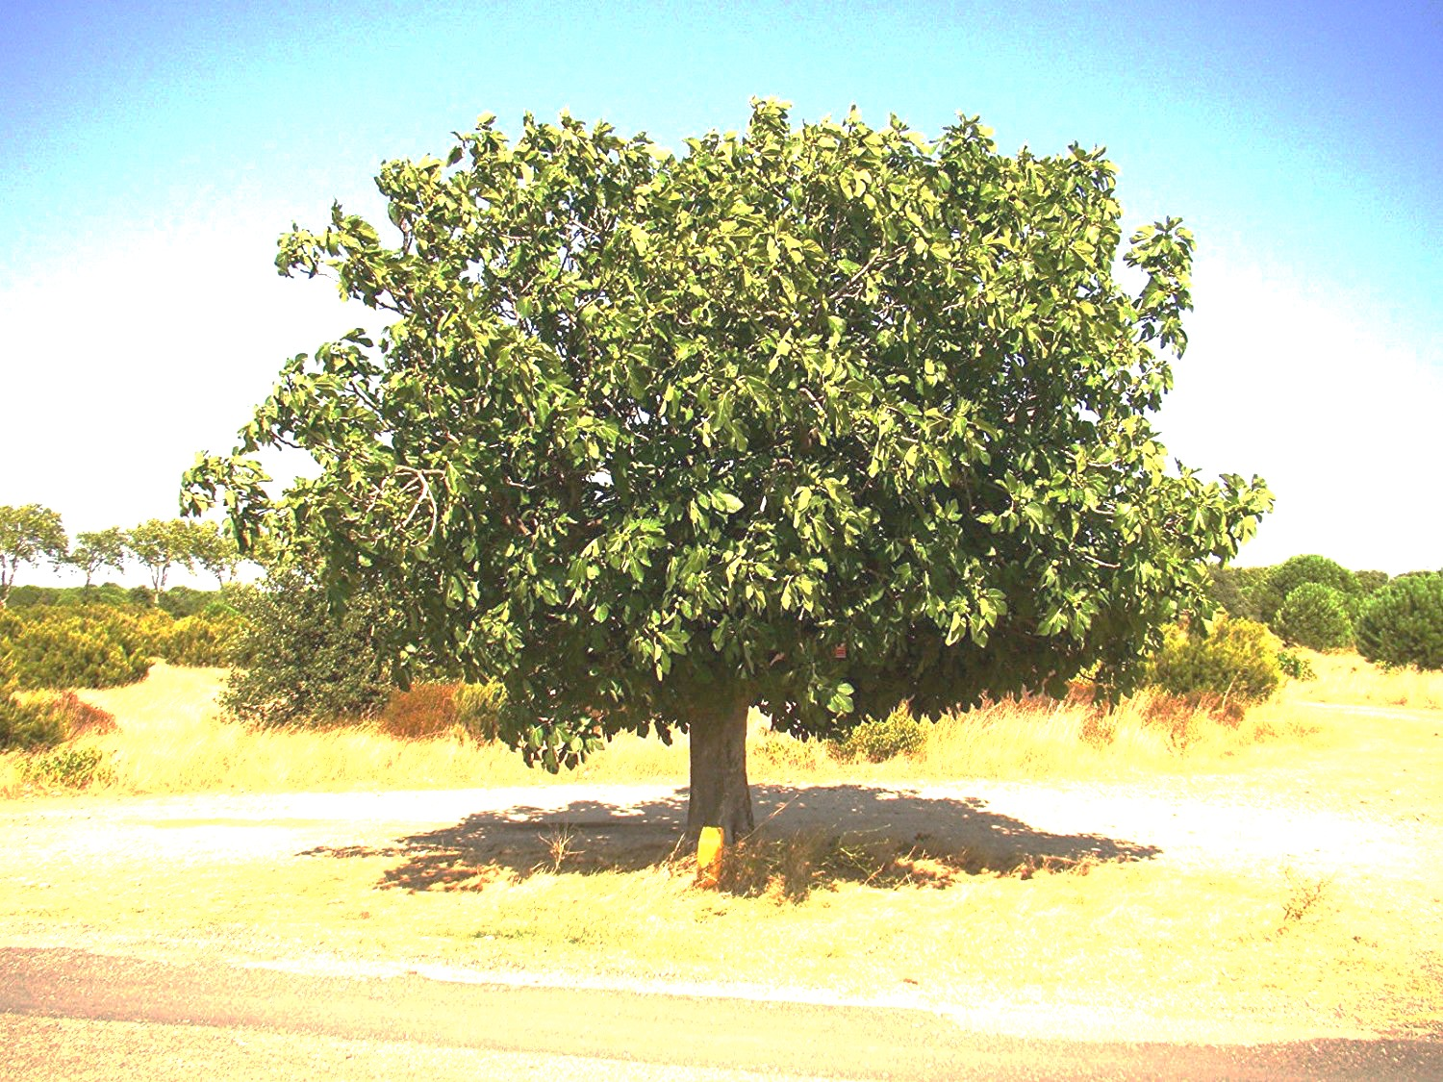
Mark 11:12-14
The next day as they were leaving Bethany, Jesus was hungry. ¹³ Seeing in the distance a fig tree in leaf, he went to find out if it had any fruit. When he reached it, he found nothing but leaves, because it was not the season for figs.¹⁴ Then he said to the tree, “May no one ever eat fruit from you again.” And his disciples heard him say it.

Slide 10
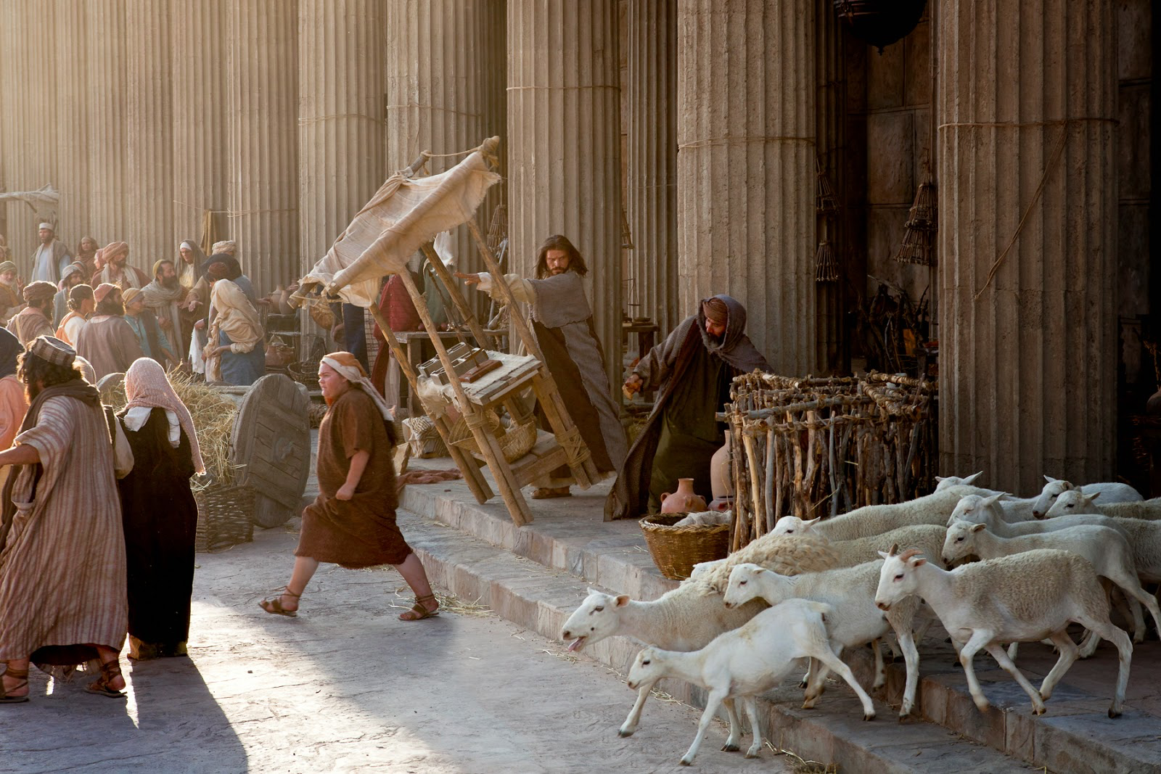
Mark 11:15-18 On reaching Jerusalem, Jesus entered the temple courts and began driving out those who were buying and selling there. He overturned the tables of the money changers and the benches of those selling doves, ¹⁶ and would not allow anyone to carry merchandise through the temple courts. ¹⁷ And as he taught them, he said, “Is it not written: ‘My house will be called a house of prayer for all nations’? But you have made it ‘a den of robbers.”¹⁸ The chief priests and the teachers of the law heard this and began looking for a way to kill him, for they feared him, because the whole crowd was amazed at his teaching.

Slide 11
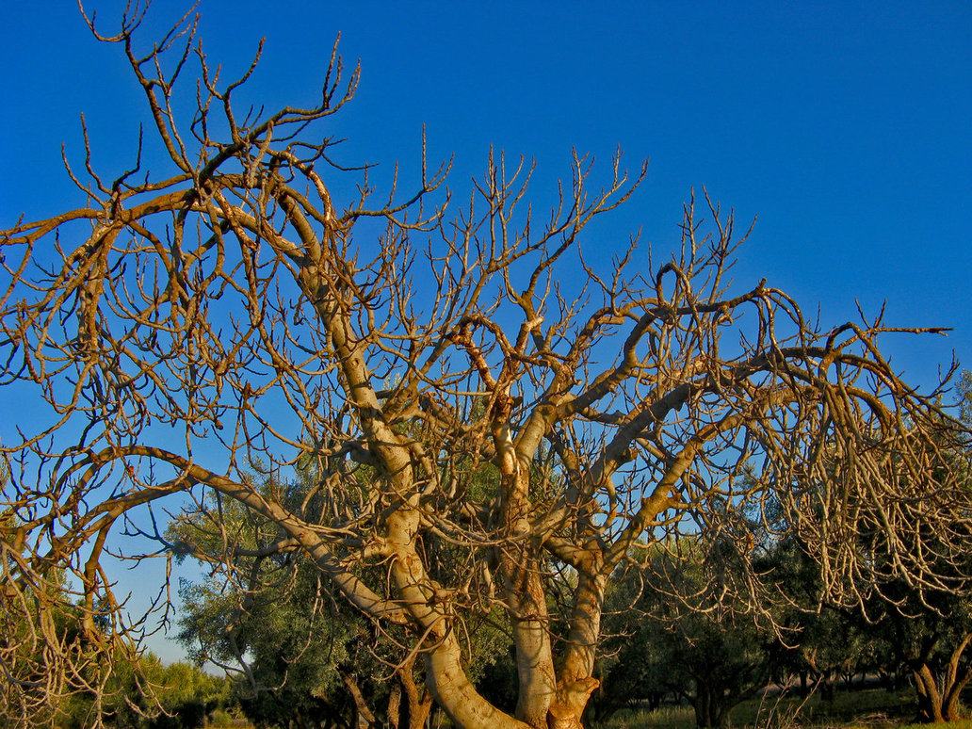
Mark 11:19-22 When evening came, Jesus and his disciples went out of the city.²⁰ In the morning, as they went along, they saw the fig tree withered from the roots. ²¹ Peter remembered and said to Jesus, “Rabbi, look! The fig tree you cursed has withered!” ²² “Have faith in God,” Jesus answered

Slide 12
Zechariah 9:9-13
Rejoice greatly, Daughter Zion! Shout, Daughter Jerusalem! See, your king comes to you, righteous and victorious, lowly and riding on a donkey, on a colt, the foal of a donkey. ¹⁰ I will take away the chariots from Ephraim and the warhorses from Jerusalem, and the battle bow will be broken. He will proclaim peace to the nations. His rule will extend from sea to sea and from the River to the ends of the earth. ¹¹ As for you, because of the blood of my covenant with you, I will free your prisoners from the waterless pit. ¹² Return to your fortress, you prisoners of hope; even now I announce that I will restore twice as much to you. ¹³ I will bend Judah as I bend my bow and fill it with Ephraim. I will rouse your sons, Zion, against your sons, Greece, and make you like a warrior’s sword.

Slide 13
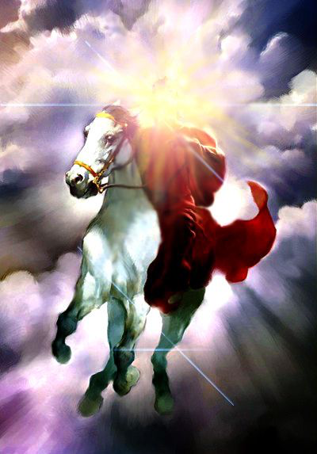
Revelation 19:11-16 I saw heaven standing open and there before me was a white horse, whose rider is called Faithful and True. With justice he judges and wages war. ¹² His eyes are like blazing fire, and on his head are many crowns. He has a name written on him that no one knows but he himself. ¹³ He is dressed in a robe dipped in blood, and his name is the Word of God. ¹⁴ The armies of heaven were following him, riding on white horses and dressed in fine linen, white and clean.¹⁵ Coming out of his mouth is a sharp sword with which to strike down the nations. “He will rule them with an iron scepter.” He treads the winepress of the fury of the wrath of God Almighty. ¹⁶ On his robe and on his thigh he has this name written: King of Kings and Lord of Lords.

Slide 14
Isaiah 63:1-3
Who is this coming from Edom, from Bozrah, with his garments stained crimson? Who is this, robed in splendor, striding forward in the greatness of his strength? “It is I, proclaiming victory, mighty to save.” ² Why are your garments red, like those of one treading the winepress? ³“I have trodden the winepress alone; from the nations no one was with me. I trampled them in my anger and trod them down in my wrath; their blood spattered my garments, and I stained all my clothing.

Slide 15
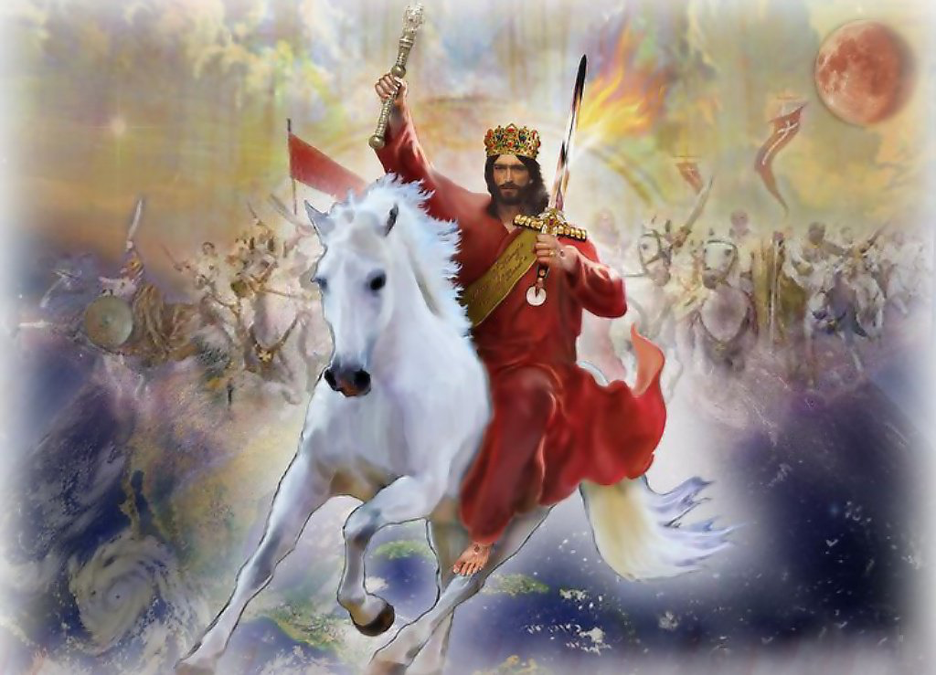
Revelation 17:14
They will wage war against the Lamb, but the Lamb will triumph over them because he is Lord of lords and King of kings—and with him will be his called, chosen and faithful followers.”

Slide 16
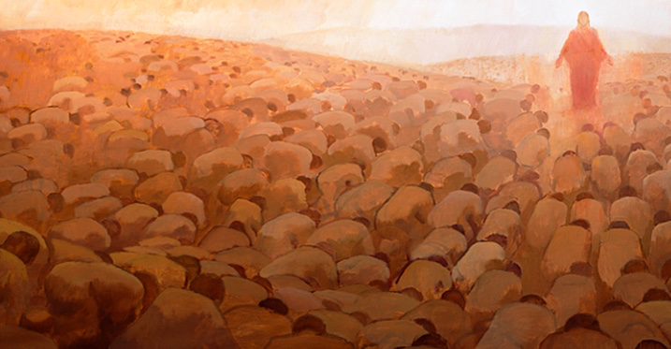
Philippians 2:9-11 Therefore God exalted him to the highest place and gave him the name that is above every name,¹⁰ that at the name of Jesus every knee should bow, in heaven and on earth and under the earth,¹¹ and every tongue acknowledge that Jesus Christ is Lord, to the glory of God the Father.

Slide 17
Luke 19:39-42
Some of the Pharisees in the crowd said to Jesus, “Teacher, rebuke your disciples!”⁴⁰ “I tell you,” he replied, “if they keep quiet, the stones will cry out.” ⁴¹ As he approached Jerusalem and saw the city, he wept over it ⁴² and said, “If you, even you, had only known on this day what would bring you peace—but now it is hidden from your eyes.

Slide 18
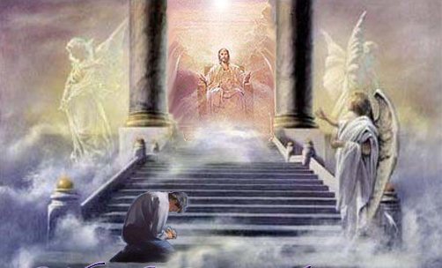
2 Corinthians 5:9-10 So we make it our goal to please him, whether we are at home in the body or away from it. ¹⁰ For we must all appear before the judgment seat of Christ, so that each of us may receive what is due us for the things done while in the body, whether good or bad.

