Slide 2
“The Power of the
Holy Spirit”
(Part 6)
(Gifts)

Slide 3
1 Corinthians 12:8-10
To one there is given through the Spirit a message of wisdom, to another a message of knowledge by means of the same Spirit, ⁹ to another faith by the same Spirit, to another gifts of healing by that one Spirit,¹⁰ to another miraculous powers, to another prophecy, to another distinguishing between spirits, to another speaking in different kinds of tongues, and to still another the interpretation of tongues.

Slide 4
Ephesians 4:7-8
But to each one of us grace has been given as Christ apportioned it. ⁸ This is why it says: “When he ascended on high, he took many captives and gave gifts to his people.” …..¹¹ So Christ himself gave the apostles, the prophets, the evangelists, the pastors and teachers, ¹² to equip his people for works of service, so that the body of Christ may be built up ¹³ until we all reach unity in the faith and in the knowledge of the Son of God and become mature, attaining to the whole measure of the fullness of Christ.

Slide 5
Romans 12:4-8 For just as each of us has one body with many members, and these members do not all have the same function, ⁵ so in Christ we, though many, form one body, and each member belongs to all the others. ⁶ We have different gifts, according to the grace given to each of us. If your gift is prophesying, then prophesy in accordance with your faith; ⁷ if it is serving, then serve; if it is teaching, then teach; ⁸ if it is to encourage, then give encouragement; if it is giving, then give generously; if it is to lead, do it diligently; if it is to show mercy, do it cheerfully.

Slide 6
2 Peter 1:3 His divine power has given us everything we need for a godly life through our knowledge of him who called us by his own glory and goodness.

Slide 7
Psalm 111:10
The fear of the Lord is the beginning of wisdom; all who follow his precepts have good understanding. To him belongs eternal praise.

Slide 8
1 Kings 3:12
“I will do what you have asked. I will give you a wise and discerning heart, so that there will never have been anyone like you, nor will there ever be.”

Slide 9
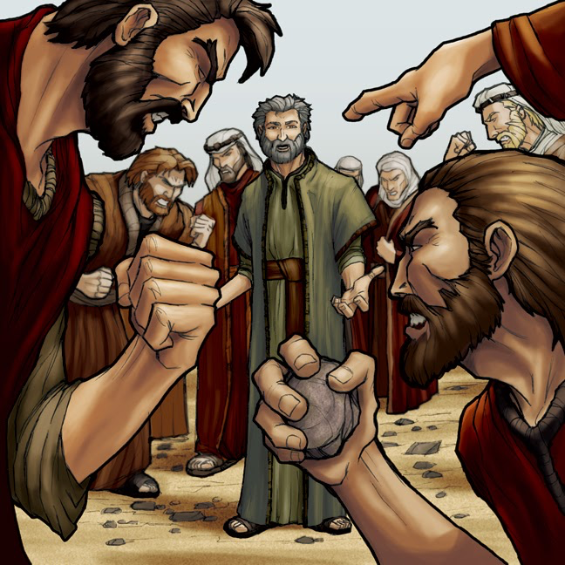
Acts 6:8-10
Now Stephen, a man full of God’s grace and power, performed great wonders and signs among the people. ⁹ Opposition arose, however, from members of the Synagogue of the Freedmen (as it was called)—Jews of Cyrene and Alexandria as well as the provinces of Cilicia and Asia—who began to argue with Stephen. ¹⁰ But they could not stand up against the wisdom the Spirit gave him as he spoke.

Slide 10
Romans 15:14
I myself am satisfied about you, my brothers, that you yourselves are full of goodness, filled with all knowledge and able to instruct one another.

Slide 11
Acts 27:21-26 Since they had been without food for a long time, Paul stood up among them and said, “Men, you should have listened to me and not have set sail from Crete and incurred this injury and loss. ²² Yet now I urge you to take heart, for there will be no loss of life among you, but only of the ship. ²³ For this very night there stood before me an angel of the God to whom I belong and whom I worship, ²⁴ and he said, ‘Do not be afraid, Paul; you must stand before Caesar. And behold, God has granted you all those who sail with you.’ ²⁵ So take heart, men, for I have faith in God that it will be exactly as I have been told. ²⁶ But we must run aground on some island.”

Slide 12
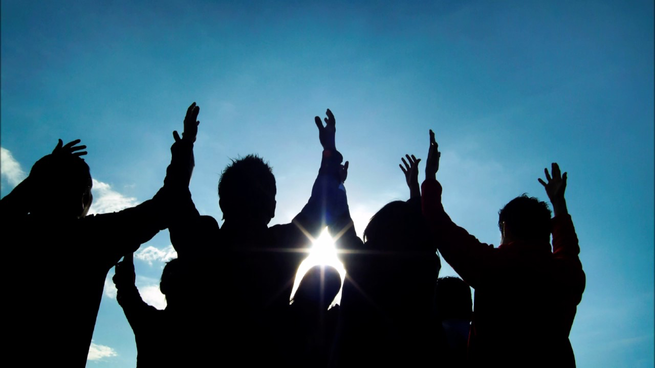
Acts 14:3 So they remained for a long time, speaking boldly for the Lord, who bore witness to the word of his grace, granting signs and wonders to be done by their hands.

Slide 13
2 Peter 1:19-21 And we have the prophetic word more fully confirmed, to which you will do well to pay attention as to a lamp shining in a dark place, until the day dawns and the morning star rises in your hearts, ²⁰ knowing this first of all, that no prophecy of Scripture comes from someone's own interpretation. ²¹ For no prophecy was ever produced by the will of man, but men spoke from God as they were carried along by the Holy Spirit.

Slide 14
Ephesians 4:11-13 So Christ himself gave the apostles, the prophets, the evangelists, the pastors and teachers, ¹² to equip his people for works of service, so that the body of Christ may be built up ¹³ until we all reach unity in the faith and in the knowledge of the Son of God and become mature, attaining to the whole measure of the fullness of Christ.

Slide 15
John 20: 19-22 On the evening of that day, the first day of the week, the doors being locked where the disciples were for fear of the Jews, Jesus came and stood among them and said to them, “Peace be with you.” ²⁰ When he had said this, he showed them his hands and his side. Then the disciples were glad when they saw the Lord. ²¹ Jesus said to them again, “Peace be with you. As the Father has sent me, even so I am sending you.” ²² And when he had said this, he breathed on them and said to them, “Receive the Holy Spirit.

Slide 16
Acts 1:4-9
And while staying with them he ordered them not to depart from Jerusalem, but to wait for the promise of the Father, which, he said, “you heard from me; ⁵ for John baptized with water, but you will be baptized with the Holy Spirit not many days from now.”⁶ So when they had come together, they asked him, “Lord, will you at this time restore the kingdom to Israel?” ⁷ He said to them, “It is not for you to know times or seasons that the Father has fixed by his own authority. ⁸ But you will receive power when the Holy Spirit has come upon you, and you will be my witnesses in Jerusalem and in all Judea and Samaria, and to the end of the earth.” ⁹ And when he had said these things, as they were looking on, he was lifted up, and a cloud took him out of their sight.

Slide 17
Hebrews 4:12 For the word of God is alive and active. Sharper than any double-edged sword, it penetrates even to dividing soul and spirit, joints and marrow; it judges the thoughts and attitudes of the heart.

Slide 18
1 Peter 1:22-23 Having purified your souls by your obedience to the truth for a sincere brotherly love, love one another earnestly from a pure heart, ²³ since you have been born again, not of perishable seed but of imperishable, through the living and abiding word of God;
Isaiah 55:11 so shall my word be that goes out from my mouth; it shall not return to me empty, but it shall accomplish that which I purpose, and shall succeed in the thing for which I sent it.

Slide 19
1 Thessalonians 5:19-22
Do not quench the Spirit. ²⁰ Do not despise prophecies,
²¹ but test everything; hold fast what is good. ²² Abstain from every form of evil.

Slide 20
1 Corinthians 12:31 But earnestly desire the higher gifts. And I will show you a still more excellent way.
1 Corinthians 14:1 Pursue love, and earnestly desire the spiritual gifts, especially that you may prophesy.
1 Corinthians 14:39 So, my brothers, earnestly desire to prophesy, and do not forbid speaking in tongues.

