Slide 2
Hebrews 4:12 For the word of God is alive and active. Sharper than any double-edged sword, it penetrates even to dividing soul and spirit, joints and marrow; it judges the thoughts and attitudes of the heart.

Slide 3
“The Power of the
Holy Spirit”
(Part 5)
(Gifts)

Slide 4
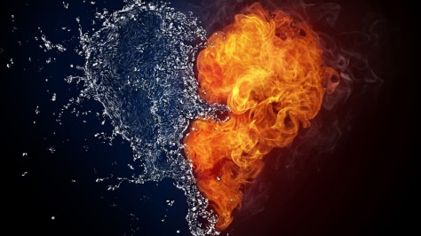
1 Thessalonians 5:19-21
Do not quench the Spirit. ²⁰ Do not despise prophecies, ²¹ but test everything; hold fast what is good.

Slide 5
1 Corinthians 12:27-31
Now you are the body of Christ and individually members of it. ²⁸ And God has appointed in the church first apostles, second prophets, third teachers, then miracles, then gifts of healing, helping, administrating, and various kinds of tongues. ²⁹ Are all apostles? Are all prophets? Are all teachers? Do all work miracles? ³⁰ Do all possess gifts of healing? Do all speak with tongues? Do all interpret? ³¹ But earnestly desire the higher gifts. And I will show you a still more excellent way.

Slide 6
In Romans 12, 1Corinthians 12, and Ephesians 4 these are the Spiritual gifts mentioned:
Exhortation – giving – leadership – mercy – prophesy – service – teaching – administration – apostle – discernment – faith – healings – helps – knowledge – miracles – tongues – interpretation of tongues – wisdom – evangelism - pastor

Slide 7
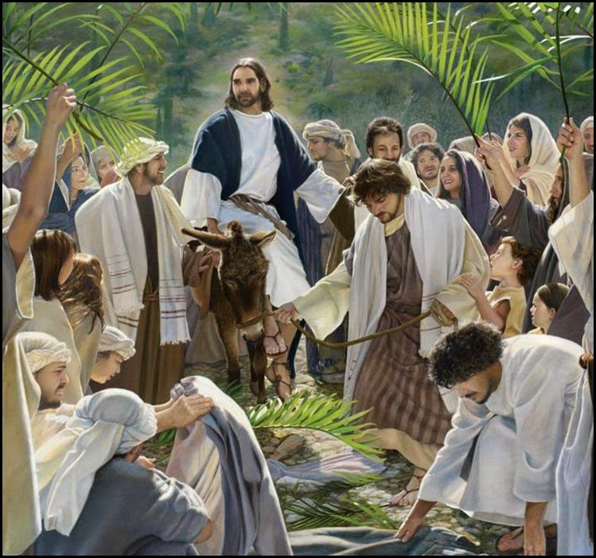
John 12:18
That was the reason so many went out to meet him—because they had heard about this miraculous sign.

Slide 8
1Corinthians 14:29-33
Let two or three prophets speak, and let the others weigh what is said. ³⁰ If a revelation is made to another sitting there, let the first be silent. ³¹ For you can all prophesy one by one, so that all may learn and all be encouraged, ³² and the spirits of prophets are subject to prophets. ³³ For God is not a God of confusion but of peace.

Slide 9
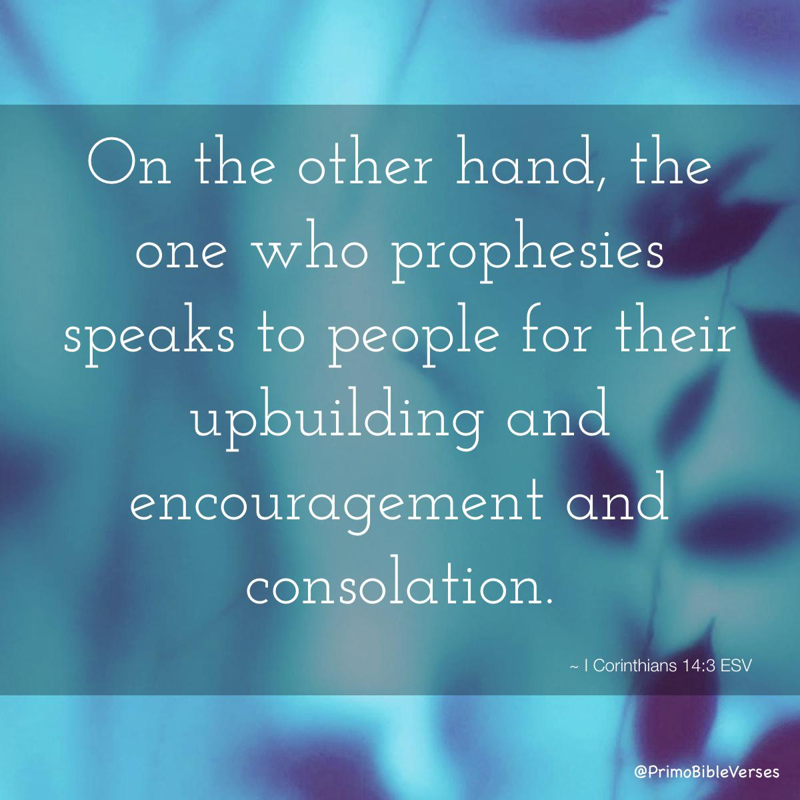

Slide 10
1 Corinthians 12:27-13:3
Now you are the body of Christ and individually members of it. ²⁸ And God has appointed in the church first apostles, second prophets, third teachers, then miracles, then gifts of healing, helping, administrating, and various kinds of tongues. ²⁹ Are all apostles? Are all prophets? Are all teachers? Do all work miracles? ³⁰ Do all possess gifts of healing? Do all speak with tongues? Do all interpret? ³¹ But earnestly desire the higher gifts. And I will show you a still more excellent way. 13 If I speak in the tongues of men and of angels, but have not love, I am a noisy gong or a clanging cymbal. ² And if I have prophetic powers, and understand all mysteries and all knowledge, and if I have all faith, so as to remove mountains, but have not love, I am nothing. ³ If I give away all I have, and if I deliver up my body to be burned, but have not love, I gain nothing.

Slide 11
1 Corinthians 14:1-5
Follow the way of love and eagerly desire gifts of the Spirit, especially prophecy. ² For anyone who speaks in a tongue does not speak to people but to God. Indeed, no one understands them; they utter mysteries by the Spirit. ³ But the one who prophesies speaks to people for their strengthening, encouraging and comfort. ⁴ Anyone who speaks in a tongue edifies themselves, but the one who prophesies edifies the church. ⁵ I would like every one of you to speak in tongues, but I would rather have you prophesy. The one who prophesies is greater than the one who speaks in tongues, unless someone interprets, so that the church may be edified.

Slide 12
1Corinthians 14:3
On the other hand, the one who prophesies speaks to people for their up building and encouragement and consolation.
.

Slide 13
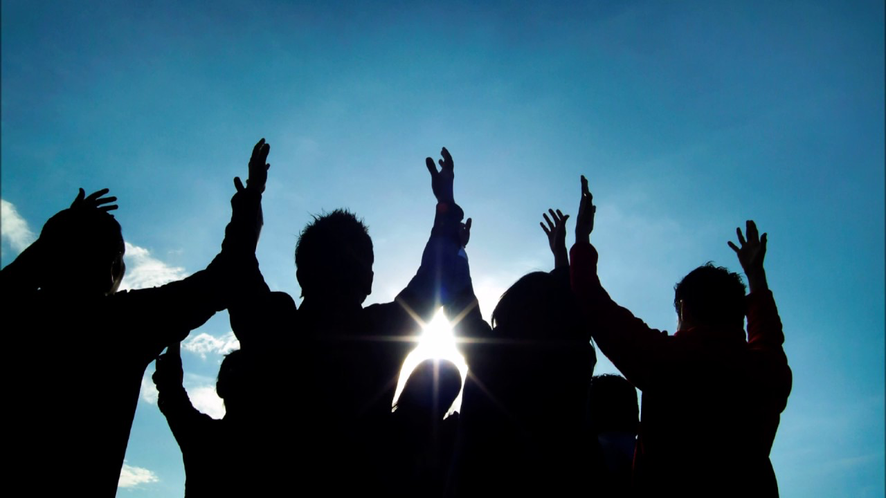
1 Corinthians 12:7 Now to each one the manifestation of the Spirit is given for the common good.

Slide 14
Ephesians 4:15-16
Rather, speaking the truth in love, we are to grow up in every way into him who is the head, into Christ, ¹⁶ from whom the whole body, joined and held together by every joint with which it is equipped, when each part is working properly, makes the body grow so that it builds itself up in love.

Slide 16
1 Corinthians 11:23-26
For I received from the Lord what I also passed on to you: The Lord Jesus, on the night he was betrayed, took bread, ²⁴ and when he had given thanks, he broke it and said, “This is my body, which is for you; do this in remembrance of me.” ²⁵ In the same way, after supper he took the cup, saying, “This cup is the new covenant in my blood; do this, whenever you drink it, in remembrance of me.” ²⁶ For whenever you eat this bread and drink this cup, you proclaim the Lord’s death until he comes.

Slide 17
Ephesians 5:2
and walk in the way of love, just as Christ loved us and gave himself up for us as a fragrant offering and sacrifice to God.

