Slide 2
Hebrews 4:12 For the word of God is alive and active. Sharper than any double-edged sword, it penetrates even to dividing soul and spirit, joints and marrow; it judges the thoughts and attitudes of the heart.

Slide 3
“The Power of the
Holy Spirit”
(Part 4)

Slide 4
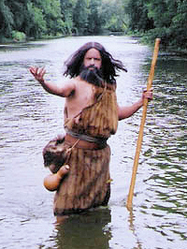
John 1:31
I myself did not know him, but the reason I came baptizing with water was that he might be revealed to Israel.”

Slide 5
John 1:32
Then John gave this testimony:
“I saw the Spirit come down from heaven as a dove and remain on him.”

Slide 6
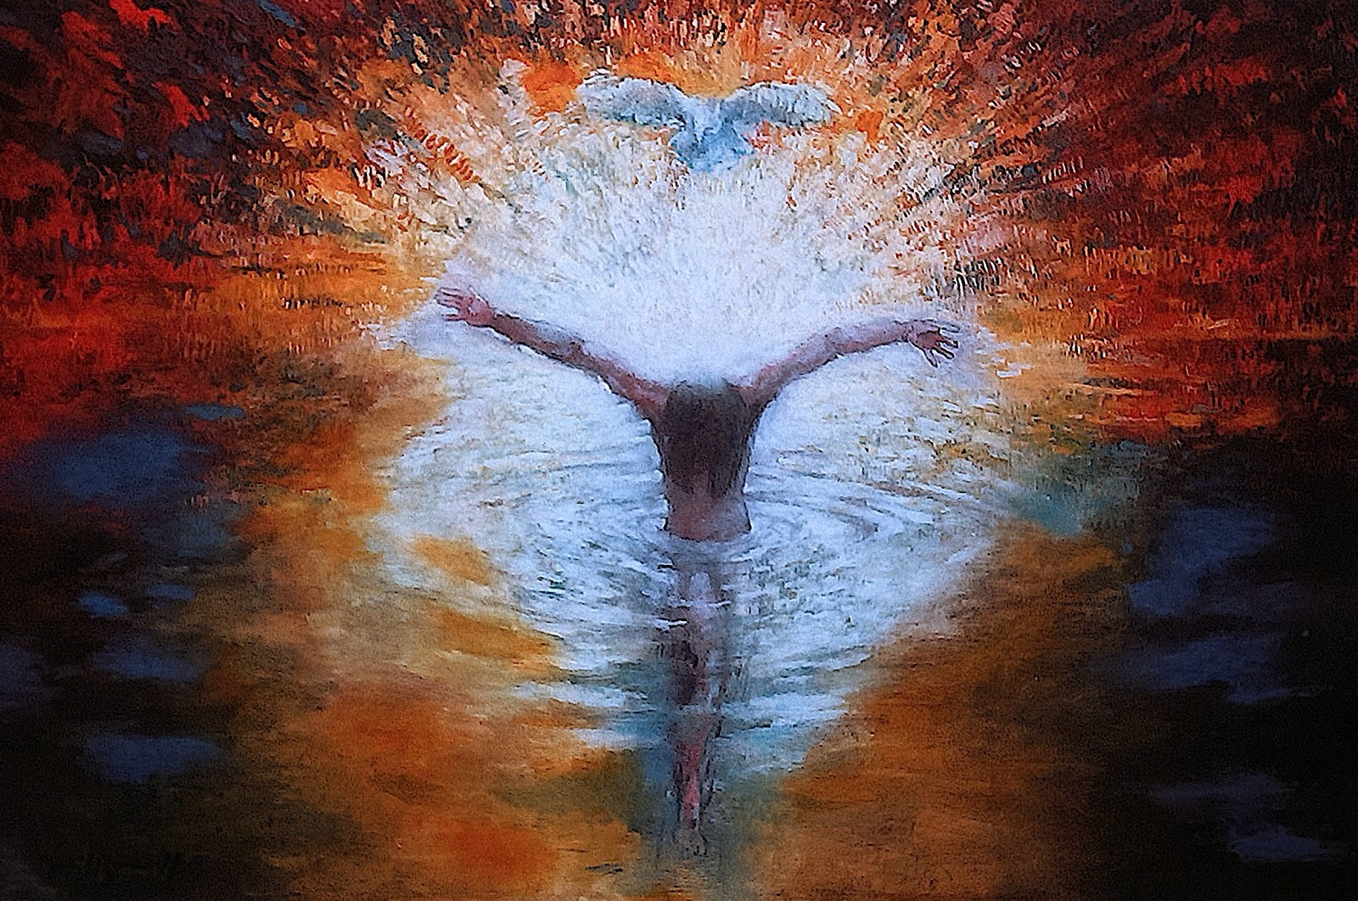
John 14:16-17 And I will pray the Father, and He will give you another Helper, that He may abide with you forever, ¹⁷ the Spirit of truth, whom the world cannot receive, because it neither sees Him nor knows Him; but you know Him, for He dwells with you and will be in you.
And I myself did not know him, but the one who sent me to baptize with water told me, ‘The man on whom you see the Spirit come down and remain is the one who will baptize with the Holy Spirit.’ John 1:33

Slide 7
Isaiah 11:1-2
There shall come forth a Rod from the stem of Jesse, And a Branch shall grow out of his roots. ² The Spirit of the Lord shall rest upon Him, The Spirit of wisdom and understanding, The Spirit of counsel and might, The Spirit of knowledge and of the fear of the Lord.

Slide 8
Isaiah 42:1
“Here is my servant, whom I uphold, my chosen one in whom I delight; I will put my Spirit on him, and he will bring justice to the nations.

Slide 9
Isaiah 61:1
The Spirit of the Sovereign Lord is on me, because the Lord has anointed me to proclaim good news to the poor. He has sent me to bind up the brokenhearted, to proclaim freedom for the captives and release from darkness for the prisoners,

Slide 10
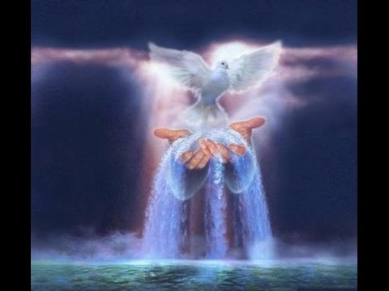
Joel 2:28
“And afterward, I will pour out my Spirit on all people. Your sons and daughters will prophesy, your old men will dream dreams, your young men will see visions.

Slide 12
Ezekiel 36:27
And I will put my Spirit in you and move you to follow my decrees and be careful to keep my laws.

Slide 13
And I myself did not know him, but the one who sent me to baptize with water told me, ‘The man on whom you see the Spirit come down and remain is the one who will baptize with the Holy Spirit.’ John 1:33

Slide 14
John 3:3 Jesus replied, “Very truly I tell you, no one can see the kingdom of God unless they are born again.”
John 3:6 Flesh gives birth to flesh, but the Spirit gives birth to spirit.

Slide 15
John 7:38-39
He who believes in Me, as the Scripture has said, out of his heart will flow rivers of living water.” ³⁹ But this He spoke concerning the Spirit, whom those believing in Him would receive; for the Holy Spirit was not yet given, because Jesus was not yet glorified.

Slide 16
John 15:26 “When the Advocate comes, whom I will send to you from the Father—the Spirit of truth who goes out from the Father—he will testify about me.

Slide 17
1 Corinthians 12:3
Therefore I want you to know that no one who is speaking by the Spirit of God says, “Jesus be cursed,” and no one can say, “Jesus is Lord,” except by the Holy Spirit.

Slide 19
Acts 1:5&8 For John baptized with water, but in a few days you will be baptized with the Holy Spirit.”…
⁸ But you will receive power when the Holy Spirit comes on you; and you will be my witnesses in Jerusalem, and in all Judea and Samaria, and to the ends of the earth.”

Slide 20
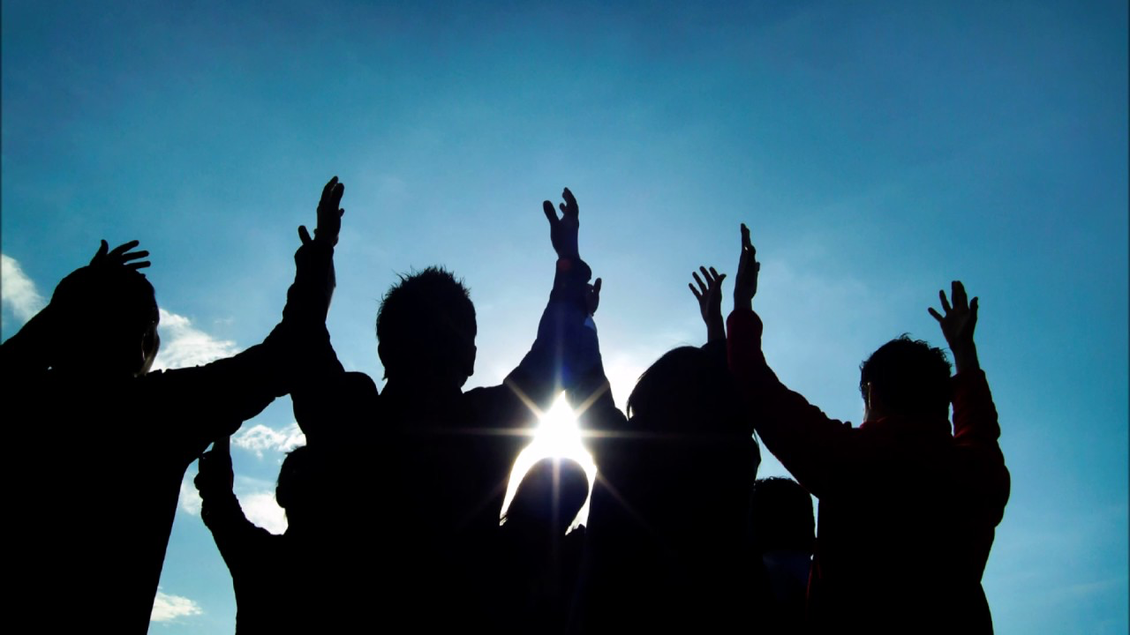
Acts 10:46
For they heard them speaking in tongues and praising God.

Slide 21
Acts 5:29 ..32 Peter and the other apostles replied: “We must obey God rather than human beings! ….
³² We are witnesses of these things, and so is the Holy Spirit, whom God has given to those who obey him.”

Slide 22
Acts 2:38-41
Peter replied, “Repent and be baptized, every one of you, in the name of Jesus Christ for the forgiveness of your sins. And you will receive the gift of the Holy Spirit. ³⁹ The promise is for you and your children and for all who are far off—for all whom the Lord our God will call.”⁴⁰ With many other words he warned them; and he pleaded with them, “Save yourselves from this corrupt generation.”⁴¹ Those who accepted his message were baptized, and about three thousand were added to their number that day.

Slide 23
John 7:37-39
On the last and greatest day of the festival, Jesus stood and said in a loud voice, “Let anyone who is thirsty come to me and drink. ³⁸ Whoever believes in me, as Scripture has said, rivers of living water will flow from within them.”³⁹ By this he meant the Spirit, whom those who believed in him were later to receive. Up to that time the Spirit had not been given, since Jesus had not yet been glorified.

