Slide 2
Hebrews 4:12 For the word of God is alive and active. Sharper than any double-edged sword, it penetrates even to dividing soul and spirit, joints and marrow; it judges the thoughts and attitudes of the heart.

Slide 3
The Power of the
Holy Spirit
(Part 2)

Slide 4
John 14:15 “If you love me, keep my commands.
John 14:21 Whoever has my commands and keeps them is the one who loves me. The one who loves me will be loved by my Father, and I too will love them and show myself to them.”
John 15:10 If you keep my commands, you will remain in my love, just as I have kept my Father’s commands and remain in his love.

Slide 5
1 John 2:3
We know that we have come to know him if we keep his commands.
2 John 1:6
And this is love: that we walk in obedience to his commands. As you have heard from the beginning, his command is that you walk in love.

Slide 6
John 13:34-35 “A new command I give you: Love one another. As I have loved you, so you must love one another. ³⁵ By this everyone will know that you are my disciples, if you love one another.”
John 6:14-15

Slide 7
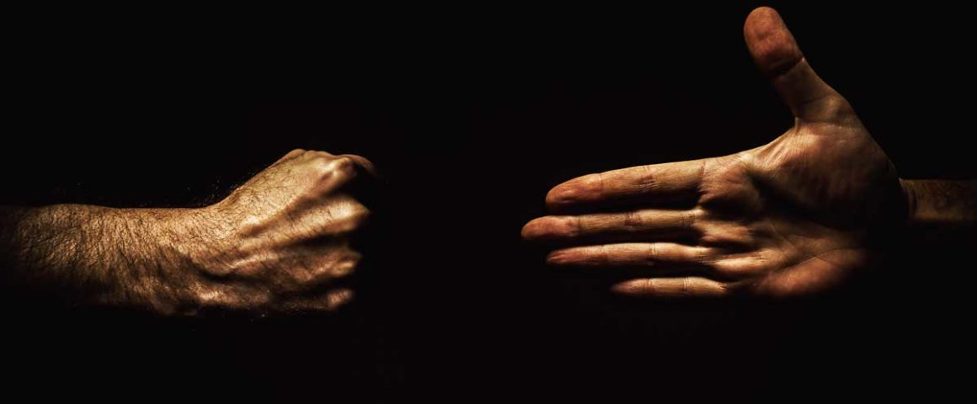
Matthew 5:44-45
But I tell you, love your enemies and pray for those who persecute you,⁴⁵ that you may be children of your Father in heaven. He causes his sun to rise on the evil and the good, and sends rain on the righteous and the unrighteous.

Slide 8
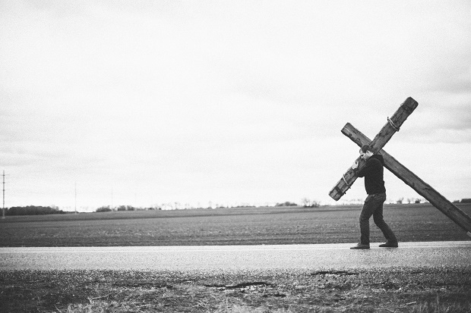
Matthew 16:24-25
Then Jesus said to his disciples, “Whoever wants to be my disciple must deny themselves and take up their cross and follow me. ²⁵ For whoever wants to save their life will lose it, but whoever loses their life for me will find it.

Slide 9
Matthew 28:18-20
Then Jesus came to them and said, “All authority in heaven and on earth has been given to me.
¹⁹ Therefore go and make disciples of all nations, baptizing them in the name of the Father and of the Son and of the Holy Spirit, ²⁰ and teaching them to obey everything I have commanded you. And surely I am with you always, to the very end of the age.”

Slide 10
Acts 1:8
But you will receive power when the Holy Spirit comes on you; and you will be my witnesses in Jerusalem, and in all Judea and Samaria, and to the ends of the earth.”

Slide 11
VIDEO – Depraved Indifference – Eric Ludy

Slide 12
Acts 1:8
But you will receive power when the Holy Spirit comes on you; and you will be my witnesses in Jerusalem, and in all Judea and Samaria, and to the ends of the earth.

Slide 13
John 8:29 The one who sent me is with me; he has not left me alone, for I always do what pleases him.”
John 4:34 Jesus said to them, My food (nourishment) is to do the will (pleasure) of Him Who sent Me and to accomplish and completely finish His work.

Slide 14
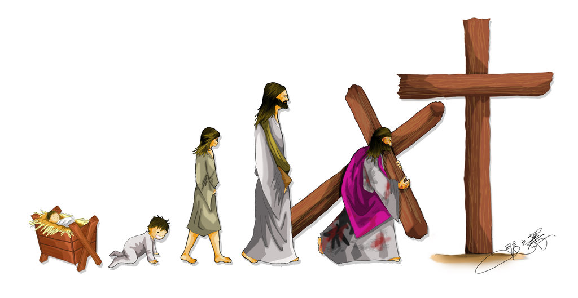
Philippians 2:5-8 In your relationships with one another, have the same mindset as Christ Jesus:⁶ Who, being in very nature God, did not consider equality with God something to be used to his own advantage; ⁷rather, he made himself nothing by taking the very nature of a servant, being made in human likeness.⁸ And being found in appearance as a man, he humbled himself by becoming obedient to death—even death on a cross!

Slide 15
2 Corinthians 5:20
We are therefore Christ’s ambassadors, as though God were making his appeal through us. We implore you on Christ’s behalf: Be reconciled to God.

Slide 16
Galatians 2:20

Slide 17
Romans 8:10
But if Christ is in you, then even though your body is subject to death because of sin, the Spirit gives life because of righteousness.

Slide 18
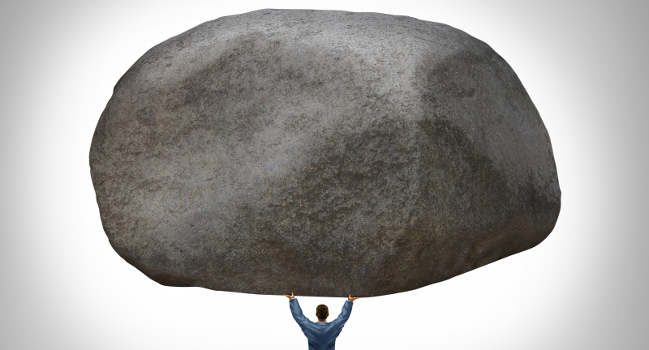
2 Timothy 4:3-5
Philippians 4:13
I can do all this through HIM who gives me strength.

Slide 19
Romans 8:37
No, in all these things we are more than conquerors through him who loved us.

Slide 20
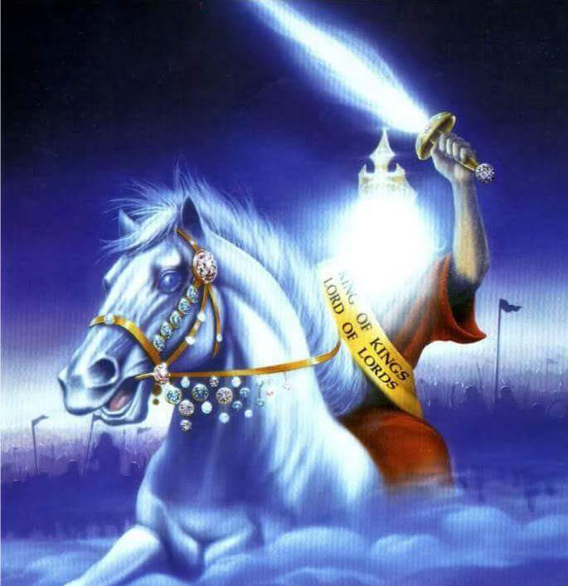
Revelation 17:14
They will wage war against the Lamb, but the Lamb will triumph over them because he is Lord of lords and King of kings—and with him will be his called, chosen and faithful followers.”

Slide 21
Video song - WAR CRY

Slide 22
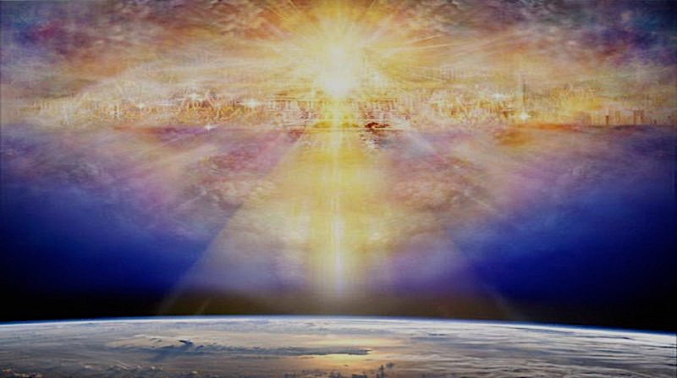
Ephesians 3:16 I pray that out of his glorious riches he may strengthen you with power through his Spirit in your inner being, Colossians 1:11-12 being strengthened with all power according to his glorious might so that you may have great endurance and patience, ¹² and giving joyful thanks to the Father, who has qualified you to share in the inheritance of his holy people in the kingdom of light.

