Slide 2
Hebrews 4:12 For the word of God is alive and active. Sharper than any double-edged sword, it penetrates even to dividing soul and spirit, joints and marrow; it judges the thoughts and attitudes of the heart.

Slide 3
The Power of the
Holy Spirit
(Part 1)

Slide 4
Luke 19:10
“For the Son of Man came to seek and to save the lost.”

Slide 5
Matthew 28:18-20
Then Jesus came to them and said, “All authority in heaven and on earth has been given to me. ¹⁹ Therefore go and make disciples of all nations, baptizing them in the name of the Father and of the Son and of the Holy Spirit,²⁰ and teaching them to obey everything I have commanded you. And surely I am with you always, to the very end of the age.”

Slide 6
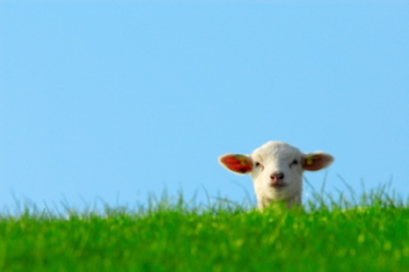
Matthew 10:5-6
These twelve Jesus sent out with the following instructions: “Do not go among the Gentiles or enter any town of the Samaritans. ⁶ Go rather to the lost sheep of Israel.
John 6:14-15

Slide 7
2 Corinthians 5:18-21
All this is from God, who reconciled us to himself through Christ and gave us the ministry of reconciliation: ¹⁹ that God was reconciling the world to himself in Christ, not counting people’s sins against them. And he has committed to us the message of reconciliation. ²⁰ We are therefore Christ’s ambassadors, as though God were making his appeal through us. We implore you on Christ’s behalf: Be reconciled to God. ²¹ God made him who had no sin to be sin for us, so that in him we might become the righteousness of God.

Slide 8
Isaiah 52:7-8 How beautiful on the mountains are the feet of those who bring good news, who proclaim peace, who bring good tidings, who proclaim salvation, who say to Zion, “Your God reigns!” ⁸ Listen! Your watchmen lift up their voices; together they shout for joy. When the Lord returns to Zion, they will see it with their own eyes.

Slide 10
Acts 1:7-9
He said to them: “It is not for you to know the times or dates the Father has set by his own authority. ⁸ But you will receive power when the Holy Spirit comes on you; and you will be my witnesses in Jerusalem, and in all Judea and Samaria, and to the ends of the earth.”⁹ After he said this, he was taken up before their very eyes, and a cloud hid him from their sight.

Slide 11
Acts 2:1-12
When the day of Pentecost came, they were all together in one place. ² Suddenly a sound like the blowing of a violent wind came from heaven and filled the whole house where they were sitting. ³ They saw what seemed to be tongues of fire that separated and came to rest on each of them. ⁴ All of them were filled with the Holy Spirit and began to speak in other tongues as the Spirit enabled them.⁵ Now there were staying in Jerusalem God-fearing Jews from every nation under heaven. ⁶ When they heard this sound, a crowd came together in bewilderment, because each one heard their own language being spoken.⁷ Utterly amazed, they asked: “Aren’t all these who are speaking Galileans? ⁸ Then how is it that each of us hears them in our native language? ⁹ Parthians, Medes and Elamites; residents of Mesopotamia, Judea and Cappadocia,Pontus and Asia, ¹⁰ Phrygia and Pamphylia, Egypt and the parts of Libya near Cyrene; visitors from Rome ¹¹ (both Jews and converts to Judaism); Cretans and Arabs—we hear them declaring the wonders of God in our own tongues!” ¹² Amazed and perplexed, they asked one another, “What does this mean?”

Slide 12
Acts 2:36-41 “Therefore let all Israel be assured of this: God has made this Jesus, whom you crucified, both Lord and Messiah.”³⁷ When the people heard this, they were cut to the heart and said to Peter and the other apostles, “Brothers, what shall we do?”³⁸ Peter replied, “Repent and be baptized, every one of you, in the name of Jesus Christ for the forgiveness of your sins. And you will receive the gift of the Holy Spirit. ³⁹ The promise is for you and your children and for all who are far off—for all whom the Lord our God will call.” ⁴⁰ With many other words he warned them; and he pleaded with them, “Save yourselves from this corrupt generation.” ⁴¹ Those who accepted his message were baptized, and about three thousand were added to their number that day.

Slide 13
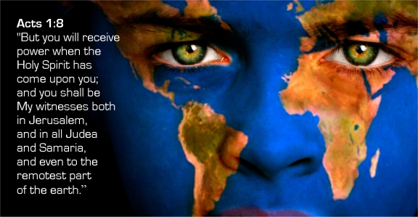

Slide 14
1 Peter 4:11 If anyone speaks, they should do so as one who speaks the very words of God. If anyone serves, they should do so with the strength God provides, so that in all things God may be praised through Jesus Christ. To him be the glory and the power for ever and ever. Amen.

Slide 15
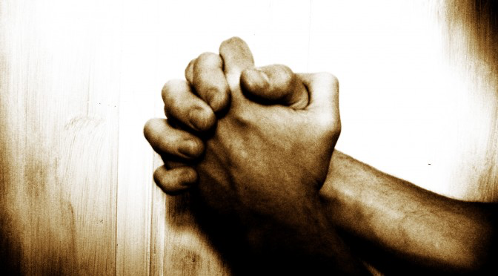
2 Thessalonians 1:11-12
With this in mind, we constantly pray for you, that our God may make you worthy of his calling, and that by his power he may bring to fruition your every desire for goodness and your every deed prompted by faith. ¹² We pray this so that the name of our Lord Jesus may be glorified in you, and you in him, according to the grace of our God and the Lord Jesus Christ.

Slide 16
1 Timothy 4:10
That is why we labor and strive, because we have put our hope in the living God, who is the Savior of all people, and especially of those who believe.

Slide 17
John 11:3-5 So the sisters sent word to Jesus, “Lord, the one you love is sick.”⁴ When he heard this, Jesus said, “This sickness will not end in death. No, it is for God’s glory so that God’s Son may be glorified through it.” ⁵ Now Jesus loved Martha and her sister and Lazarus.

Slide 18
2 Timothy 4:3-5
Romans 8:17-19 Now if we are children, then we are heirs—heirs of God and co-heirs with Christ, if indeed we share in his sufferings in order that we may also share in his glory.¹⁸ I consider that our present sufferings are not worth comparing with the glory that will be revealed in us. ¹⁹ For the creation waits in eager expectation for the children of God to be revealed.

Slide 19
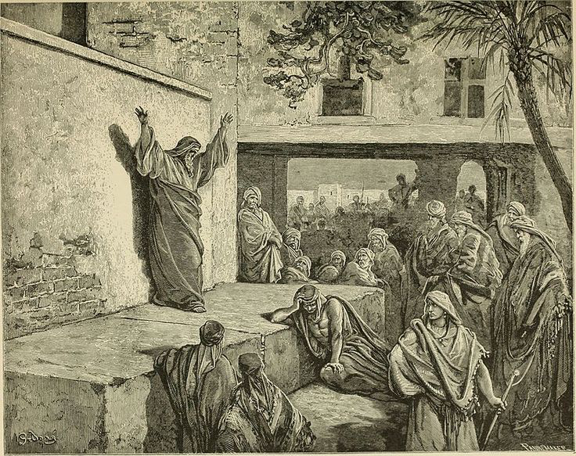
Acts 17:16-17
While Paul was waiting for them in Athens, he was greatly distressed to see that the city was full of idols. ¹⁷ So he reasoned in the synagogue with both Jews and God-fearing Greeks, as well as in the marketplace day by day with those who happened to be there.

Slide 20
Mark 13:9-11“You must be on your guard. You will be handed over to the local councils and flogged in the synagogues. On account of me you will stand before governors and kings as witnesses to them. ¹⁰ And the gospel must first be preached to all nations. ¹¹ Whenever you are arrested and brought to trial, do not worry beforehand about what to say. Just say whatever is given you at the time, for it is not you speaking, but the Holy Spirit.

Slide 21
John 15:26-27
“When the Advocate comes, whom I will send to you from the Father—the Spirit of truth who goes out from the Father—he will testify about me.²⁷ And you also must testify, for you have been with me from the beginning.

Slide 22
John 14:16-17
“If you love me, keep my commands. ¹⁶ And I will ask the Father, and he will give you another advocate to help you and be with you forever— ¹⁷ the Spirit of truth. The world cannot accept him, because it neither sees him nor knows him. But you know him, for he lives with you and will be in you.

Slide 23
John 14:25-27
“All this I have spoken while still with you. ²⁶ But the Advocate, the Holy Spirit, whom the Father will send in my name, will teach you all things and will remind you of everything I have said to you. ²⁷ Peace I leave with you; my peace I give you. I do not give to you as the world gives. Do not let your hearts be troubled and do not be afraid.

