Slide 2
“SPIRITUAL WARFARE”

Slide 3
Proverbs 20:18
Plans are established by seeking advice; so if you wage war, obtain guidance.

Slide 4
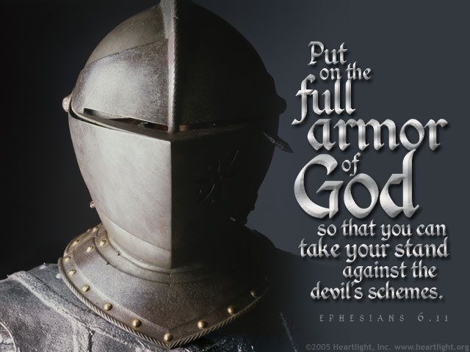
2 Corinthians 2:11 in order that Satan might not outwit us. For we are not unaware of his schemes.
Ephesians 6:11 Put on the full armor of God, so that you can take your stand against the devil’s schemes.

Slide 5
1 Peter 5:9 Resist him, standing firm in the faith, because you know that the family of believers throughout the world is undergoing the same kind of sufferings.
John 6:14-15

Slide 6
1 John 4:4 You, dear children, are from God and have overcome them, because the one who is in you is greater than the one who is in the world.
2 Corinthians 12:10 That is why, for Christ’s sake, I delight in weaknesses, in insults, in hardships, in persecutions, in difficulties. For when I am weak, then I am strong.

Slide 7
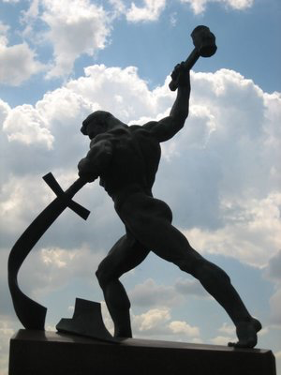
Joel 3:10
Beat your plowshares into swords and your pruning hooks into spears. Let the weakling say,
“I am strong”
2 Corinthians 10:4
The weapons we fight with are not the weapons of the world. On the contrary, they have divine power to demolish strongholds.

Slide 8
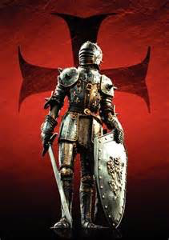
Ephesians 6:13
Therefore put on the full armor of God, so that when the day of evil comes, you may be able to stand your ground, and after you have done everything, to stand.

Slide 9
2 Corinthians 10:3-5
For though we live in the world, we do not wage war as the world does.⁴ The weapons we fight with are not the weapons of the world. On the contrary, they have divine power to demolish strongholds. ⁵ We demolish arguments and every pretension that sets itself up against the knowledge of God, and we take captive every thought to make it obedient to Christ.

Slide 10
Romans 12:2 Do not conform to the pattern of this world, but be transformed by the renewing of your mind. Then you will be able to test and approve what God’s will is—his good, pleasing and perfect will.
Ephesians 4:23-24 to be made new in the attitude of your minds; ²⁴ and to put on the new self, created to be like God in true righteousness and holiness.

Slide 11
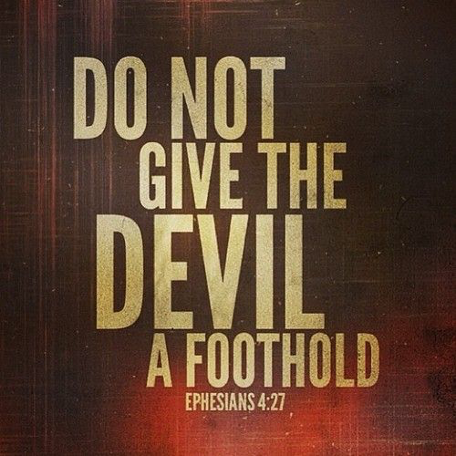

Slide 13
Proverbs 4:23 Above all else, guard your heart, for everything you do flows from it.

Slide 14
James 3:10
Out of the same mouth come praise and cursing. My brothers and sisters, this should not be.
Psalm 141:3
"Set a guard, O Lord, over my mouth; keep watch over the door of my lips."

Slide 15
Matthew 16:18
And I tell you that you are Peter, and on this rock I will build my church, and the gates of Hades will not overcome it.

Slide 16
Ephesians 6:12
For our struggle is not against flesh and blood, but against the rulers, against the authorities, against the powers of this dark world and against the spiritual forces of evil in the heavenly realms.

Slide 17
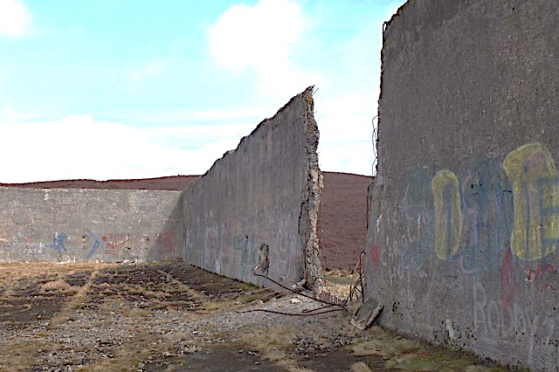
This is what the Sovereign Lord says: Woe to the foolish prophets who follow their own spirit and have seen nothing! ⁴ Your prophets, Israel, are like jackals among ruins. ⁵ You have not gone up to the breaches in the wall to repair it for the people of Israel so that it will stand firm in the battle on the day of the Lord.
Ezekiel 13:3-5
Ezekiel 22:30
“I looked for someone among them who would build up the wall and stand before me in the gap on behalf of the land so I would not have to destroy it, but I found no one.

Slide 18
Psalm 115:16
The highest heavens belong to the Lord, but the earth he has given to mankind.

Slide 20
Isaiah 61:1-3
The Spirit of the Sovereign Lord is on me, because the Lord has anointed me to proclaim good news to the poor. He has sent me to bind up the brokenhearted, to proclaim freedom for the captives and release from darkness for the prisoners, ² to proclaim the year of the Lord’s favor and the day of vengeance of our God, to comfort all who mourn, ³ and provide for those who grieve in Zion—to bestow on them a crown of beauty instead of ashes, the oil of joy instead of mourning, and a garment of praise instead of a spirit of despair. They will be called oaks of righteousness, a planting of the Lord for the display of his splendor.

