Slide 2
Hebrews 4:12 For the word of God is alive and active. Sharper than any double-edged sword, it penetrates even to dividing soul and spirit, joints and marrow; it judges the thoughts and attitudes of the heart.

Slide 3
Seeking Advice and Obtaining Guidance.

Slide 4
2 Timothy 3:10-4:5 You, however, know all about my teaching, my way of life, my purpose, faith, patience, love, endurance, ¹¹ persecutions, sufferings—what kinds of things happened to me in Antioch, Iconium and Lystra, the persecutions I endured. Yet the Lord rescued me from all of them. ¹² In fact, everyone who wants to live a godly life in Christ Jesus will be persecuted, ¹³ while evildoers and impostors will go from bad to worse, deceiving and being deceived. ¹⁴ But as for you, continue in what you have learned and have become convinced of, because you know those from whom you learned it, ¹⁵ and how from infancy you have known the Holy Scriptures, which are able to make you wise for salvation through faith in Christ Jesus. ¹⁶ All Scripture is God-breathed and is useful for teaching, rebuking, correcting and training in righteousness,¹⁷ so that the servant of God may be thoroughly equipped for every good work.

Slide 5
2Timothy 4:1-5 In the presence of God and of Christ Jesus, who will judge the living and the dead, and in view of his appearing and his kingdom, I give you this charge: ² Preach the word; be prepared in season and out of season; correct, rebuke and encourage—with great patience and careful instruction. ³ For the time will come when people will not put up with sound doctrine. Instead, to suit their own desires, they will gather around them a great number of teachers to say what their itching ears want to hear. ⁴ They will turn their ears away from the truth and turn aside to myths. ⁵ But you, keep your head in all situations, endure hardship, do the work of an evangelist, discharge all the duties of your ministry.
John 6:14-15

Slide 6
2 Timothy 3:10-4:5 You, however, know all about my teaching, my way of life, my purpose, faith, patience, love, endurance, ¹¹ persecutions, sufferings—what kinds of things happened to me in Antioch, Iconium and Lystra, the persecutions I endured. Yet the Lord rescued me from all of them.

Slide 7
Acts 14:19-22 Then some Jews came from Antioch and Iconium and won the crowd over. They stoned Paul and dragged him outside the city, thinking he was dead. ²⁰ But after the disciples had gathered around him, he got up and went back into the city. The next day he and Barnabas left for Derbe. They preached the gospel in that city and won a large number of disciples. Then they returned to Lystra, Iconium and Antioch, ²² strengthening the disciples and encouraging them to remain true to the faith. “We must go through many hardships to enter the kingdom of God,” they said.

Slide 8
2 Timothy 3:12-13
In fact, everyone who wants to live a godly life in Christ Jesus will be persecuted, ¹³ while evildoers and impostors will go from bad to worse, deceiving and being deceived.

Slide 10
Philippians 1:29 For it has been granted to you on behalf of Christ not only to believe in him, but also to suffer for him,

Slide 11
1 Peter 4:12
Dear friends, do not be surprised at the fiery ordeal that has come on you to test you, as though something strange were happening to you.

Slide 12
Acts 5:41 The apostles left the Sanhedrin, rejoicing because they had been counted worthy of suffering disgrace for the Name.

Slide 13
2 Timothy 3:14-15
But as for you, continue in what you have learned and have become convinced of, because you know those from whom you learned it, ¹⁵ and how from infancy you have known the Holy Scriptures, which are able to make you wise for salvation through faith in Christ Jesus.

Slide 14
2Timothy 3:16-17
All Scripture is God-breathed and is useful for teaching, rebuking, correcting and training in righteousness,¹⁷ so that the servant of God may be thoroughly equipped for every good work.

Slide 15
Romans 15:4
For everything that was written in the past was written to teach us, so that through the endurance taught in the Scriptures and the encouragement they provide we might have hope.

Slide 16
2 Corinthians 4:8-10
We are hard pressed on every side, but not crushed; perplexed, but not in despair;⁹ persecuted, but not abandoned; struck down, but not destroyed. ¹⁰ We always carry around in our body the death of Jesus, so that the life of Jesus may also be revealed in our body.

Slide 17
2 Timothy 4:1-2
In the presence of God and of Christ Jesus, who will judge the living and the dead, and in view of his appearing and his kingdom, I give you this charge: ² Preach the word; be prepared in season and out of season; correct, rebuke and encourage—with great patience and careful instruction.

Slide 18
2 Timothy 4:3-5
For the time will come when people will not put up with sound doctrine. Instead, to suit their own desires, they will gather around them a great number of teachers to say what their itching ears want to hear. ⁴ They will turn their ears away from the truth and turn aside to myths. ⁵ But you, keep your head in all situations, endure hardship, do the work of an evangelist, discharge all the duties of your ministry.

Slide 19
2 Timothy 4:18
The Lord will rescue me from every evil attack and will bring me safely to his heavenly kingdom. To him be glory for ever and ever. Amen.

Slide 20
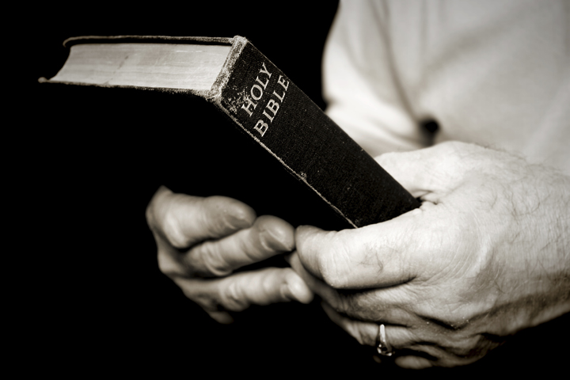
Titus 1:9
He must hold firmly to the trustworthy message as it has been taught, so that he can encourage others by sound doctrine and refute those who oppose it.

Slide 21
1 Peter 1:13
Therefore, with minds that are alert and fully sober, set your hope on the grace to be brought to you when Jesus Christ is revealed at his coming.

Slide 22
2 Timothy 2:19-22
Nevertheless, God’s solid foundation stands firm, sealed with this inscription: “The Lord knows those who are his,” and, “Everyone who confesses the name of the Lord must turn away from wickedness.”²⁰ In a large house there are articles not only of gold and silver, but also of wood and clay; some are for special purposes and some for common use. ²¹ Those who cleanse themselves from the latter will be instruments for special purposes, made holy, useful to the Master and prepared to do any good work.²² Flee the evil desires of youth and pursue righteousness, faith, love and peace, along with those who call on the Lord out of a pure heart.

Slide 23
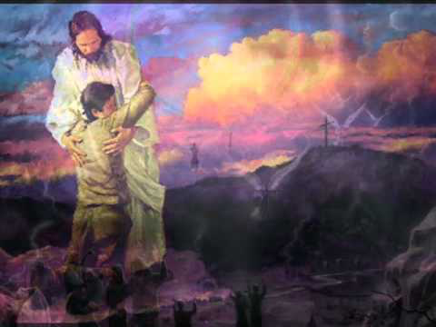
Hebrews 13:20-21
Now may the God of peace, who through the blood of the eternal covenant brought back from the dead our Lord Jesus, that great Shepherd of the sheep, ²¹ equip you with everything good for doing his will, and may he work in us what is pleasing to him, through Jesus Christ, to whom be glory for ever and ever. Amen.

