Slide 2
“Silence Broken”

Slide 3
Luke 1:1-4 Many have undertaken to draw up an account of the things that have been fulfilled among us, ² just as they were handed down to us by those who from the first were eyewitnesses and servants of the word. ³ With this in mind, since I myself have carefully investigated everything from the beginning, I too decided to write an orderly account for you, most excellent Theophilus, ⁴ so that you may know the certainty of the things you have been taught.

Slide 4
Luke 1:5-7 In the time of Herod king of Judea there was a priest named Zechariah, who belonged to the priestly division of Abijah; his wife Elizabeth was also a descendant of Aaron.⁶ Both of them were righteous in the sight of God, observing all the Lord’s commands and decrees blamelessly. ⁷ But they were childless because Elizabeth was not able to conceive, and they were both very old.

Slide 5
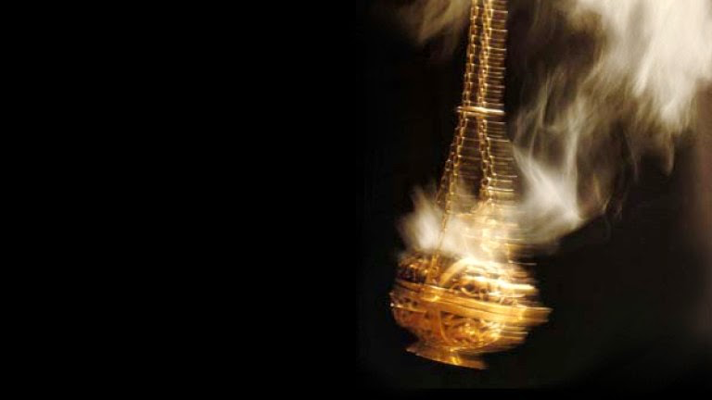
Luke 1:8-10
Once when Zechariah’s division was on duty and he was serving as priest before God,⁹ he was chosen by lot, according to the custom of the priesthood, to go into the temple of the Lord and burn incense. ¹⁰ And when the time for the burning of incense came, all the assembled worshipers were praying outside.
John 6:14-15

Slide 6
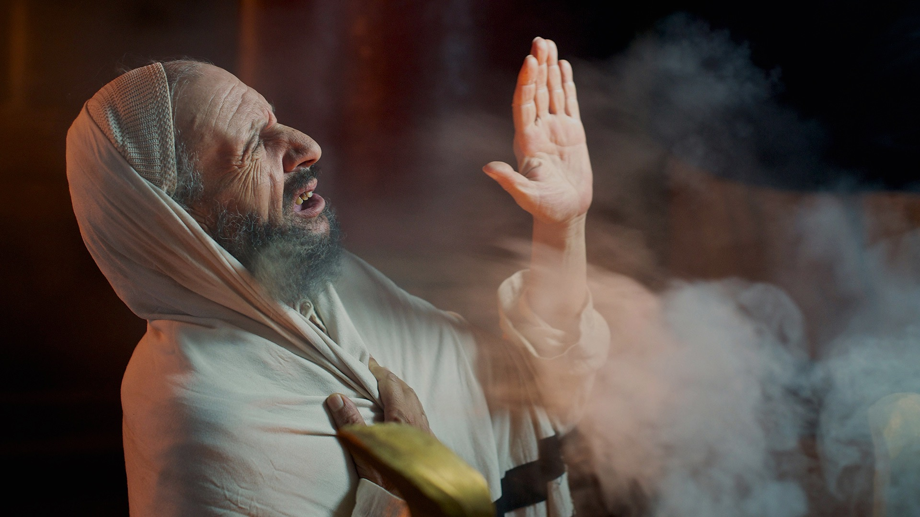
Luke 1:11-13
Then an angel of the Lord appeared to him, standing at the right side of the altar of incense. ¹² When Zechariah saw him, he was startled and was gripped with fear. ¹³ But the angel said to him: “Do not be afraid, Zechariah; your prayer has been heard. Your wife Elizabeth will bear you a son, and you are to call him John.

Slide 7
Luke 1:14-15 He will be a joy and delight to you, and many will rejoice because of his birth, ¹⁵ for he will be great in the sight of the Lord. He is never to take wine or other fermented drink, and he will be filled with the Holy Spirit even before he is born.

Slide 8
Luke 1:16-18
He will bring back many of the people of Israel to the Lord their God. And he will go on before the Lord, in the spirit and power of Elijah, to turn the hearts of the parents to their children and the disobedient to the wisdom of the righteous—to make ready a people prepared for the Lord.” ¹⁸ Zechariah asked the angel, “How can I be sure of this? I am an old man and my wife is well along in years
Luke 1:16-18 He will bring back many of the people of Israel to the Lord their God. And he will go on before the Lord, in the spirit and power of Elijah, to turn the hearts of the parents to their children and the disobedient to the wisdom of the righteous—to make ready a people prepared for the Lord.” ¹⁸ Zechariah asked the angel, “How can I be sure of this? I am an old man and my wife is well along in years

Slide 9
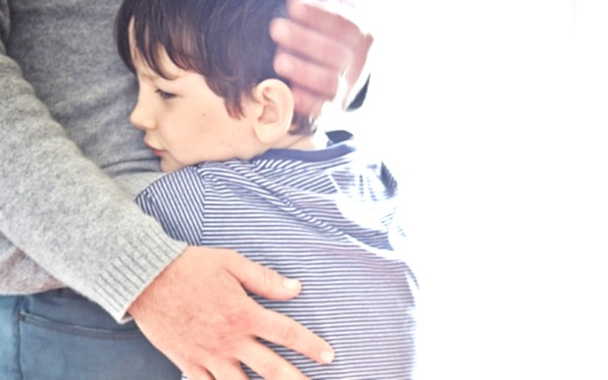
Malachi 4:5-6 “See, I will send the prophet Elijah to you before that great and dreadful day of the Lord comes. ⁶ He will turn the hearts of the parents to their children, and the hearts of the children to their parents; or else I will come and strike the land with total destruction.”

Slide 10
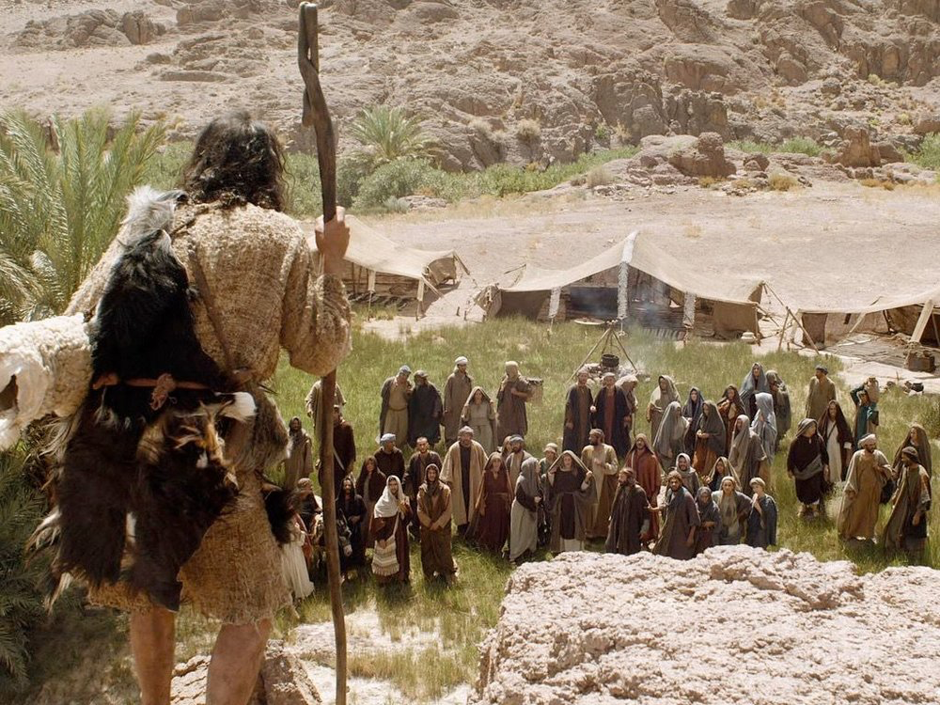
Isaiah 40:3 A voice of one calling: “In the wilderness prepare the way for the Lord; make straight in the desert a highway for our God.

Slide 11
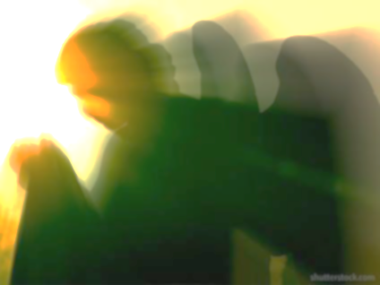
Luke 1:19-21 The angel said to him, “I am Gabriel. I stand in the presence of God, and I have been sent to speak to you and to tell you this good news. ²⁰ And now you will be silent and not able to speak until the day this happens, because you did not believe my words, which will come true at their appointed time.” Meanwhile, the people were waiting for Zechariah and wondering why he stayed so long in the temple.

Slide 12
Luke 1:22-25
When he came out, he could not speak to them. They realized he had seen a vision in the temple, for he kept making signs to them but remained unable to speak. When his time of service was completed, he returned home. ²⁴ After this his wife Elizabeth became pregnant and for five months remained in seclusion. ²⁵ “The Lord has done this for me,” she said. “In these days he has shown his favor and taken away my disgrace among the people.”

Slide 13
Luke 1:26-27
In the sixth month of Elizabeth’s pregnancy, God sent the angel Gabriel to Nazareth, a town in Galilee, ²⁷ to a virgin pledged to be married to a man named Joseph, a descendant of David. The virgin’s name was Mary.

Slide 14
Luke 1:57-63
When it was time for Elizabeth to have her baby, she gave birth to a son. ⁵⁸ Her neighbors and relatives heard that the Lord had shown her great mercy, and they shared her joy.⁵⁹ On the eighth day they came to circumcise the child, and they were going to name him after his father Zechariah, ⁶⁰ but his mother spoke up and said, “No! He is to be called John.”⁶¹ They said to her, “There is no one among your relatives who has that name.”⁶² Then they made signs to his father, to find out what he would like to name the child. ⁶³ He asked for a writing tablet, and to everyone’s astonishment he wrote, “His name is John.”

Slide 15
Luke 1:64-66 Immediately his mouth was opened and his tongue set free, and he began to speak, praising God. ⁶⁵ All the neighbors were filled with awe, and throughout the hill country of Judea people were talking about all these things. ⁶⁶ Everyone who heard this wondered about it, asking, “What then is this child going to be?” For the Lord’s hand was with him.

Slide 16
Luke 1:67-75
His father Zechariah was filled with the Holy Spirit and prophesied: ⁶⁸ “Praise be to the Lord, the God of Israel, because he has come to his people and redeemed them.⁶⁹ He has raised up a horn of salvation for us in the house of his servant David ⁷⁰ (as he said through his holy prophets of long ago), ⁷¹salvation from our enemies and from the hand of all who hate us ⁷² to show mercy to our ancestors and to remember his holy covenant,⁷³ the oath he swore to our father Abraham: ⁷⁴ to rescue us from the hand of our enemies, and to enable us to serve him without fear ⁷⁵in holiness and righteousness before him all our days.

Slide 17
Luke 1:76-80 And you, my child, will be called a prophet of the Most High; for you will go on before the Lord to prepare the way for him, ⁷⁷ to give his people the knowledge of salvation through the forgiveness of their sins, ⁷⁸ because of the tender mercy of our God, by which the rising sun will come to us from heaven ⁷⁹ to shine on those living in darkness and in the shadow of death, to guide our feet into the path of peace.”⁸⁰ And the child grew and became strong in spirit; and he lived in the wilderness until he appeared publicly to Israel.

Slide 18
John 1:29
The next day John saw Jesus coming toward him and said, “Look, the Lamb of God, who takes away the sin of the world!

