Slide 1
Identity Crisis
Who am I?
Who are we?

Slide 2
Hebrews 4:12 Amplified Bible, Classic Edition (AMPC)
For the Word that God speaks is alive and full of power [making it active, operative, energizing, and effective]; it is sharper than any two-edged sword, penetrating to the dividing line of the breath of life (soul) and [the immortal] spirit, and of joints and marrow [of the deepest parts of our nature], exposing and sifting and analyzing and judging the very thoughts and purposes of the heart.

Slide 3
Romans 3:9-12 ) What, then, is the situation? Do we have any advantage? Not at all. We have already accused everyone (both Jews and Greeks) of being under the power of sin, as Scripture says, “Not one person has God’s approval. No one understands. No one searches for God. Everyone has turned away. Together they have become rotten to the core. No one does anything good, not even one person.”
We are not good people!!!

Slide 4
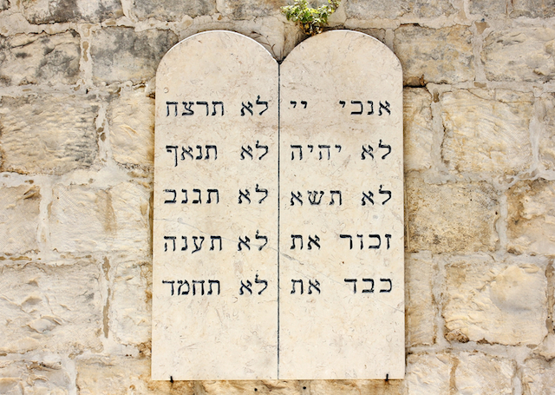
Exodus 20 GOD’S WORD Translation (GW)
The Ten Commandments
”Never have any other god.
Never make your own carved idols or statues that represent any creature in the sky, on the earth, or in the water. Never worship them or serve them, because I, the Lord your God, am a God who does not tolerate rivals(El Kanna- Jealous God).
“Never use the name of the Lord your God carelessly. The Lord will make sure that anyone who carelessly uses his name will be punished.

Slide 5
“Remember the day of rest by observing it as a holy day. You have six days to do all your work. The seventh day is the day of rest—a holy day dedicated to the Lord your God. You, your sons, your daughters, your male and female slaves, your cattle, and the foreigners living in your city must never do any work on that day. In six days the Lord made heaven, earth, and the sea, along with everything in them. He didn’t work on the seventh day. That’s why the Lord blessed the day he stopped his work and set this day apart as holy.
“Honor your father and your mother, so that you may live for a long time in the land the Lord your God is giving you.
“Never murder”
“Never commit adultery.”
“Never steal.”
“Never lie when you testify about your neighbor.
“Never desire to take your neighbor’s household away from him. “Never desire to take your neighbor’s wife, his male or female slave, his ox, his donkey, or anything else that belongs to him.”

Slide 6
Jesus went even further in a couple of instances!!!
Matthew 5:21-22 GOD’S WORD Translation (GW)
“You have heard that it was said to your ancestors, ‘Never murder. Whoever murders will answer for it in court.’ But I can guarantee that whoever is angry with another believer will answer for it in court. Whoever calls another believer an insulting name will answer for it in the highest court. Whoever calls another believer a fool will answer for it in hellfire.
Matthew 5:27-28 GOD’S WORD Translation (GW)
“You have heard that it was said, ‘Never commit adultery.’ But I can guarantee that whoever looks with lust at a woman has already committed adultery in his heart.

Slide 7
Ezekiel 14:6
“So tell the nation of Israel, ‘This is what the Almighty Lord says: Change the way you think and act! Turn away from your idols, and don’t return to any of your disgusting things.
Ezekiel 18:32
I don’t want anyone to die,” declares the Almighty Lord. “Change the way you think and act!”
Matthew 3:2
“Turn to God and change the way you think and act, because the kingdom of heaven is near.”
Matthew 3:8
Do those things that prove you have turned to God andhave changed the way you think and act

Slide 8
Luke 13:3
No! I can guarantee that they weren’t. But if you don’t turn to God and change the way you think and act, then you, too, will all die.
Acts 3:19
So change the way you think and act, and turn to God to have your sins removed.
Romans 2:4-5
Do you have contempt for God, who is very kind to you, puts up with you, and deals patiently with you? Don’t you realize that it is God’s kindness that is trying to lead you to him and change the way you think and act?
Since you are stubborn and don’t want to change theway you think and act, you are adding to the anger that God will have against you on that day when God vents his anger. At that time God will reveal that his decisions are fair.

Slide 9
John 13:34-35 GOD’S WORD Translation (GW)
“I’m giving you a new commandment: Love each other in the same way that I have loved you. Everyone will know that you are my disciples because of your love for each other.”

Slide 10
God forgiveness for us. + Forgiveness of others.
Mark 11:25
Whenever you pray, forgive anything you have against anyone. Then your Father in heaven will forgive your failures.”
Matthew 6:14
“If you forgive the failures of others, your heavenly Father will also forgive you.
Matthew 18:21-22
Then Peter came to Jesus and asked him, “Lord, how often do I have to forgive a believer who wrongs me? Seven times?” Jesus answered him, “I tell you, not just seven times, but seventy times seven.

Slide 11
Forgiveness of Self:
Proverbs 16:25
There is a way that seems right to a person, but eventually it ends in death.
Philippians 4:8-9
Finally, brothers and sisters, keep your thoughts on whatever is right or deserves praise: things that are true, honorable, fair, pure, acceptable, or commendable. Practice what you’ve learned and received from me, what you heard and saw me do. Then the God who gives this peace will be with you.

