Slide 2
“AWAKE and SOBER”

Slide 3
Hebrews 4:12
For the word of God is alive and active. Sharper than any double-edged sword, it penetrates even to dividing soul and spirit, joints and marrow; it judges the thoughts and attitudes of the heart.
Hebrews 4:12 For the word of God is alive and active. Sharper than any double-edged sword, it penetrates even to dividing soul and spirit, joints and marrow; it judges the thoughts and attitudes of the heart.

Slide 4
1 Thessalonians 5:1-3
Now, brothers and sisters, about times and dates we do not need to write to you, ² for you know very well that the day of the Lord will come like a thief in the night. ³ While people are saying, “Peace and safety,” destruction will come on them suddenly, as labor pains on a pregnant woman, and they will not escape.

Slide 5
1 Thessalonians 4:13-18
But I do not want you to be ignorant, brethren, concerning those who have fallen asleep, lest you sorrow as others who have no hope. ¹⁴ For if we believe that Jesus died and rose again, even so God will bring with Him those who sleep in Jesus.¹⁵ For this we say to you by the word of the Lord, that we who are alive and remain until the coming of the Lord will by no means precede those who are asleep. ¹⁶ For the Lord Himself will descend from heaven with a shout, with the voice of an archangel, and with the trumpet of God. And the dead in Christ will rise first. ¹⁷ Then we who are alive and remain shall be caught up together with them in the clouds to meet the Lord in the air. And thus we shall always be with the Lord. ¹⁸ Therefore comfort one another with these words.
John 6:14-15

Slide 6
2 Thessalonians 2:1-3 Now, brethren, concerning the coming of our Lord Jesus Christ and our gathering together to Him, we ask you, ² not to be soon shaken in mind or troubled, either by spirit or by word or by letter, as if from us, as though the day of Christ had come. ³ Let no one deceive you by any means; for that Day will not come unless the falling away comes first, and the man of sin is revealed, the son of perdition,

Slide 7
1 Thessalonians 5:4-7
⁴ But you, brothers and sisters, are not in darkness so that this day should surprise you like a thief. ⁵ You are all children of the light and children of the day. We do not belong to the night or to the darkness. ⁶ So then, let us not be like others, who are asleep, but let us be awake and sober. ⁷ For those who sleep, sleep at night, and those who get drunk, get drunk at night.

Slide 8
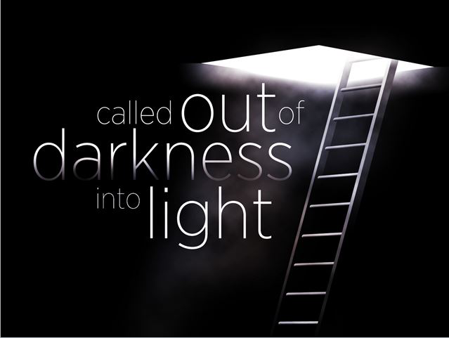
Acts 26:17-18
I will deliver you from the Jewish people, as well as from the Gentiles, to whom I now send you, ¹⁸ to open their eyes, in order to turn them from darkness to light, and from the power of Satan to God, that they may receive forgiveness of sins and an inheritance among those who are sanctified by faith in Me.’

Slide 9
1 Thessalonians 5:8-9
But since we belong to the day, let us be sober, putting on faith and love as a breastplate, and the hope of salvation as a helmet. ⁹ For God did not appoint us to suffer wrath but to receive salvation through our Lord Jesus Christ.
Exodus 3:14

Slide 11
1 Thessalonians 5:10 He died for us so that, whether we are awake or asleep, we may live together with him.

Slide 12
1 Thessalonians 4:13-15
Brothers and sisters, we do not want you to be uninformed about those who sleep in death, so that you do not grieve like the rest of mankind, who have no hope. ¹⁴ For we believe that Jesus died and rose again, and so we believe that God will bring with Jesus those who have fallen asleep in him. ¹⁵ According to the Lord’s word, we tell you that we who are still alive, who are left until the coming of the Lord, will certainly not precede those who have fallen asleep.

Slide 13
1 Thessalonians 5:11 Therefore encourage one another and build each other up, just as in fact you are doing.

