Slide 2
“Will He Find Faith On The Earth? ”

Slide 3
Hebrews 4:12 For the word of God is alive and active. Sharper than any double-edged sword, it penetrates even to dividing soul and spirit, joints and marrow; it judges the thoughts and attitudes of the heart.

Slide 4
Luke 18:1-8 Then Jesus told his disciples a parable to show them that they should always pray and not give up. ² He said: “In a certain town there was a judge who neither feared God nor cared what people thought. ³ And there was a widow in that town who kept coming to him with the plea, ‘Grant me justice against my adversary.’ ⁴ “For some time he refused. But finally he said to himself, ‘Even though I don’t fear God or care what people think, ⁵ yet because this widow keeps bothering me, I will see that she gets justice, so that she won’t eventually come and attack me!
John 6:14-15

Slide 5
⁶And the Lord said, “Listen to what the unjust judge says. ⁷ And will not God bring about justice for his chosen ones, who cry out to him day and night? Will he keep putting them off? ⁸ I tell you, he will see that they get justice, and quickly. However, when the Son of Man comes, will he find faith on the earth?”

Slide 6
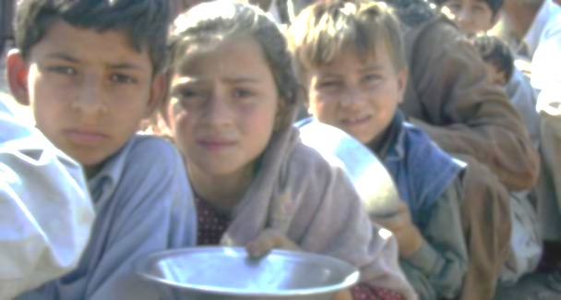
James 2:16-18 If one of you says to them, “Go in peace; keep warm and well fed,” but does nothing about their physical needs, what good is it? ¹⁷ In the same way, faith by itself, if it is not accompanied by action, is dead ¹⁸ But someone will say, “You have faith; I have deeds. ”Show me your faith without deeds, and I will show you my faith by my deeds.

Slide 7
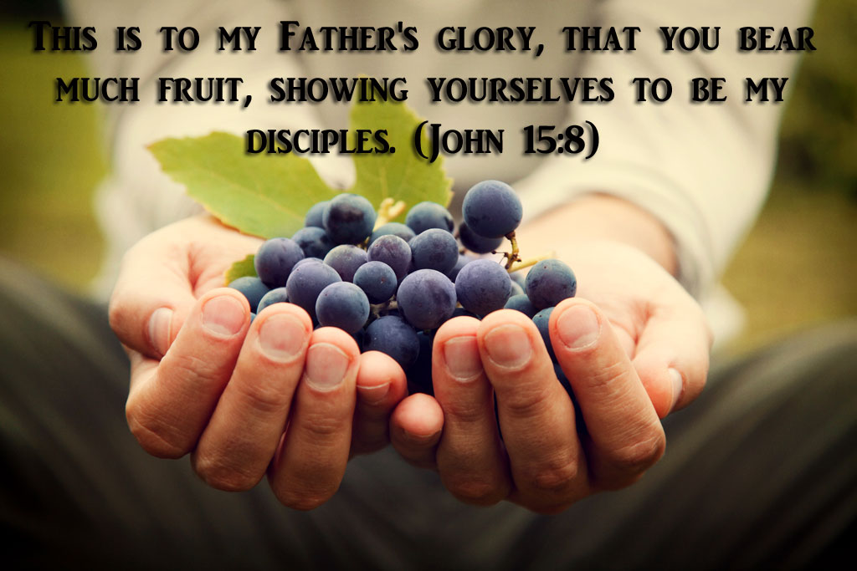

Slide 9
Exodus 3:14
2 Corinthians 5:7

Slide 10
.

Slide 11
Hebrews 10:38-39
And, “But my righteous one will live by faith. And I take no pleasure in the one who shrinks back.” But we do not belong to those who shrink back and are destroyed, but to those who have faith and are saved.

Slide 12
Habakkuk 2:4 “
See, the enemy is puffed up; his desires are not upright— but the righteous person will live by his faithfulness—

Slide 14
John 17:3
Now this is eternal life: that they know you, the only true God, and Jesus Christ, whom you have sent.

Slide 15
2 Peter 2:20-21 If they have escaped the corruption of the world by knowing our Lord and Savior Jesus Christ and are again entangled in it and are overcome, they are worse off at the end than they were at the beginning. ²¹ It would have been better for them not to have known the way of righteousness, than to have known it and then to turn their backs on the sacred command that was passed on to them.
2 Peter 2:20-21 If they have escaped the corruption of the world by knowing our Lord and Savior Jesus Christ and are again entangled in it and are overcome, they are worse off at the end than they were at the beginning. ²¹ It would have been better for them not to have known the way of righteousness, than to have known it and then to turn their backs on the sacred command that was passed on to them.

Slide 16
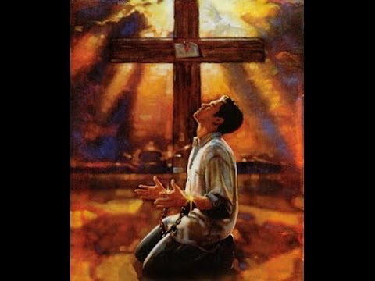
2 Corinthians 13:5
Examine yourselves to see whether you are in the faith; test yourselves. Do you not realize that Christ Jesus is in you—unless, of course, you fail the test?

Slide 17
2 Peter 1:10-11
Therefore, my brothers and sisters, make every effort to confirm your calling and election. For if you do these things, you will never stumble, ¹¹ and you will receive a rich welcome into the eternal kingdom of our Lord and Savior Jesus Christ.

Slide 18
2 Peter 1:5-7 For this very reason, make every effort to add to your faith goodness; and to goodness, knowledge; ⁶ and to knowledge, self-control; and to self-control, perseverance; and to perseverance, godliness; ⁷ and to godliness, mutual affection; and to mutual affection, love.

Slide 19
Then, when the question arises,
"When the Son of man comes, will He really find faith on the earth?"
the answer will be a resounding,
"Yes!"

