Slide 2
Hebrews 4:12 For the word of God is alive and active. Sharper than any double-edged sword, it penetrates even to dividing soul and spirit, joints and marrow; it judges the thoughts and attitudes of the heart.

Slide 3
“Time To Shine”

Slide 4
Philippians 2:12-16 Therefore, my dear friends, as you have always obeyed—not only in my presence, but now much more in my absence—continue to work out your salvation with fear and trembling^{, 13} for it is God who works in you to will and to act in order to fulfill his good purpose. ¹⁴ Do everything without grumbling or arguing, ¹⁵ so that you may become blameless and pure, “children of God without fault in a warped and crooked generation.” Then you will shine among them like stars in the sky ¹⁶ as you hold firmly to the word of life. And then I will be able to boast on the day of Christ that I did not run or labor in vain.

Slide 5
1 Corinthians 9:24-27 Do you not know that in a race all the runners run, but only one gets the prize? Run in such a way as to get the prize. ²⁵ Everyone who competes in the games goes into strict training. They do it to get a crown that will not last, but we do it to get a crown that will last forever. ²⁶ Therefore I do not run like someone running aimlessly; I do not fight like a boxer beating the air. ²⁷ No, I strike a blow to my body and make it my slave so that after I have preached to others, I myself will not be disqualified for the prize.

Slide 6
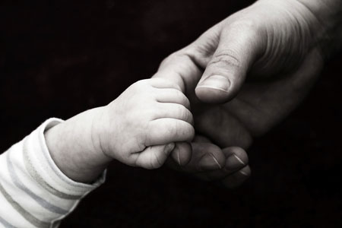
Hebrews 3:14 We have come to share in Christ, if indeed we hold our original conviction firmly to the very end.

Slide 7
Hebrews 6:9-11 Even though we speak like this, dear friends, we are convinced of better things in your case—the things that have to do with salvation. ¹⁰ God is not unjust; he will not forget your work and the love you have shown him as you have helped his people and continue to help them. ¹¹ We want each of you to show this same diligence to the very end, so that what you hope for may be fully realized.
Exodus 3:14

Slide 10
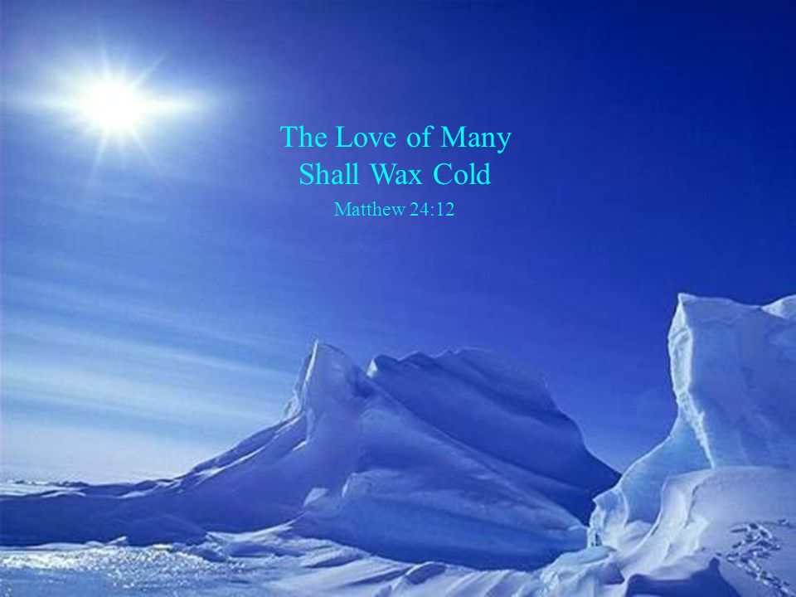
Matthew 24:11-13
and many false prophets will appear and deceive many people. ¹² Because of the increase of wickedness, the love of most will grow cold, ¹³ but the one who stands firm to the end will be saved.

Slide 11
Luke 6:27-36 “But to you who are listening I say: Love your enemies, do good to those who hate you, 28 bless those who curse you, pray for those who mistreat you. 29 If someone slaps you on one cheek, turn to them the other also. If someone takes your coat, do not withhold your shirt from them. 30 Give to everyone who asks you, and if anyone takes what belongs to you, do not demand it back. 31 Do to others as you would have them do to you.

Slide 12
Luke 6:32-36 “If you love those who love you, what credit is that to you? Even sinners love those who love them. 33 And if you do good to those who are good to you, what credit is that to you? Even sinners do that. 34 And if you lend to those from whom you expect repayment, what credit is that to you? Even sinners lend to sinners, expecting to be repaid in full. 35 But love your enemies, do good to them, and lend to them without expecting to get anything back. Then your reward will be great, and you will be children of the Most High, because he is kind to the ungrateful and wicked. 36 Be merciful, just as your Father is merciful.

Slide 13
Philippians 2:14-16 Do everything without grumbling or arguing, ¹⁵ so that you may become blameless and pure, “children of God without fault in a warped and crooked generation.” Then you will shine among them like stars in the sky ¹⁶ as you hold firmly to the word of life. And then I will be able to boast on the day of Christ that I did not run or labor in vain.

Slide 14
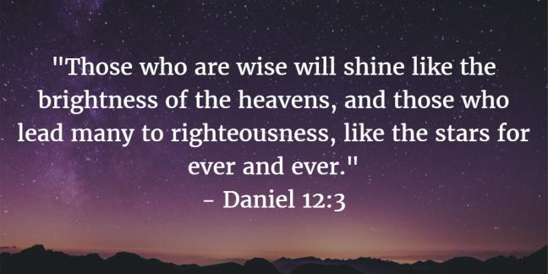
Matthew 11:29-30

