Slide 2
“The Life We Are
Called To Live ”

Slide 3
Hebrews 4:12 For the word of God is alive and active. Sharper than any double-edged sword, it penetrates even to dividing soul and spirit, joints and marrow; it judges the thoughts and attitudes of the heart.

Slide 4
John 6:14-15

Slide 5
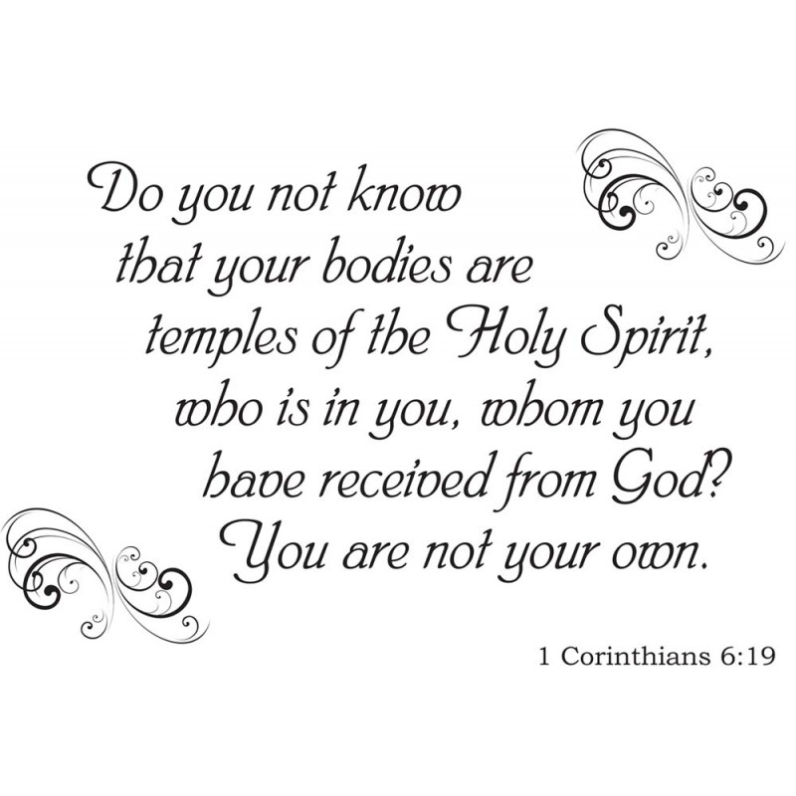

Slide 6
Ephesians 1:13-14
And you also were included in Christ when you heard the message of truth, the gospel of your salvation. When you believed, you were marked in him with a seal, the promised Holy Spirit, ¹⁴ who is a deposit guaranteeing our inheritance until the redemption of those who are God’s possession—to the praise of his glory.

Slide 8
Acts 6:7 So the word of God spread. The number of disciples in Jerusalem increased rapidly, and a large number of priests became obedient to the faith.
Acts 12:24 But the word of God continued to spread and flourish.
Acts 16:5 So the churches were strengthened in the faith and grew daily in number
Acts 19:20 In this way the word of the Lord spread widely and grew in power.
1 Timothy 1:15 Here is a trustworthy saying that deserves full acceptance: Christ Jesus came into the world to save sinners—of whom I am the worst.
Exodus 3:14

Slide 9
John 3:16-17
For God so loved the world that he gave his one and only Son, that whoever believes in him shall not perish but have eternal life. ¹⁷ For God did not send his Son into the world to condemn the world, but to save the world through him.

Slide 10
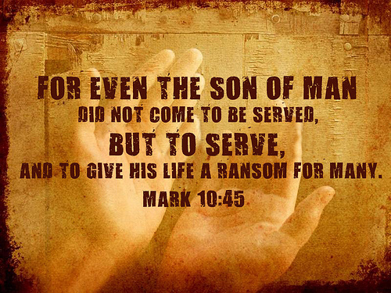

Slide 11
Do not suppose that I have come to bring peace to the earth. I did not come to bring peace, but a sword. ³⁵ For I have come to turn “‘a man against his father, a daughter against her mother, a daughter-in-law against her mother-in-law Matthew 10:34-35

Slide 12
Acts 1:7-9 He said to them: “It is not for you to know the times or dates the Father has set by his own authority. ⁸ But you will receive power when the Holy Spirit comes on you; and you will be my witnesses in Jerusalem, and in all Judea and Samaria, and to the ends of the earth.” ⁹ After he said this, he was taken up before their very eyes, and a cloud hid him from their sight.

Slide 13
Mark 16:14-16 ¹⁴ Later Jesus appeared to the Eleven as they were eating; he rebuked them for their lack of faith and their stubborn refusal to believe those who had seen him after he had risen.¹⁵ He said to them, “Go into all the world and preach the gospel to all creation.¹⁶ Whoever believes and is baptized will be saved, but whoever does not believe will be condemned.

Slide 15
Matthew 28:18-20
Then Jesus came to them and said, “All authority in heaven and on earth has been given to me. ¹⁹ Therefore go and make disciples of all nations, baptizing them in the name of the Father and of the Son and of the Holy Spirit, ²⁰ and teaching them to obey everything I have commanded you. And surely I am with you always, to the very end of the age.”

Slide 16
Matthew 10:22
You will be hated by everyone because of me, but the one who stands firm to the end will be saved.

Slide 17
“Then you will be handed over to be persecuted and put to death, and you will be hated by all nations because of me.
Matthew 24:9

Slide 18
2 Corinthians 4:8-10
We are hard pressed on every side, but not crushed; perplexed, but not in despair;⁹ persecuted, but not abandoned; struck down, but not destroyed. ¹⁰ We always carry around in our body the death of Jesus, so that the life of Jesus may also be revealed in our body.

Slide 19
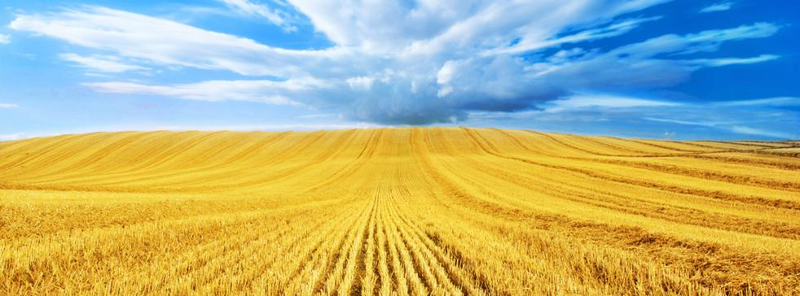
Luke 10:2 He told them, “The harvest is plentiful, but the workers are few. Ask the Lord of the harvest, therefore, to send out workers into his harvest field
Matthew 7:13-14 “Enter through the narrow gate. For wide is the gate and broad is the road that leads to destruction, and many enter through it. ¹⁴ But small is the gate and narrow the road that leads to life, and only a few find it

Slide 20
Romans 10:13-15 “Everyone who calls on the name of the Lord will be saved.” ¹⁴ How, then, can they call on the one they have not believed in? And how can they believe in the one of whom they have not heard? And how can they hear without someone preaching to them? ¹⁵ And how can anyone preach unless they are sent? As it is written: “How beautiful are the feet of those who bring good news!”

Slide 21
Revelation 2: 7 “He who has an ear, let him hear what the Spirit says to the churches. To him who overcomes I will give to eat from the tree of life, which is in the midst of the Paradise of God.”’
11 “He who has an ear, let him hear what the Spirit says to the churches. He who overcomes shall not be hurt by the second death.”
17 “He who has an ear, let him hear what the Spirit says to the churches. To him who overcomes I will give some of the hidden manna to eat. And I will give him a white stone, and on the stone a new name written which no one knows except him who receives it.”’
26 And he who overcomes, and keeps My works until the end, to him I will give power over the nations—

Slide 22
Revelation 3:5 He who overcomes shall be clothed in white garments, and I will not blot out his name from the Book of Life; but I will confess his name before My Father and before His angels.
12 He who overcomes, I will make him a pillar in the temple of My God, and he shall go out no more. I will write on him the name of My God and the name of the city of My God, the New Jerusalem, which comes down out of heaven from My God. And I will write on him My new name.
21 To him who overcomes I will grant to sit with Me on My throne, as I also overcame and sat down with My Father on His throne.

