Slide 2
The CALL
Come/Abide/Learn/Live

Slide 3
Hebrews 4:12
For the word of God is alive and active. Sharper than any double-edged sword, it penetrates even to dividing soul and spirit, joints and marrow; it judges the thoughts and attitudes of the heart.
Hebrews 4:12 For the word of God is alive and active. Sharper than any double-edged sword, it penetrates even to dividing soul and spirit, joints and marrow; it judges the thoughts and attitudes of the heart.

Slide 4
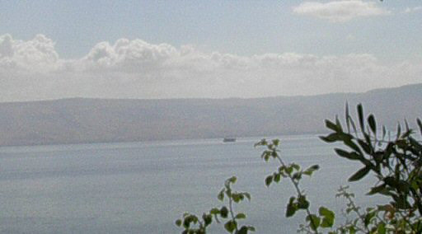
Matthew 4:18-20 As Jesus was walking beside the Sea of Galilee, he saw two brothers, Simon called Peter and his brother Andrew. They were casting a net into the lake, for they were fishermen. ¹⁹ “Come, follow me,” Jesus said, “and I will send you out to fish for people.” ²⁰ At once they left their nets and followed him.
John 6:14-15

Slide 5
Mark 1:16-18 As Jesus walked beside the Sea of Galilee, he saw Simon and his brother Andrew casting a net into the lake, for they were fishermen. ¹⁷ “Come, follow me,” Jesus said, “and I will send you out to fish for people.” ¹⁸ At once they left their nets and followed him.

Slide 6
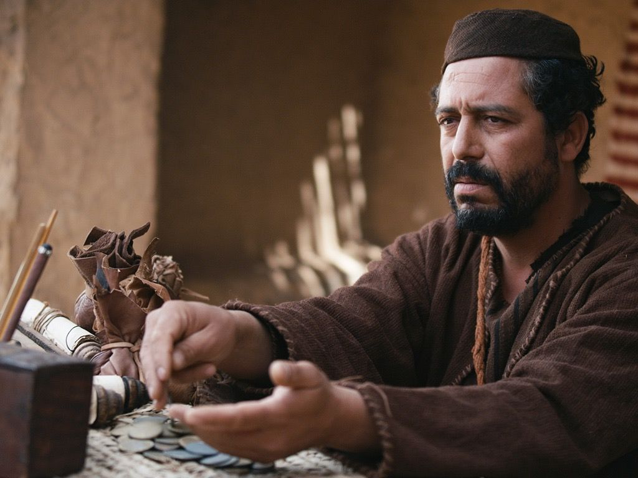
Matthew 9:9
As Jesus went on from there, he saw a man named Matthew sitting at the tax collector’s booth. “Follow me, ”he told him, and Matthew got up and followed him.

Slide 7
1 Corinthians 1:26-31 Brothers and sisters, think of what you were when you were called. Not many of you were wise by human standards; not many were influential; not many were of noble birth. ²⁷ But God chose the foolish things of the world to shame the wise; God chose the weak things of the world to shame the strong. ²⁸ God chose the lowly things of this world and the despised things—and the things that are not—to nullify the things that are, ²⁹ so that no one may boast before him. ³⁰ It is because of him that you are in Christ Jesus, who has become for us wisdom from God—that is, our righteousness, holiness and redemption. ³¹ Therefore, as it is written: “Let the one who boasts boast in the Lord.”

Slide 8
Mark 10:17, 21-22 As Jesus started on his way, a man ran up to him and fell on his knees before him. “Good teacher,” he asked, “what must I do to inherit eternal life?”…²¹Jesus looked at him and loved him. “One thing you lack,” he said. “Go, sell everything you have and give to the poor, and you will have treasure in heaven. Then come, follow me.”²² At this the man’s face fell. He went away sad, because he had great wealth.

Slide 9
Matthew 14:27-31 But Jesus immediately said to them: “Take courage! It is I. Don’t be afraid.” ²⁸ “Lord, if it’s you,” Peter replied, “tell me to come to you on the water.” ²⁹ “Come,” he said. Then Peter got down out of the boat, walked on the water and came toward Jesus. ³⁰ But when he saw the wind, he was afraid and, beginning to sink, cried out, “Lord, save me!” ³¹ Immediately Jesus reached out his hand and caught him. “You of little faith,” he said, “why did you doubt?”

Slide 10
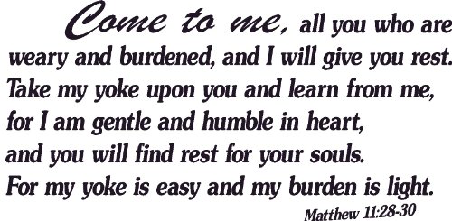
Exodus 3:14

Slide 11
Luke 6:46-49 “Why do you call me, ‘Lord, Lord,’ and do not do what I say? ⁴⁷ As for everyone who comes to me and hears my words and puts them into practice, I will show you what they are like. ⁴⁸ They are like a man building a house, who dug down deep and laid the foundation on rock. When a flood came, the torrent struck that house but could not shake it, because it was well built. ⁴⁹ But the one who hears my words and does not put them into practice is like a man who built a house on the ground without a foundation. The moment the torrent struck that house, it collapsed and its destruction was complete.”

Slide 12
1 Peter 2:20-21 But how is it to your credit if you receive a beating for doing wrong and endure it? But if you suffer for doing good and you endure it, this is commendable before God. ²¹ To this you were called, because Christ suffered for you, leaving you an example, that you should follow in his steps.

Slide 13
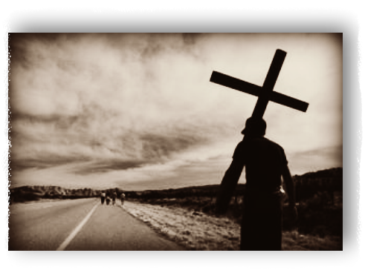
Matthew 16:24
Then Jesus said to his disciples, “Whoever wants to be my disciple must deny themselves and take up their cross and follow me.

Slide 14
Luke 14:15-23
When one of those at the table with him heard this, he said to Jesus, “Blessed is the one who will eat at the feast in the kingdom of God.”¹⁶ Jesus replied: “A certain man was preparing a great banquet and invited many guests. ¹⁷ At the time of the banquet he sent his servant to tell those who had been invited, ‘Come, for everything is now ready.’¹⁸ “But they all alike began to make excuses. The first said, ‘I have just bought a field, and I must go and see it. Please excuse me.’¹⁹ “Another said, ‘I have just bought five yoke of oxen, and I’m on my way to try them out. Please excuse me.’²⁰ “Still another said, ‘I just got married, so I can’t come.’²¹ “The servant came back and reported this to his master. Then the owner of the house became angry and ordered his servant, ‘Go out quickly into the streets and alleys of the town and bring in the poor, the crippled, the blind and the lame.’²² “‘Sir,’ the servant said, ‘what you ordered has been done, but there is still room.’²³ “Then the master told his servant, ‘Go out to the roads and country lanes and compel them to come in, so that my house will be full.

Slide 16
Matthew 21:28-31
“What do you think? There was a man who had two sons. He went to the first and said, ‘Son, go and work today in the vineyard.’²⁹ “‘I will not,’ he answered, but later he changed his mind and went.³⁰ “Then the father went to the other son and said the same thing. He answered, ‘I will, sir,’ but he did not go.³¹ “Which of the two did what his father wanted?” “The first,” they answered. Jesus said to them, “Truly I tell you, the tax collectors and the prostitutes are entering the kingdom of God ahead of you.

Slide 19
Joshua 1:9
Have I not commanded you? Be strong and courageous. Do not be afraid; do not be discouraged, for the Lord your God will be with you wherever you go.”

