Slide 2
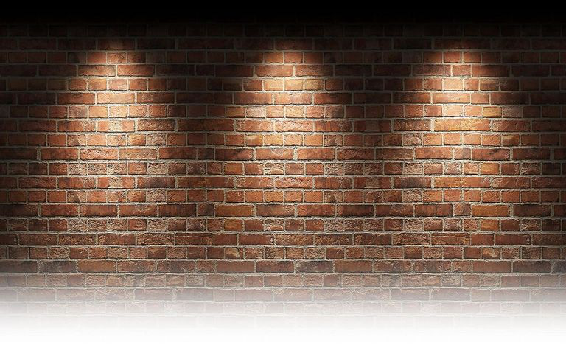
“Standing Before The Judgment Seat ”

Slide 3
Hebrews 4:12 For the word of God is alive and active. Sharper than any double-edged sword, it penetrates even to dividing soul and spirit, joints and marrow; it judges the thoughts and attitudes of the heart.

Slide 4
Philippians 1:9-11 And this is my prayer: that your love may abound more and more in knowledge and depth of insight, ¹⁰ so that you may be able to discern what is best and may be pure and blameless for the day of Christ, ¹¹ filled with the fruit of righteousness that comes through Jesus Christ—to the glory and praise of God.
John 6:14-15

Slide 5
2 Corinthians 5:10 For we must all appear before the judgment seat of Christ, so that each of us may receive what is due us for the things done while in the body, whether good or bad.

Slide 6
A good man out of the good treasure of his heart brings forth good things, and an evil man out of the evil treasure brings forth evil things. ³⁶ But I say to you that for every idle word men may speak, they will give account of it in the day of judgment. ³⁷ For by your words you will be justified, and by your words you will be condemned.”
Matthew 12:35-37

Slide 7
Romans 6:13 Do not offer any part of yourself to sin as an instrument of wickedness, but rather offer yourselves to God as those who have been brought from death to life; and offer every part of yourself to him as an instrument of righteousness.

Slide 8
Romans 14:10
You, then, why do you judge your brother or sister? Or why do you treat them with contempt? For we will all stand before God’s judgment seat.

Slide 9
1 Corinthians 3:11-15
For no one can lay any foundation other than the one already laid, which is Jesus Christ. ¹² If anyone builds on this foundation using gold, silver, costly stones, wood, hay or straw, ¹³ their work will be shown for what it is, because the Day will bring it to light. It will be revealed with fire, and the fire will test the quality of each person’s work. ¹⁴ If what has been built survives, the builder will receive a reward. ¹⁵ If it is burned up, the builder will suffer loss but yet will be saved—even though only as one escaping through the flames.

Slide 10
Romans 10:3 Since they did not know the righteousness of God and sought to establish their own, they did not submit to God’s righteousness.
Exodus 3:14

Slide 11
Matthew 5:6
Blessed are those who hunger and thirst for righteousness, for they will be filled.

Slide 12
Romans 2:4-5
Or do you show contempt for the riches of his kindness, forbearance and patience, not realizing that God’s kindness is intended to lead you to repentance? ⁵ But because of your stubbornness and your unrepentant heart, you are storing up wrath against yourself for the day of God’s wrath, when his righteous judgment will be revealed.

Slide 13
2 Corinthians 5:14-18
For Christ’s love compels us, because we are convinced that one died for all, and therefore all died. ¹⁵ And he died for all, that those who live should no longer live for themselves but for him who died for them and was raised again.¹⁶ So from now on we regard no one from a worldly point of view. Though we once regarded Christ in this way, we do so no longer.¹⁷ Therefore, if anyone is in Christ, the new creation has come: The old has gone, the new is here! ¹⁸ All this is from God, who reconciled us to himself through Christ and gave us the ministry of reconciliation:

Slide 14
Philippians 1:4-6 In all my prayers for all of you, I always pray with joy ⁵ because of your partnership in the gospel from the first day until now,⁶ being confident of this, that he who began a good work in you will carry it on to completion until the day of Christ Jesus.

