Slide 6
“Seldom Talked About Truth”

Slide 7
The Good News Times
John 6:14-15
¹⁴ After the people saw the sign Jesus performed, they began to say, “Surely this is the Prophet who is to come into the world.”¹⁵ Jesus, knowing that they intended to come and make him king by force, withdrew again to a mountain by himself.

Slide 8
John 6:26-27
Jesus answered them, “Truly, truly, I say to you, you are seeking me, not because you saw signs, but because you ate your fill of the loaves. ²⁷ Do not work for the food that perishes, but for the food that endures to eternal life, which the Son of Man will give to you.

Slide 9
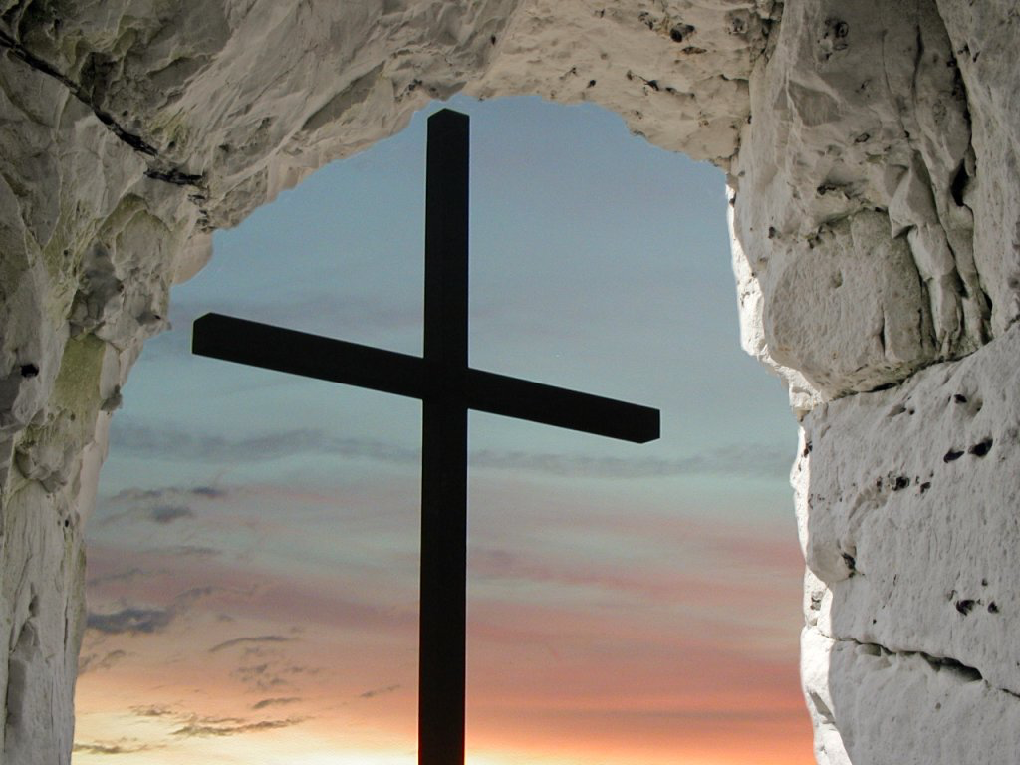
John 6:28-30
Then they said to him, “What must we do, to be doing the works of God?” ²⁹ Jesus answered them, “This is the work of God, that you believe in him whom he has sent.” ³⁰ So they said to him, “Then what sign do you do, that we may see and believe you?

Slide 10
John 6:35-36
Jesus said to them, “I am the bread of life; whoever comes to me shall not hunger, and whoever believes in me shall never thirst.³⁶ But I said to you that you have seen me and yet do not believe.

Slide 11
Acts 6:7 So the word of God spread. The number of disciples in Jerusalem increased rapidly, and a large number of priests became obedient to the faith.
Acts 12:24 But the word of God continued to spread and flourish.
Acts 16:5 So the churches were strengthened in the faith and grew daily in number
Acts 19:20 In this way the word of the Lord spread widely and grew in power.
John 6:38-40
For I have come down from heaven, not to do my own will but the will of him who sent me.³⁹ And this is the will of him who sent me, that I should lose nothing of all that he has given me, but raise it up on the last day.⁴⁰ For this is the will of my Father, that everyone who looks on the Son and believes in him should have eternal life, and I will raise him up on the last day.”
Exodus 3:14

Slide 12
John 6:48-52
I am the bread of life. ⁴⁹ Your ancestors ate the manna in the wilderness, yet they died. ⁵⁰ But here is the bread that comes down from heaven, which anyone may eat and not die. ⁵¹ I am the living bread that came down from heaven. Whoever eats this bread will live forever. This bread is my flesh, which I will give for the life of the world.” ⁵² Then the Jews began to argue sharply among themselves, “How can this man give us his flesh to eat?”

Slide 13
John 11:26
and everyone who lives and believes in me shall never die.
Do you believe this?”

Slide 14
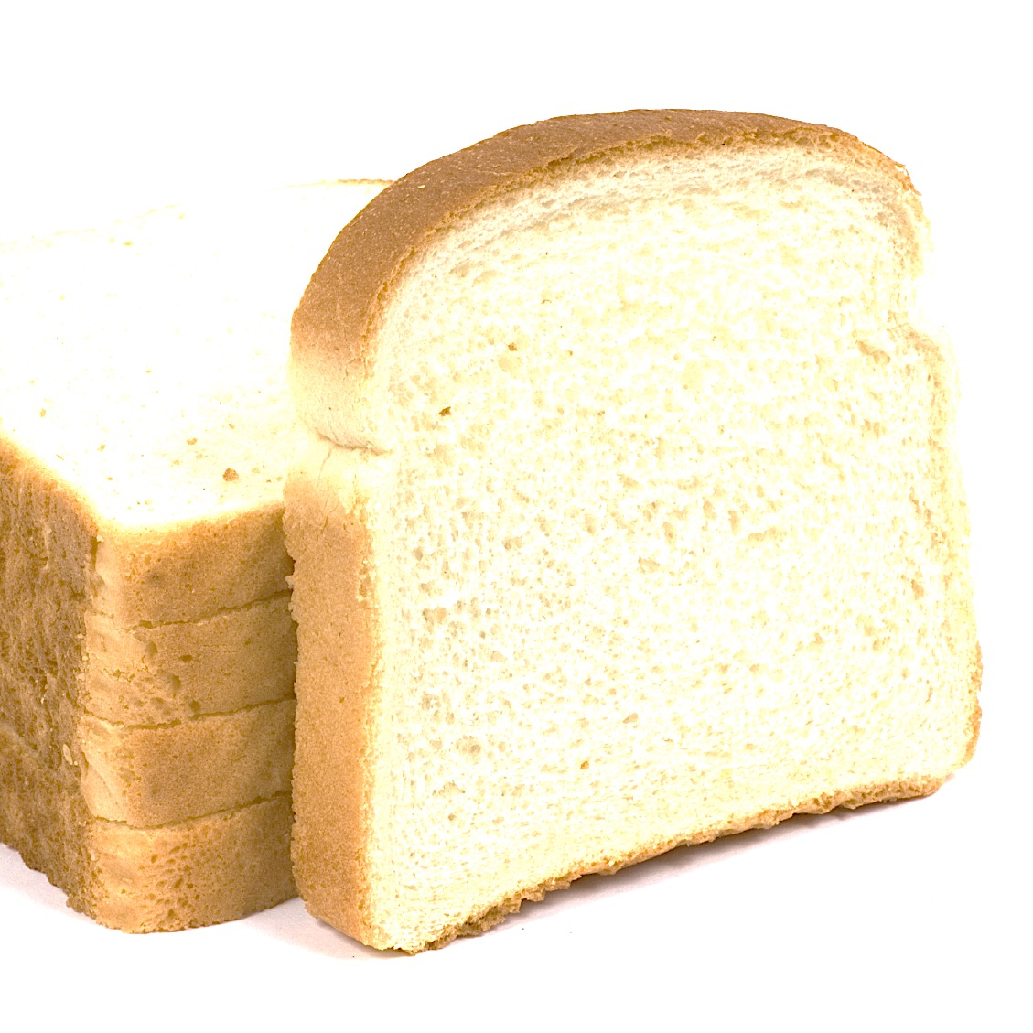
John 6: 53-59 Jesus said to them, “Very truly I tell you, unless you eat the flesh of the Son of Man and drink his blood, you have no life in you. ⁵⁴ Whoever eats my flesh and drinks my blood has eternal life, and I will raise them up at the last day. ⁵⁵ For my flesh is real food and my blood is real drink. ⁵⁶ Whoever eats my flesh and drinks my blood remains in me, and I in them. ⁵⁷ Just as the living Father sent me and I live because of the Father, so the one who feeds on me will live because of me. ⁵⁸ This is the bread that came down from heaven. Your ancestors ate manna and died, but whoever feeds on this bread will live forever.” ⁵⁹ He said this while teaching in the synagogue in Capernaum.

Slide 15
John 6:60-64 On hearing it, many of his disciples said, “This is a hard teaching. Who can accept it?” ⁶¹ Aware that his disciples were grumbling about this, Jesus said to them, “Does this offend you? ⁶² Then what if you see the Son of Man ascend to where he was before! ⁶³ The Spirit gives life; the flesh counts for nothing. The words I have spoken to you—they are full of the Spirit and life. ⁶⁴ Yet there are some of you who do not believe.” For Jesus had known from the beginning which of them did not believe and who would betray him.

Slide 16
John 6:66-69
From this time many of his disciples turned back and no longer followed him. ⁶⁷ “You do not want to leave too, do you?” Jesus asked the Twelve. ⁶⁸ Simon Peter answered him, “Lord, to whom shall we go? You have the words of eternal life. ⁶⁹ and we have believed, and have come to know, that you are the Holy One of God.”

Slide 17
Mark 4:30-32 Again he said, “What shall we say the kingdom of God is like, or what parable shall we use to describe it? ³¹ It is like a mustard seed, which is the smallest of all seeds on earth. ³² Yet when planted, it grows and becomes the largest of all garden plants, with such big branches that the birds can perch in its shade.”

Slide 18
Matthew 11:29-30

Slide 19
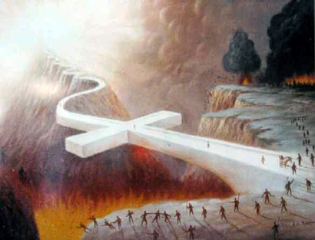
Matthew 7:13-15 “Enter by the narrow gate. For the gate is wide and the way is easy that leads to destruction, and those who enter by it are many. ¹⁴ For the gate is narrow and the way is hard that leads to life, and those who find it are few.¹⁵ “Beware of false prophets, who come to you in sheep's clothing but inwardly are ravenous wolves.

Slide 20
Acts 14:21-22
And when they had preached the gospel to that city and made many disciples, they returned to Lystra, Iconium, and Antioch, ²² strengthening the souls of the disciples, exhorting them to continue in the faith, and saying, “We must through many tribulations enter the kingdom of God.”

Slide 21
1 John 5:4-5 For whatever is born of God overcomes the world. And this is the victory that has overcome the world—our faith. ⁵ Who is he who overcomes the world, but he who believes that Jesus is the Son of God?
Romans 8:37 Yet in all these things we are more than conquerors through Him who loved us.
John 16:33 These things I have spoken to you, that in Me you may have peace. In the world you will have tribulation; but be of good cheer, I have overcome the world.”

Slide 22
Luke 14:25-33 Now great multitudes went with Him. And He turned and said to them, ²⁶ “If anyone comes to Me and does not hate his father and mother, wife and children, brothers and sisters, yes, and his own life also, he cannot be My disciple. ²⁷ And whoever does not bear his cross and come after Me cannot be My disciple.

Slide 23
²⁸ For which of you, intending to build a tower, does not sit down first and count the cost, whether he has enough to finish it— ²⁹ lest, after he has laid the foundation, and is not able to finish, all who see it begin to mock him, ³⁰ saying, ‘This man began to build and was not able to finish’? ³¹ Or what king, going to make war against another king, does not sit down first and consider whether he is able with ten thousand to meet him who comes against him with twenty thousand? ³² Or else, while the other is still a great way off, he sends a delegation and asks conditions of peace. ³³ So likewise, whoever of you does not forsake all that he has cannot be My disciple.

