Slide 2
“Seeking As You Were Sought ”

Slide 3
Hebrews 4:12
For the word of God is alive and active. Sharper than any double-edged sword, it penetrates even to dividing soul and spirit, joints and marrow; it judges the thoughts and attitudes of the heart.
Hebrews 4:12 For the word of God is alive and active. Sharper than any double-edged sword, it penetrates even to dividing soul and spirit, joints and marrow; it judges the thoughts and attitudes of the heart.

Slide 4
John 6:14-15

Slide 5
Luke 19 :1-10 Jesus entered Jericho and was passing through. ² A man was there by the name of Zacchaeus; he was a chief tax collector and was wealthy. ³ He wanted to see who Jesus was, but because he was short he could not see over the crowd. ⁴ So he ran ahead and climbed a sycamore-fig tree to see him, since Jesus was coming that way.⁵ When Jesus reached the spot, he looked up and said to him, “Zacchaeus, come down immediately. I must stay at your house today.” ⁶ So he came down at once and welcomed him gladly.⁷ All the people saw this and began to mutter, “He has gone to be the guest of a sinner.”⁸ But Zacchaeus stood up and said to the Lord, “Look, Lord! Here and now I give half of my possessions to the poor, and if I have cheated anybody out of anything, I will pay back four times the amount.”⁹ Jesus said to him, “Today salvation has come to this house, because this man, too, is a son of Abraham. ¹⁰ For the Son of Man came to seek and to save the lost.”

Slide 7
1 Timothy 1:15
Here is a trustworthy saying that deserves full acceptance: Christ Jesus came into the world to save sinners—of whom I am the worst.

Slide 8
1 Chronicles 16:8-11
Give praise to the Lord, proclaim his name; make known among the nations what he has done.⁹ Sing to him, sing praise to him; tell of all his wonderful acts.¹⁰ Glory in his holy name; let the hearts of those who seek the Lord rejoice. ¹¹ Look to the Lord and his strength; seek his face always.

Slide 9
1 Corinthians 11:23-26 For I received from the Lord what I also passed on to you: The Lord Jesus, on the night he was betrayed, took bread, ²⁴ and when he had given thanks, he broke it and said, “This is my body, which is for you; do this in remembrance of me.” ²⁵ In the same way, after supper he took the cup, saying, “This cup is the new covenant in my blood; do this, whenever you drink it, in remembrance of me.”²⁶ For whenever you eat this bread and drink this cup, you proclaim the Lord’s death until he comes.

Slide 10
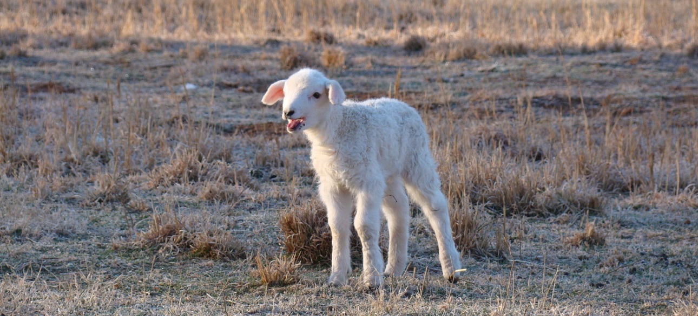
Exodus 3:14
Luke 19:10 For the Son of Man came to seek and to save the lost.”

Slide 11
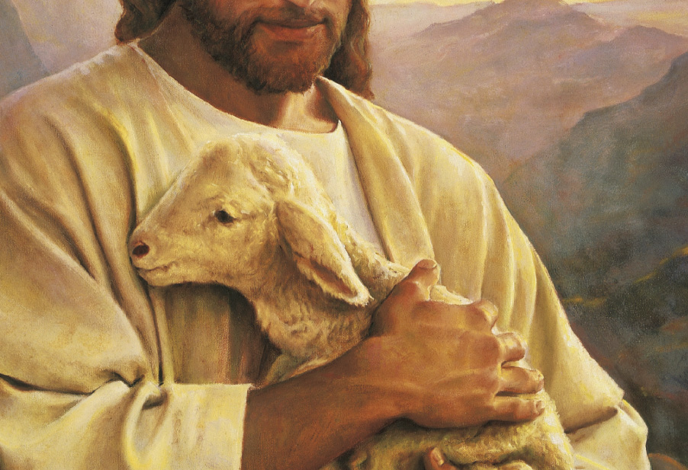
Luke 15:3-7 Then Jesus told them this parable: ⁴ “Suppose one of you has a hundred sheep and loses one of them. Doesn’t he leave the ninety-nine in the open country and go after the lost sheep until he finds it? ⁵ And when he finds it, he joyfully puts it on his shoulders ⁶ and goes home. Then he calls his friends and neighbors together and says, ‘Rejoice with me; I have found my lost sheep.’ ⁷ I tell you that in the same way there will be more rejoicing in heaven over one sinner who repents than over ninety-nine righteous persons who do not need to repent.

Slide 12
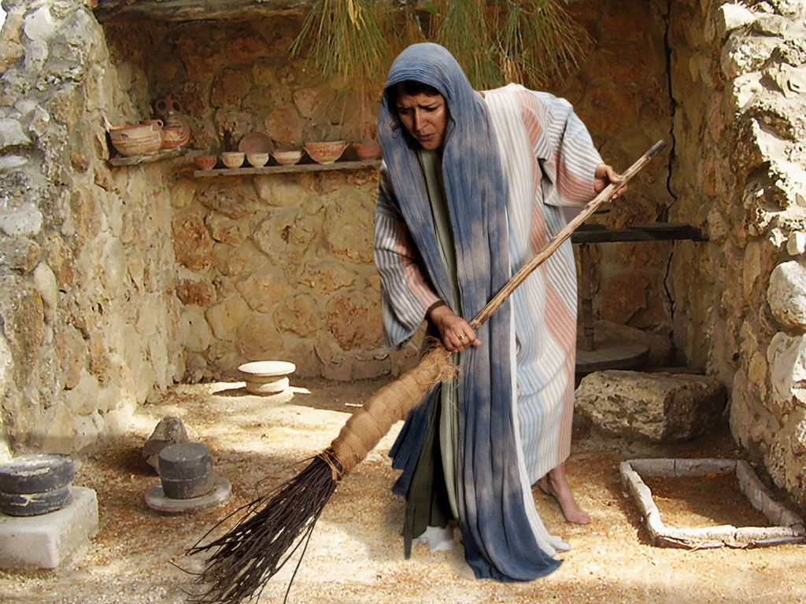
Luke 15:8-10 “Or suppose a woman has ten silver coins and loses one. Doesn’t she light a lamp, sweep the house and search carefully until she finds it? ⁹ And when she finds it, she calls her friends and neighbors together and says, ‘Rejoice with me; I have found my lost coin.’¹⁰ In the same way, I tell you, there is rejoicing in the presence of the angels of God over one sinner who repents.”

Slide 13
Luke 15:17-22
“When he came to his senses, he said, ‘How many of my father’s hired servants have food to spare, and here I am starving to death!¹⁸ I will set out and go back to my father and say to him: Father, I have sinned against heaven and against you. ¹⁹ I am no longer worthy to be called your son; make me like one of your hired servants.’ ²⁰ So he got up and went to his father. “But while he was still a long way off, his father saw him and was filled with compassion for him; he ran to his son, threw his arms around him and kissed him.²¹ “The son said to him, ‘Father, I have sinned against heaven and against you. I am no longer worthy to be called your son.’²² “But the father said to his servants, ‘Quick! Bring the best robe and put it on him. Put a ring on his finger and sandals on his feet.

Slide 14
Matthew 7:21
“Not everyone who says to me, ‘Lord, Lord,’ will enter the kingdom of heaven, but only the one who does the will of my Father who is in heaven.”

Slide 15
Matthew 12:50
For whoever does the will of my Father in heaven is my brother and sister and mother.”

Slide 16
Luke 19:10
For the Son of Man came to seek and to save the lost.”

