Slide 2
Hebrews 4:12 For the word of God is alive and active. Sharper than any double-edged sword, it penetrates even to dividing soul and spirit, joints and marrow; it judges the thoughts and attitudes of the heart.

Slide 3
“Seeing God”

Slide 4
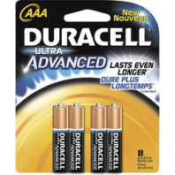
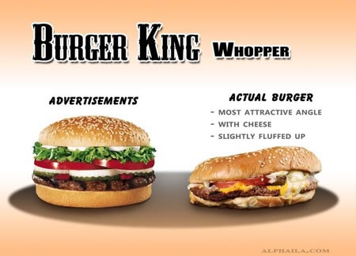
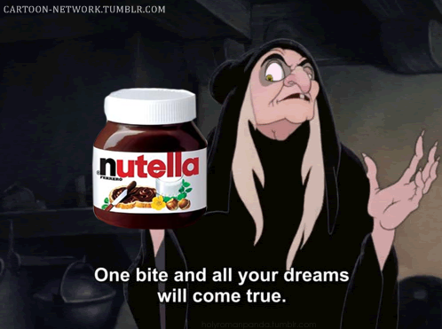
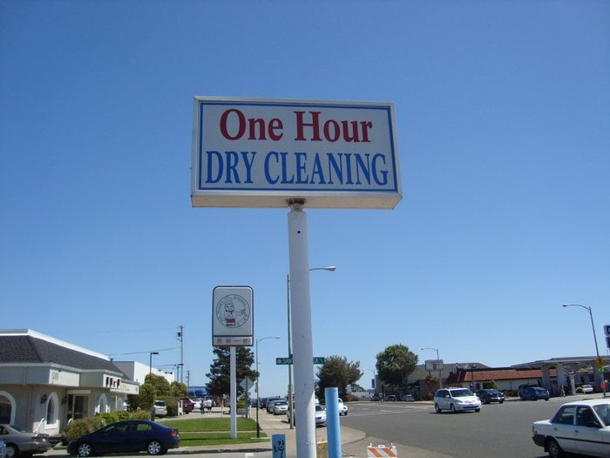

Slide 6
Isaiah 29:13 The Lord says: “These people come near to me with their mouth and honor me with their lips, but their hearts are far from me. Their worship of me is based on merely human rules they have been taught.
Mark 7:6 He replied, “Isaiah was right when he prophesied about you hypocrites; as it is written:“ ‘These people honor me with their lips, but their hearts are far from me.

Slide 7
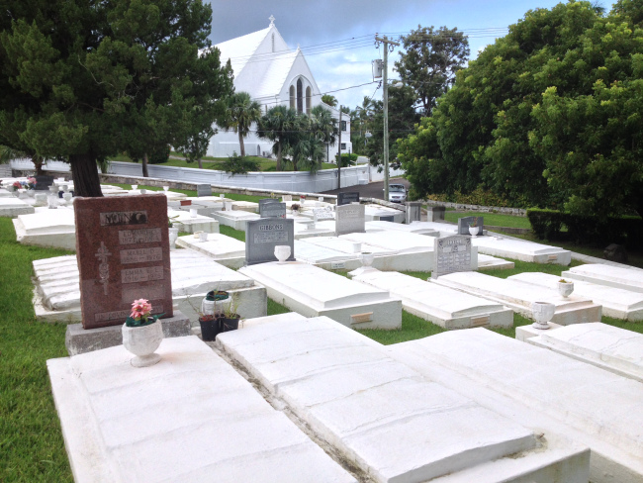
Acts 6:7 So the word of God spread. The number of disciples in Jerusalem increased rapidly, and a large number of priests became obedient to the faith.
Acts 12:24 But the word of God continued to spread and flourish.
Acts 16:5 So the churches were strengthened in the faith and grew daily in number
Acts 19:20 In this way the word of the Lord spread widely and grew in power.
Exodus 3:14
Matthew 23:27 “Woe to you, teachers of the law and Pharisees, you hypocrites! You are like whitewashed tombs, which look beautiful on the outside but on the inside are full of the bones of the dead and everything unclean..

Slide 9
Proverbs 4:23 Above all else, guard your heart, for everything you do flows from it.

Slide 10
Hebrews 12:14 Make every effort to live in peace with everyone and to be holy; without holiness no one will see the Lord.
Ephesians 4:22-24 You were taught, with regard to your former way of life, to put off your old self, which is being corrupted by its deceitful desires; ²³ to be made new in the attitude of your minds; ²⁴ and to put on the new self, created to be like God in true righteousness and holiness.

Slide 11
Isaiah 33:15-16 Those who walk righteously and speak what is right, who reject gain from extortion and keep their hands from accepting bribes, who stop their ears against plots of murder and shut their eyes against contemplating evil—16 they are the ones who will dwell on the heights, whose refuge will be the mountain fortress. Their bread will be supplied, and water will not fail them.

Slide 12
1 Samuel 16:7 But the Lord said to Samuel, “Do not consider his appearance or his height, for I have rejected him. The Lord does not look at the things people look at. People look at the outward appearance, but the Lord looks at the heart.”

Slide 13
“Not everyone who says to me, ‘Lord, Lord,’ will enter the kingdom of heaven, but only the one who does the will of my Father who is in heaven. ²² Many will say to me on that day, ‘Lord, Lord, did we not prophesy in your name and in your name drive out demons and in your name perform many miracles?’ ²³ Then I will tell them plainly, ‘I never knew you. Away from me, you evildoers!’
Matthew 7:21-23
“Lord, Lord”

Slide 14
Acts 6:3-5 Brothers and sisters, choose seven men from among you who are known to be full of the Spirit and wisdom. We will turn this responsibility over to them ⁴ and will give our attention to prayer and the ministry of the word.” ⁵ This proposal pleased the whole group. They chose Stephen, a man full of faith and of the Holy Spirit; also……..Phillip…
Acts 6:8 Now Stephen, a man full of God’s grace and power, performed great wonders and signs among the people.
Matthew 11:29-30
Acts 8:6 When the crowds heard Philip and saw the signs he performed, they all paid close attention to what he said.
Acts 7:55 But Stephen, full of the Holy Spirit, looked up to heaven and saw the glory of God, and Jesus standing at the right hand of God.

Slide 15
Psalm 24:3-5 Who may ascend the mountain of the Lord? Who may stand in his holy place? ⁴ The one who has clean hands and a pure heart, who does not trust in an idol or swear by a false god. ⁵ They will receive blessing from the Lord and vindication from God their Savior.

Slide 16
Matthew 6:1-4
“Be careful not to practice your righteousness in front of others to be seen by them. If you do, you will have no reward from your Father in heaven. ² “So when you give to the needy, do not announce it with trumpets, as the hypocrites do in the synagogues and on the streets, to be honored by others. Truly I tell you, they have received their reward in full. ³ But when you give to the needy, do not let your left hand know what your right hand is doing, ⁴ so that your giving may be in secret. Then your Father, who sees what is done in secret, will reward you.

Slide 17
Proverbs 22:11 One who loves a pure heart and who speaks with grace will have the king for a friend.

