Slide 1
Hebrews 4:12 For the word of God is alive and active. Sharper than any double-edged sword, it penetrates even to dividing soul and spirit, joints and marrow; it judges the thoughts and attitudes of the heart.

Slide 3
“NOT WHAT WAS EXPECTED ”

Slide 4
Psalm 118:25-26 Lord, save us! Lord, grant us success! ²⁶ Blessed is he who comes in the name of the Lord. From the house of the Lord we bless you

Slide 5
Matthew 21:9 The crowds that went ahead of him and those that followed shouted, “Hosanna to the Son of David!” “Blessed is he who comes in the name of the Lord!” “Hosanna in the highest heaven!”

Slide 6
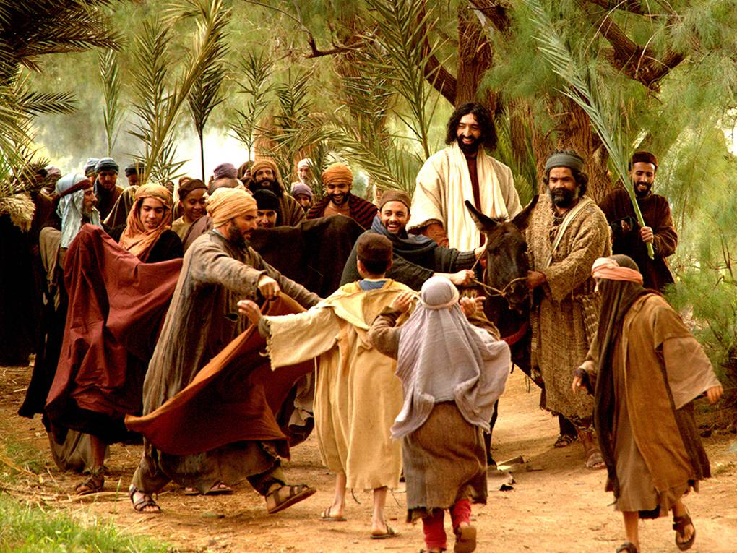
Zechariah 9:9 Rejoice greatly, O daughter of Zion! Shout aloud, O daughter of Jerusalem! Behold, your king is coming to you righteous and having salvation is he, humble and mounted on a donkey, on a colt, the foal of a donkey.

Slide 7
Matthew 23:37-39 “Jerusalem, Jerusalem, you who kill the prophets and stone those sent to you, how often I have longed to gather your children together, as a hen gathers her chicks under her wings, and you were not willing^{.38} Look, your house is left to you desolate. ³⁹ For I tell you, you will not see me again until you say, ‘Blessed is he who comes in the name of the Lord.’”

Slide 8
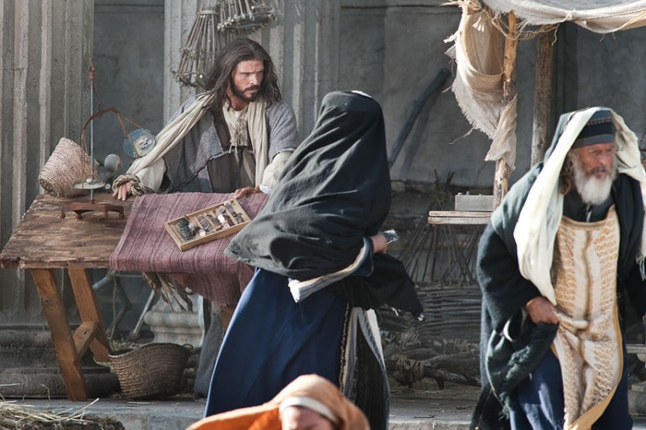
Luke 19:45-46
When Jesus entered the temple courts, he began to drive out those who were selling. ⁴⁶ “It is written,” he said to them, “‘My house will be a house of prayer’; but you have made it ‘a den of robbers.’”

Slide 9
John 12:16 His disciples did not understand these things at first, but when Jesus was glorified, then they remembered that these things had been written about him and had been done to him.

Slide 10
Zechariah 9:9-10 Rejoice greatly, O daughter of Zion! Shout aloud, O daughter of Jerusalem! Behold, your king is coming to you; righteous and having salvation is he, humble and mounted on a donkey, on a colt, the foal of a donkey. ¹⁰ I will cut off the chariot from Ephraim and the war horse from Jerusalem; and the battle bow shall be cut off, and he shall speak peace to the nations; his rule shall be from sea to sea, and from the River to the ends of the earth.

Slide 11
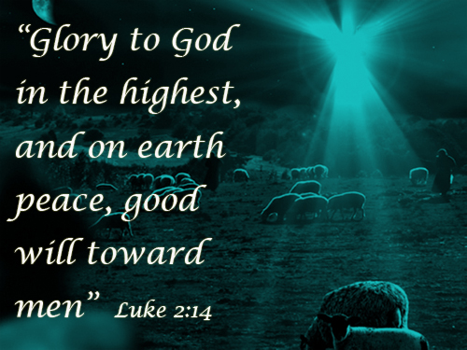

Slide 12
Philippians 2:5-8 In your relationships with one another, have the same mindset as Christ Jesus: ⁶ Who, being in very nature God, did not consider equality with God something to be used to his own advantage; ⁷ rather, he made himself nothing by taking the very nature of a servant, being made in human likeness^{.8} And being found in appearance as a man, he humbled himself by becoming obedient to death—even death on a cross!
Philippians 2:5-8 In your relationships with one another, have the same mindset as Christ Jesus: ⁶ Who, being in very nature God, did not consider equality with God something to be used to his own advantage; ⁷ rather, he made himself nothing by taking the very nature of a servant, being made in human likeness^{.8} And being found in appearance as a man, he humbled himself by becoming obedient to death—even death on a cross!
Exodus 3:14

