Slide 2
The CALL
Come/Abide/Learn/Live

Slide 3
Hebrews 4:12
For the word of God is alive and active. Sharper than any double-edged sword, it penetrates even to dividing soul and spirit, joints and marrow; it judges the thoughts and attitudes of the heart.
Hebrews 4:12 For the word of God is alive and active. Sharper than any double-edged sword, it penetrates even to dividing soul and spirit, joints and marrow; it judges the thoughts and attitudes of the heart.

Slide 4
Mathew 4:19-20 “Come, follow me,” Jesus said, “and I will send you out to fish for people.” ²⁰ At once they left their nets and followed him.

Slide 5
Matthew 14:28-30
²⁹ “Come,” he said. Then Peter got down out of the boat, walked on the water and came toward Jesus. ³⁰ But when he saw the wind, he was afraid and, beginning to sink, cried out, “Lord, save me!
John 6:14-15

Slide 7
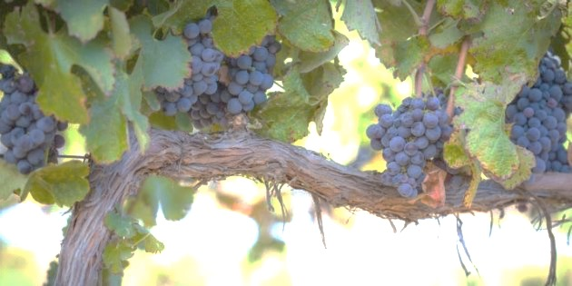
John 15:1- 4
“I am the true vine, and My Father is the vinedresser. ² Every branch in Me that does not bear fruit He takes away; and every branch that bears fruit He prunes, that it may bear more fruit. ³ You are already clean because of the word which I have spoken to you. ⁴ Abide in Me, and I in you. As the branch cannot bear fruit of itself, unless it abides in the vine, neither can you, unless you abide in Me.

Slide 9
John 5:39-40
You study the Scriptures diligently because you think that in them you have eternal life. These are the very Scriptures that testify about me, ⁴⁰ yet you refuse to come to me to have life.
Exodus 3:14

Slide 10
Matthew 7:21
“Not everyone who says to me, ‘Lord, Lord,’ will enter the kingdom of heaven, but only the one who does the will of my Father who is in heaven.

Slide 12
Ephesians 4:1
As a prisoner for the Lord, then, I urge you to live a life worthy of the calling you have received.

Slide 13
Ephesians 3:16-19
I pray that out of his glorious riches he may strengthen you with power through his Spirit in your inner being, ¹⁷ so that Christ may dwell in your hearts through faith. And I pray that you, being rooted and established in love, ¹⁸ may have power, together with all the Lord’s holy people, to grasp how wide and long and high and deep is the love of Christ, ¹⁹ and to know this love that surpasses knowledge—that you may be filled to the measure of all the fullness of God.

Slide 15
John 10:10
The thief does not come except to steal, and to kill, and to destroy. I have come that they may have life, and that they may have it more abundantly.

Slide 16
John 14:6
Jesus said to him, “I am the way, the truth, and the life. No one comes to the Father except through Me.

Slide 17
Luke 9:23Then Jesus said to his disciples, “Whoever wants to be my disciple must deny themselves and take up their cross and follow me.

Slide 18
John 15:9-11
“As the Father loved Me, I also have loved you; abide in My love. ¹⁰ If you keep My commandments, you will abide in My love, just as I have kept My Father’s commandments and abide in His love.¹¹ “These things I have spoken to you, that My joy may remain in you, and that your joy may be full.

Slide 19
Luke 10:25-28
On one occasion an expert in the law stood up to test Jesus. “Teacher,” he asked, “what must I do to inherit eternal life? ”²⁶ “What is written in the Law?” He replied. “How do you read it?” ²⁷ He answered, “‘Love the Lord your God with all your heart and with all your soul and with all your strength and with all your mind’; and, ‘Love your neighbor as yourself.’” ²⁸ “You have answered correctly,” Jesus replied. “Do this and you will live.”

Slide 20
1 Corinthians 10:31
So whether you eat or drink or whatever you do, do it all for the glory of God.

Slide 22
2 Corinthians 5:1-2
For we know that if the earthly tent we live in is destroyed, we have a building from God, an eternal house in heaven, not built by human hands. ² Meanwhile we groan, longing to be clothed instead with our heavenly dwelling,

Slide 23
Matthew 28:18-20
Then Jesus came to them and said, “All authority in heaven and on earth has been given to me.¹⁹ Therefore go and make disciples of all nations, baptizing them in the name of the Father and of the Son and of the Holy Spirit, ²⁰ and teaching them to obey everything I have commanded you. And surely I am with you always, to the very end of the age.”

