Slide 2
The CALL
Come/Abide/Learn/Live

Slide 3
Hebrews 4:12
For the word of God is alive and active. Sharper than any double-edged sword, it penetrates even to dividing soul and spirit, joints and marrow; it judges the thoughts and attitudes of the heart.
Hebrews 4:12 For the word of God is alive and active. Sharper than any double-edged sword, it penetrates even to dividing soul and spirit, joints and marrow; it judges the thoughts and attitudes of the heart.

Slide 4
Mathew 4:19 “Come, follow me,” Jesus said, “and I will send you out to fish for people.” ²⁰ At once they left their nets and followed him.

Slide 5
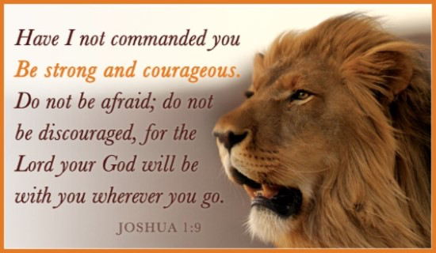
John 6:14-15

Slide 6
ABIDE :
To stay; to continue in a place; to have one's abode; to dwell;
To wait; to pause; to remain stable or fixed in some state or condition; to continue; to remain.
To wait for; to be prepared for; to await; to watch for;

Slide 7
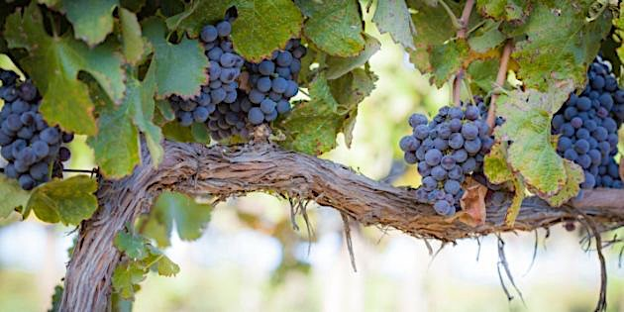
John 15:5
“I am the vine, you are the branches. He who abides in Me, and I in him, bears much fruit; for without Me you can do nothing.

Slide 9
Ezekiel 34:27
The trees will yield their fruit and the ground will yield its crops; the people will be secure in their land. They will know that I am the Lord, when I break the bars of their yoke and rescue them from the hands of those who enslaved them.
Exodus 3:14

Slide 12
Luke 6:46,
“Why do you call me ‘Lord, Lord,’ and not do what I say?”

Slide 14
Matthew 7:21
“Not everyone who says to me, ‘Lord, Lord,’ will enter the kingdom of heaven, but only the one who does the will of my Father who is in heaven.

Slide 15
Luke 10:25-28
On one occasion an expert in the law stood up to test Jesus. “Teacher,” he asked, “what must I do to inherit eternal life? ”²⁶ “What is written in the Law?” He replied. “How do you read it?” ²⁷ He answered, “‘Love the Lord your God with all your heart and with all your soul and with all your strength and with all your mind’; and, ‘Love your neighbor as yourself.’” ²⁸ “You have answered correctly,” Jesus replied. “Do this and you will live.”

Slide 16
Matthew 5: 1-11 Now when Jesus saw the crowds, he went up on a mountainside and sat down. His disciples came to him, ² and he began to teach them. He said:
³ “Blessed are the poor in spirit, for theirs is the kingdom of heaven. ⁴ Blessed are those who mourn, for they will be comforted. ⁵ Blessed are the meek, for they will inherit the earth. ⁶ Blessed are those who hunger and thirst for righteousness, for they will be filled. ⁷ Blessed are the merciful, for they will be shown mercy. ⁸ Blessed are the pure in heart, for they will see God. ⁹ Blessed are the peacemakers, for they will be called children of God. ¹⁰ Blessed are those who are persecuted because of righteousness, for theirs is the kingdom of heaven. ¹¹ “Blessed are you when people insult you, persecute you and falsely say all kinds of evil against you because of me. ¹² Rejoice and be glad, because great is your reward in heaven, for in the same way they persecuted the prophets who were before you.

Slide 17
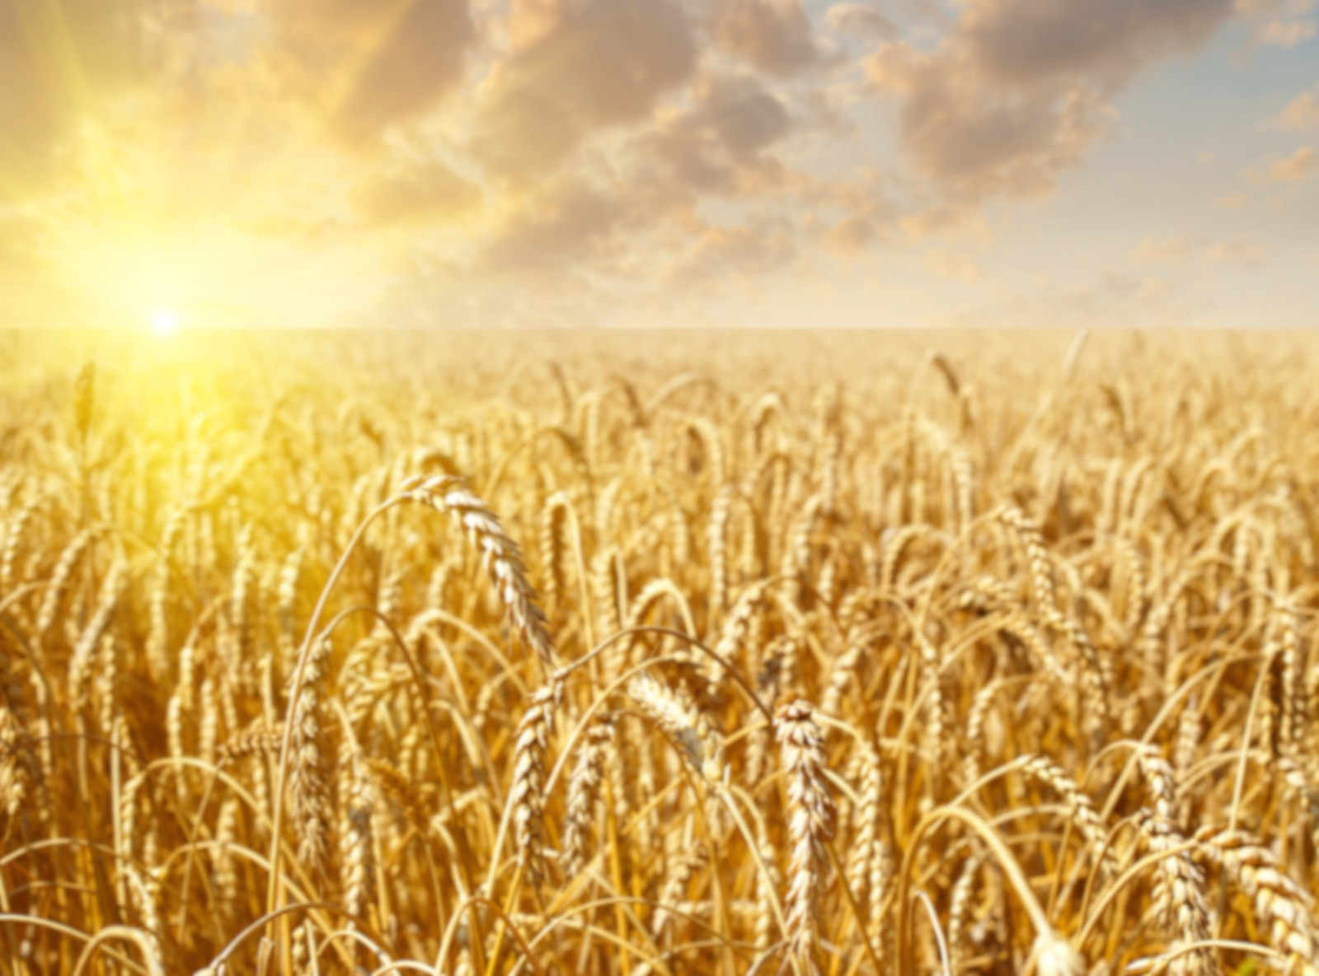
John 4:34-35
“My food,” said Jesus, “is to do the will of him who sent me and to finish his work. ³⁵ Don’t you have a saying, ‘It’s still four months until harvest’? I tell you, open your eyes and look at the fields! They are ripe for harvest.

Slide 18
Matthew 28:18-20 Then Jesus came to them and said, “All authority in heaven and on earth has been given to me.¹⁹ Therefore go and make disciples of all nations, baptizing them in the name of the Father and of the Son and of the Holy Spirit, ²⁰ and teaching them to obey everything I have commanded you. And surely I am with you always, to the very end of the age.”

Slide 20
Luke 6:46,
“Why do you call me ‘Lord, Lord,’ and not do what I say?”

