Slide 2
Hebrews 4:12 For the word of God is alive and active. Sharper than any double-edged sword, it penetrates even to dividing soul and spirit, joints and marrow; it judges the thoughts and attitudes of the heart.

Slide 3
“In HIM We Have Life”

Slide 4
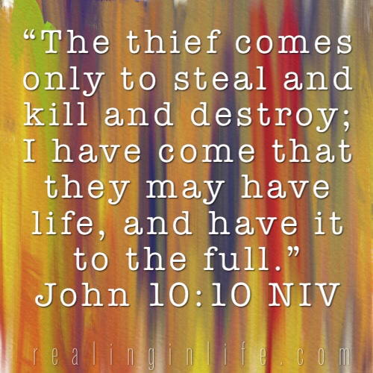
John 6:14-15

Slide 5
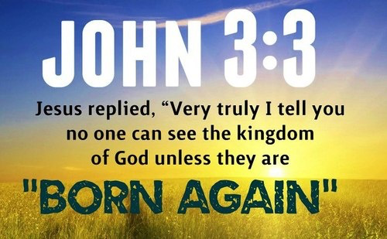

Slide 6
1 Peter 1:23-24 For you have been born again, not of perishable seed, but of imperishable, through the living and enduring word of God. ²⁴ For, “All people are like grass, and all their glory is like the flowers of the field; the grass withers and the flowers fall, ²⁵ but the word of the Lord endures forever.” And this is the word that was preached to you.
Jeremiah 51:6 “Flee from Babylon! Run for your lives! Do not be destroyed because of her sins. It is time for the Lord’s vengeance; he will repay her what she deserves.

Slide 7
Acts 6:7 So the word of God spread. The number of disciples in Jerusalem increased rapidly, and a large number of priests became obedient to the faith.
Acts 12:24 But the word of God continued to spread and flourish.
Acts 16:5 So the churches were strengthened in the faith and grew daily in number
Acts 19:20 In this way the word of the Lord spread widely and grew in power.
Exodus 3:14

Slide 8
Romans 6:4 We were therefore buried with him through baptism into death in order that, just as Christ was raised from the dead through the glory of the Father, we too may live a new life.

Slide 9
Romans 8:11 And if the Spirit of him who raised Jesus from the dead is living in you, he who raised Christ from the dead will also give life to your mortal bodies because of his Spirit who lives in you.

Slide 11
Matthew 6:25 “Therefore I tell you, do not worry about your life, what you will eat or drink; or about your body, what you will wear. Is not life more than food, and the body more than clothes?

Slide 13
Ezekiel 33: 1-7 The word of the Lord came to me: ² “Son of man, speak to your people and say to them: ‘When I bring the sword against a land, and the people of the land choose one of their men and make him their watchman, ³ and he sees the sword coming against the land and blows the trumpet to warn the people, ⁴ then if anyone hears the trumpet but does not heed the warning and the sword comes and takes their life, their blood will be on their own head. ⁵ Since they heard the sound of the trumpet but did not heed the warning, their blood will be on their own head. If they had heeded the warning, they would have saved themselves^{. 6} But if the watchman sees the sword coming and does not blow the trumpet to warn the people and the sword comes and takes someone’s life, that person’s life will be taken because of their sin, but I will hold the watchman accountable for their blood.’⁷ “Son of man, I have made you a watchman for the people of Israel; so hear the word I speak and give them warning from me.

Slide 14
Philippians 2:12-15
Therefore, my dear friends, as you have always obeyed—not only in my presence, but now much more in my absence—continue to work out your salvation with fear and trembling, ¹³ for it is God who works in you to will and to act in order to fulfill his good purpose. ¹⁴ Do everything without grumbling or arguing, ¹⁵ so that you may become blameless and pure, “children of God without fault in a warped and crooked generation.” Then you will shine among them like stars in the sky

Slide 15
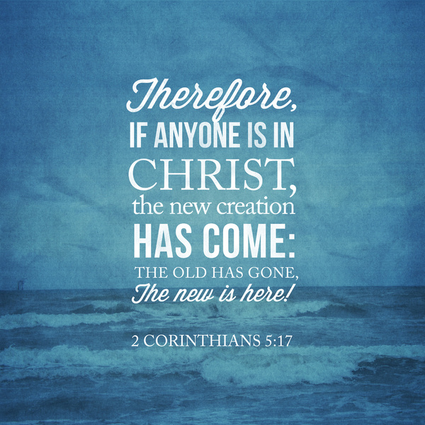

Slide 16
Romans 6:4
We were therefore buried with him through baptism into death in order that, just as Christ was raised from the dead through the glory of the Father, we too may live a new life.

Slide 17
2 Corinthians 3:6
He has made us competent as ministers of a new covenant—not of the letter but of the Spirit; for the letter kills, but the Spirit gives life.

