Slide 2
“GOD IS LOVE”

Slide 3
Hebrews 4:12
For the word of God is alive and active. Sharper than any double-edged sword, it penetrates even to dividing soul and spirit, joints and marrow; it judges the thoughts and attitudes of the heart.
Hebrews 4:12 For the word of God is alive and active. Sharper than any double-edged sword, it penetrates even to dividing soul and spirit, joints and marrow; it judges the thoughts and attitudes of the heart.

Slide 4
1 John 4:8
Whoever does not love does not know God, because God is love.
John 6:14-15

Slide 5
1 John 4:16
And so we know and rely on the love God has for us. God is love. Whoever lives in love lives in God, and God in them.

Slide 6
Genesis 1:31
God saw all that he had made, and it was very good. And there was evening, and there was morning—the sixth day.

Slide 7
1 John 3:1
See what great love the Father has lavished on us, that we should be called children of God! And that is what we are! The reason the world does not know us is that it did not know him.

Slide 8
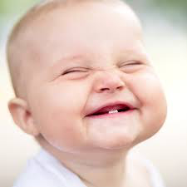
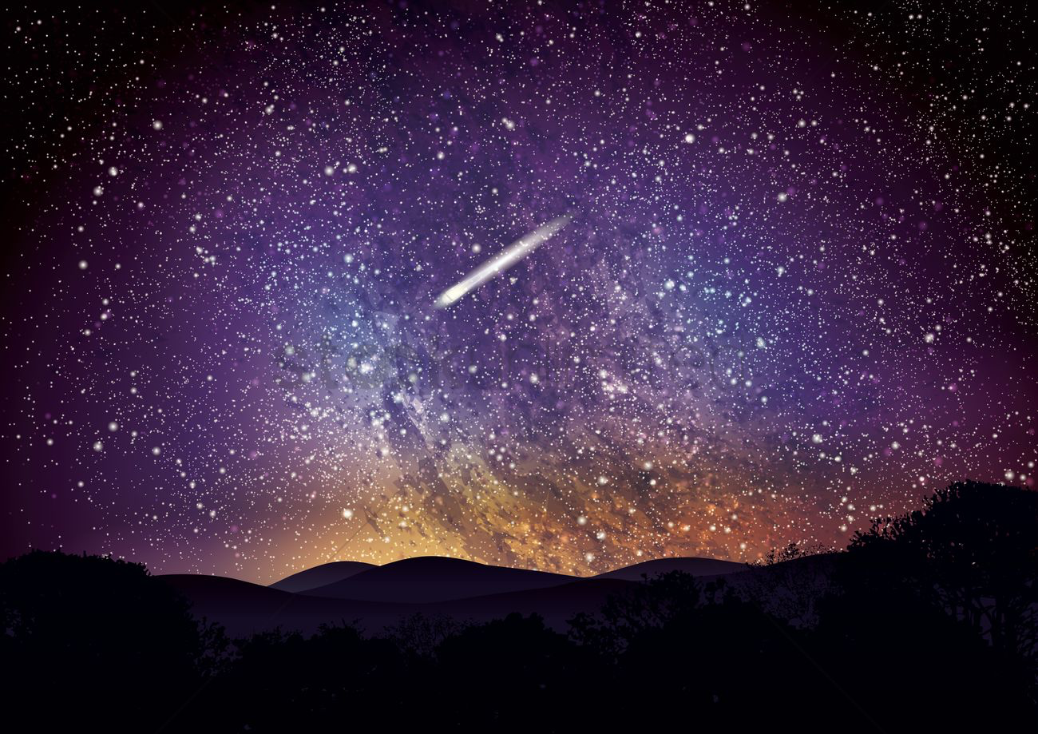
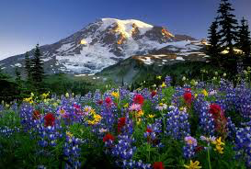
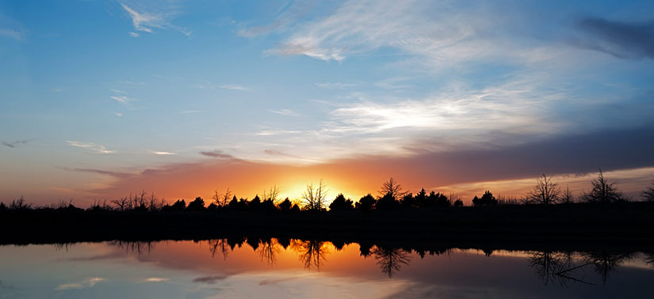
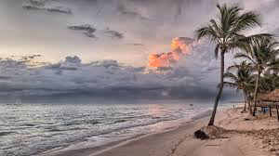

Slide 9
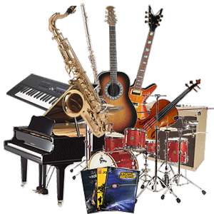
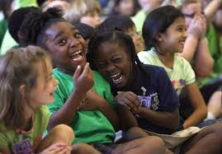
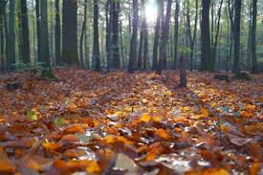
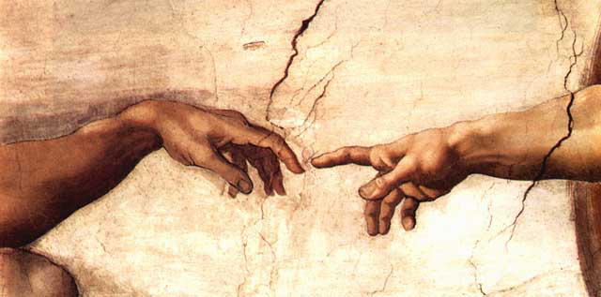
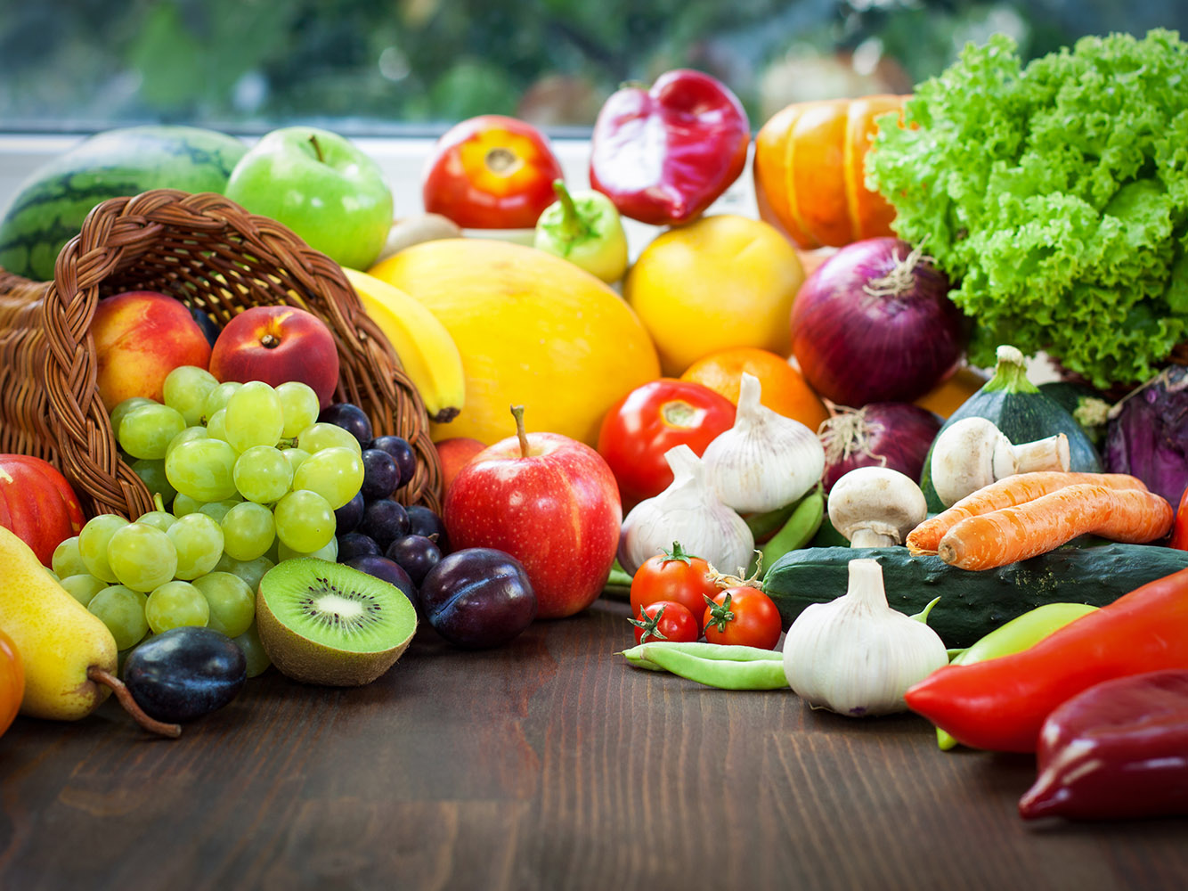

Slide 10
Exodus 3:14

Slide 12
Galatians 2:20
I have been crucified with Christ and I no longer live, but Christ lives in me. The life I now live in the body, I live by faith in the Son of God, who loved me and gave himself for me.

Slide 13
Ephesians 2:3-5
All of us also lived among them at one time, gratifying the cravings of our flesh and following its desires and thoughts. Like the rest, we were by nature deserving of wrath. ⁴ But because of his great love for us, God, who is rich in mercy, ⁵ made us alive with Christ even when we were dead in transgressions—it is by grace you have been saved.

Slide 14
John 3:16

Slide 15
Romans 8:37-39
No, in all these things we are more than conquerors through him who loved us. ³⁸ For I am convinced that neither death nor life, neither angels nor demons, neither the present nor the future, nor any powers, ³⁹ neither height nor depth, nor anything else in all creation, will be able to separate us from the love of God that is in Christ Jesus our Lord.

Slide 16
Luke 11:42
“Woe to you Pharisees, because you give God a tenth of your mint, rue and all other kinds of garden herbs, but you neglect justice and the love of God. You should have practiced the latter without leaving the former undone.

Slide 17
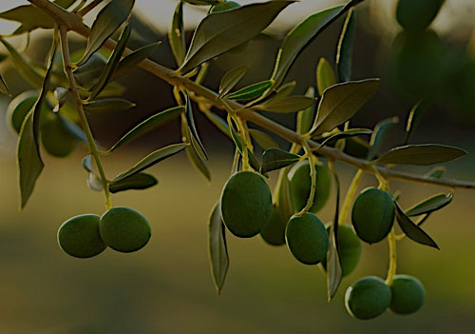
Psalm 52:7-9
“Here now is the man who did not make God his stronghold but trusted in his great wealth and grew strong by destroying others!” But I am like an olive tree flourishing in the house of God; I trust in God’s unfailing love for ever and ever. ⁹ For what you have done I will always praise you in the presence of your faithful people. And I will hope in your name, for your name is good.

Slide 18
Psalm 136:23-26
He remembered us in our low estate
His love endures forever.
²⁴ He freed us from our enemies.
His love endures forever. ²⁵ He gives food to every creature.
His love endures forever.
²⁶ Give thanks to the God of heaven.
His love endures forever.
Endures forever

Slide 19
Matthew 22:37-39
Jesus replied: “‘Love the Lord your God with all your heart and with all your soul and with all your mind.’ ³⁸ This is the first and greatest commandment.³⁹ And the second is like it: ‘Love your neighbor as yourself.’

Slide 20
Ephesians 3:17-20
so that Christ may dwell in your hearts through faith. And I pray that you, being rooted and established in love, ¹⁸ may have power, together with all the Lord’s holy people, to grasp how wide and long and high and deep is the love of Christ, ¹⁹ and to know this love that surpasses knowledge—that you may be filled to the measure of all the fullness of God.²⁰ Now to him who is able to do immeasurably more than all we ask or imagine, according to his power that is at work within us, ²¹ to him be glory in the church and in Christ Jesus throughout all generations, for ever and ever! Amen.

