Slide 2
“FROM THUNDER TO LOVE”

Slide 3
Hebrews 4:12 For the word of God is alive and active. Sharper than any double-edged sword, it penetrates even to dividing soul and spirit, joints and marrow; it judges the thoughts and attitudes of the heart.

Slide 4
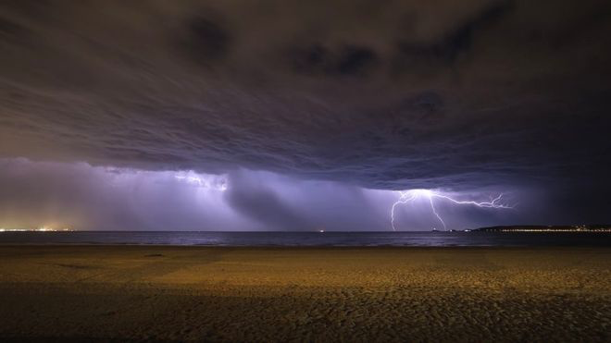
Mark 3:17 James son of Zebedee and his brother John (to them he gave the name Boanerges, which means “sons of thunder”
John 6:14-15

Slide 5
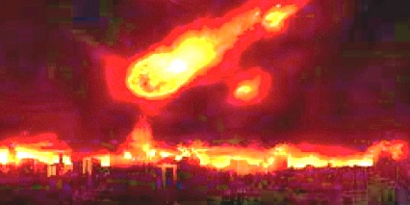
Luke 9:54 When the disciples James and John saw this, they asked, “Lord, do you want us to call fire down from heaven to destroy them?”

Slide 6
Mark 9:38 “Teacher,” said John, “we saw someone driving out demons in your name and we told him to stop, because he was not one of us.”

Slide 7
Mark 10:35-37 Then James and John, the sons of Zebedee, came to him. “Teacher,” they said, “we want you to do for us whatever we ask.” ³⁶ “What do you want me to do for you?” he asked.³⁷ They replied, “Let one of us sit at your right and the other at your left in your glory.”

Slide 8
1 John 1:5-10 This is the message we have heard from him and declare to you: God is light; in him there is no darkness at all. ⁶ If we claim to have fellowship with him and yet walk in the darkness, we lie and do not live out the truth. ⁷ But if we walk in the light, as he is in the light, we have fellowship with one another, and the blood of Jesus, his Son, purifies us from all sin. If we claim to be without sin, we deceive ourselves and the truth is not in us. ⁹ If we confess our sins, he is faithful and just and will forgive us our sins and purify us from all unrighteousness. ¹⁰ If we claim we have not sinned, we make him out to be a liar and his word is not in us.

Slide 9
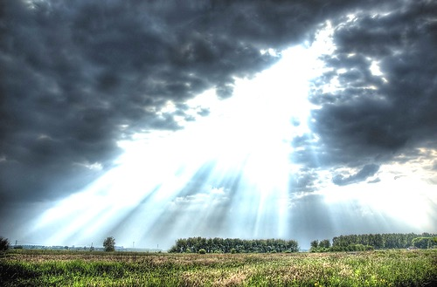
John 3:19-21 This is the verdict: Light has come into the world, but people loved darkness instead of light because their deeds were evil. ²⁰ Everyone who does evil hates the light, and will not come into the light for fear that their deeds will be exposed. ²¹ But whoever lives by the truth comes into the light, so that it may be seen plainly that what they have done has been done in the sight of God.

Slide 10
Luke 11:4 Forgive us our sins, for we also forgive everyone who sins against us. And lead us not into temptation.’”
Exodus 3:14

Slide 11
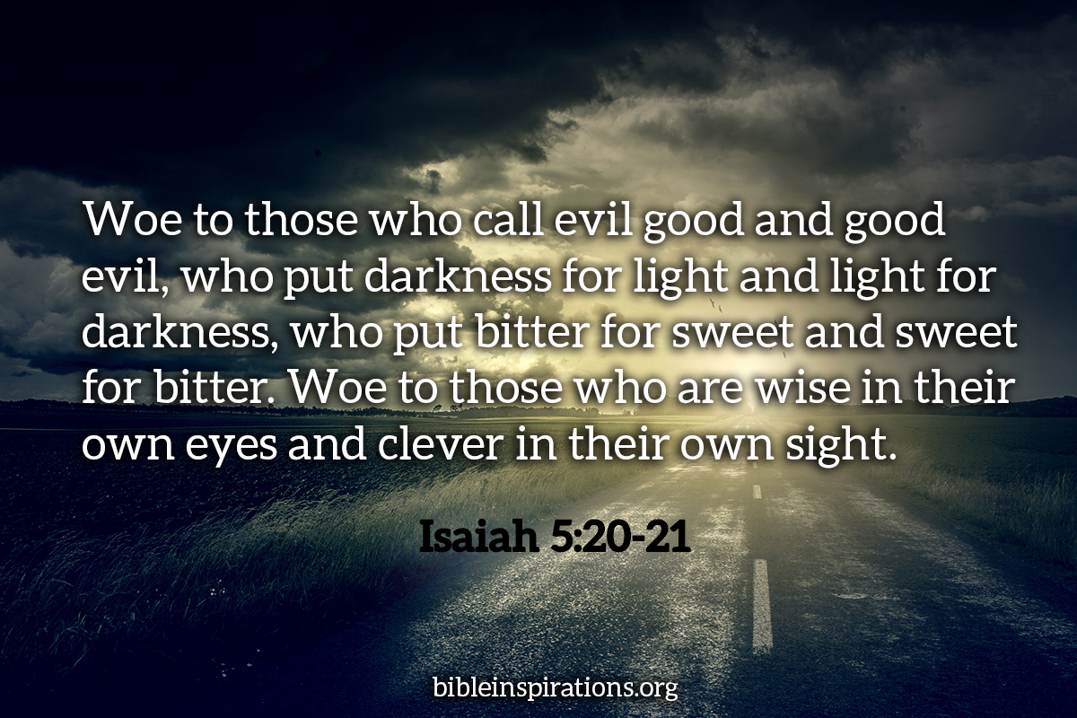
.

Slide 12
1John 2:1-2
My dear children, I write this to you so that you will not sin. But if anybody does sin, we have an advocate with the Father—Jesus Christ, the Righteous One. ² He is the atoning sacrifice for our sins, and not only for ours but also for the sins of the whole world.

Slide 13
1John 2:3-6 We know that we have come to know him if we keep his commands. ⁴ Whoever says, “I know him,” but does not do what he commands is a liar, and the truth is not in that person. ⁵ But if anyone obeys his word, love for God is truly made complete in them. This is how we know we are in him: ⁶ Whoever claims to live in him must live as Jesus did..

Slide 14
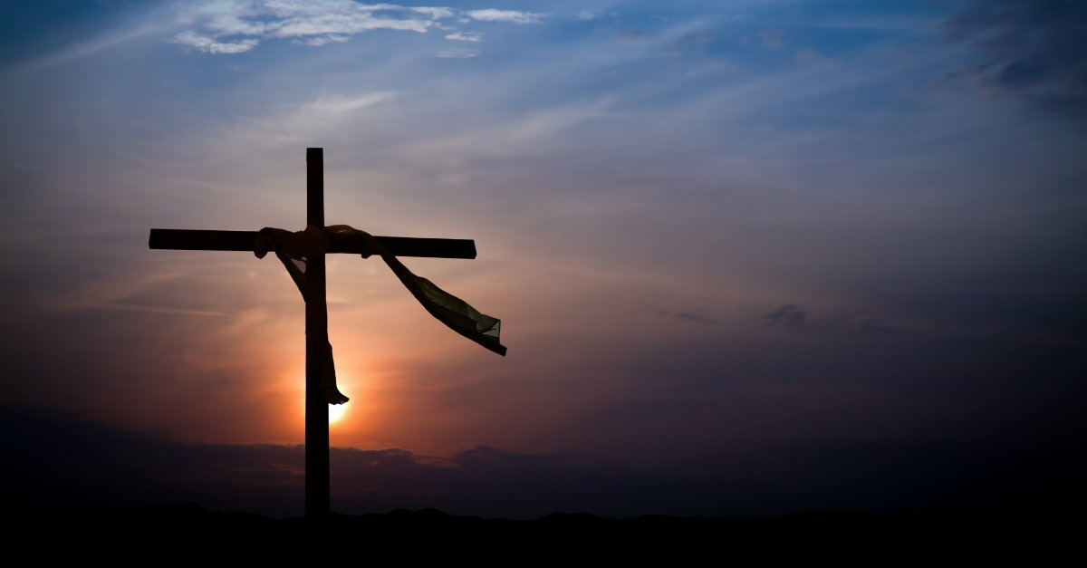
1 John 4:10
This is love: not that we loved God, but that he loved us and sent his Son as an atoning sacrifice for our sins.

Slide 15
1 John 3:16-18 This is how we know what love is: Jesus Christ laid down his life for us. And we ought to lay down our lives for our brothers and sisters. ¹⁷ If anyone has material possessions and sees a brother or sister in need but has no pity on them, how can the love of God be in that person? ¹⁸ Dear children, let us not love with words or speech but with actions and in truth.

Slide 16
2 Peter 2:20-21 If they have escaped the corruption of the world by knowing our Lord and Savior Jesus Christ and are again entangled in it and are overcome, they are worse off at the end than they were at the beginning. ²¹ It would have been better for them not to have known the way of righteousness, than to have known it and then to turn their backs on the sacred command that was passed on to them.
1 John 4:12 No one has ever seen God; but if we love one another, God lives in us and his love is made complete in us.

Slide 17
John 17:21 that all of them may be one, Father, just as you are in me and I am in you. May they also be in us so that the world may believe that you have sent me.

