Slide 2
“Forgetting,
To Focus”

Slide 3
Hebrews 4:12
For the word of God is alive and active. Sharper than any double-edged sword, it penetrates even to dividing soul and spirit, joints and marrow; it judges the thoughts and attitudes of the heart.
Hebrews 4:12 For the word of God is alive and active. Sharper than any double-edged sword, it penetrates even to dividing soul and spirit, joints and marrow; it judges the thoughts and attitudes of the heart.

Slide 4
Philippians 3:7-9 But whatever were gains to me I now consider loss for the sake of Christ. ⁸ What is more, I consider everything a loss because of the surpassing worth of knowing Christ Jesus my Lord, for whose sake I have lost all things. I consider them garbage, that I may gain Christ ⁹ and be found in him, not having a righteousness of my own that comes from the law, but that which is through faith in Christ—the righteousness that comes from God on the basis of faith.

Slide 5
Philippians 3:12-14
Not that I have already obtained all this, or have already arrived at my goal, but I press on to take hold of that for which Christ Jesus took hold of me. ¹³ Brothers and sisters, I do not consider myself yet to have taken hold of it. But one thing I do: Forgetting what is behind and straining toward what is ahead, ¹⁴ I press on toward the goal to win the prize for which God has called me heavenward in Christ Jesus.
John 6:14-15

Slide 6
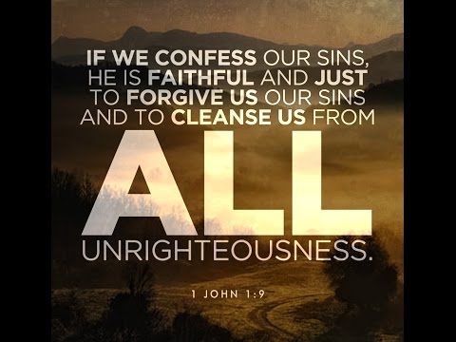

Slide 8
Proverbs 28:13
Whoever conceals their sins does not prosper, but the one who confesses and renounces them finds mercy.
Exodus 3:14

Slide 9
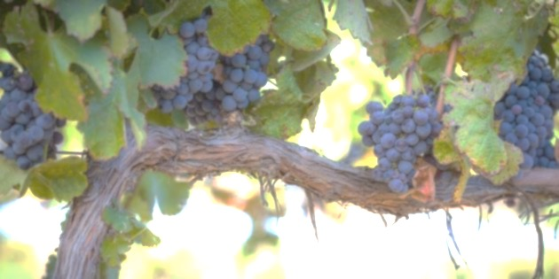
John 15:5
I am the vine; you are the branches. If you remain in me and I in you, you will bear much fruit; apart from me you can do nothing.

Slide 11
Philippians 3:10-11
¹⁰ I want to know Christ—yes, to know the power of his resurrection and participation in his sufferings, becoming like him in his death,
¹¹ and so, somehow, attaining to the resurrection from the dead.

Slide 12
1 Corinthians 11:23-26 (NLV) I have given you the teaching I received from the Lord. The night Jesus was handed over to the soldiers, He took bread. ²⁴ When He had given thanks, He broke it and said, “Take this bread and eat it. This is My body which is broken for you. Do this to remember Me.”²⁵ In the same way after supper, He took the cup. He said, “This cup is the New Way of Worship made between God and you by My blood. Whenever you drink it, do it to remember Me.” ²⁶ Every time you eat this bread and drink from this cup you are telling of the Lord’s death until He comes again.

